Slide 1
Presented by: Larry Barabino Jr., NORD CEO April 1, 2025

Slide 2
CEO Updates
The spring season of Movies in the Park, in partnership with Fox Sports, began on Friday, March 7th each Friday through May 16th , a different park across the city will host a family-friendly movie night.
On Saturday, March 8th , NORD and Ochsner hosted the 4th Annual Health and Wellness Family Expo in the Joe Brown Gymnasium. Additionally on this date, NORD hosted Summer Camp Registration events at five locations across the city.
NORD is gearing up for another full summer of programming. More than 1,250 young people have already registered for summer camps, including over 1,000 children and 250 teens. Camp registration will be open through May 9th .
Ryan Edwards, Jr. crowned the 2025 Louisiana State Golden Gloves Champion in the 16/17-year-old division. Ryan is a participant of Spartan Boxing Club, a NORD partner that calls Milne Rec Center home.
Five major facility and maintenance projects are now complete at Cuccia-Burns Park, Burke Park, Norman Playground, Morris F.X. Jeff Stadium, and Joe Brown Park. These improvements enhance spaces for recreation and community activities.
NORD is partnering with OPSO and Lafitte Greenway Partnership to host Easter Celebrations at Joe Brown Park, Morris F.X. Jeff Park, and the Lafitte Greenway on Saturday, March 16th from 11:00 a.m. – 1:00 p.m.
Last night the NORD 14U Allstars defeated South LaFourche Parish 14U with a score of 45 to 29 to win their second consecutive Biddy National Championship. The team went undefeated in tournament play.
Recent media coverage and public discussions have highlighted concerns about facility conditions, many of which were already being addressed through planned improvements. While we welcome collaboration, none of the groups involved reached out to NORD/ the City or the NORD Commission Chair directly. Despite these challenges, we remain committed to our mission and continue to invest in facility upgrades, program expansion, and strategic partnerships to ensure safe, high-quality recreation for all residents.

Slide 3
The Big Green Easy: Action Items Update
Several projects from The Big Green Easy master plan were delayed due to funding constraints. With funding now partially restored, progress is underway on numerous one-year action items. The list of projects in progress or already completed is extensive.
Here are just a few examples of the work that has been done or is currently underway:
Lyons Center – Basketball court improvements/re-finishing
Morris F.X. Jeff Sr. Stadium – Refurbished concession stands, locker rooms and running track replacement
Sanchez Rec Center – Rooftop HVAC unit repair
Milne Concession Building – Interior repairs and renovations
Gert Town Natatorium – Dehumidification equipment repairs
A.L. Davis Playground – Resurfaced tennis and pickleball courts
Looking Ahead We will continue sharing regular updates on The Big Green Easy as more projects move forward, ensuring the community stays informed on progress and future improvements.

Slide 4
March 2025, NORD Commission has the following numbers of organic impressions earned on Facebook social media platforms.
Up 1.8% in Conversation ‘Engagement’
Gained 27.2% more ‘Reach’ since last month (Feb 2025)
Up 1.8% in Followers
Facebook 10.3K Page Reach up 36.1% (the number of unique people who saw any of the posts).
Facebook Posts/Stories 20+(frequently and consistently) with $0.00 AD dollars
* Analytics organic reach impressions with $0.00 AD marketing dollars with fresh creative designs posted as it pertains to cumulative activity on Facebook and Instagram in a 31-day cycle. *

Slide 5
March 2025, NORD Commission has the following numbers of organic impressions earned on Instagram social media platforms.
Down 49.6% in Interaction ‘Engagement’
Lost 41.6% less ‘Visits’ since last month (Feb 2025)
Up 13.9% in Un-Followers
Instagram 32.7K Page Reach up 35% (the number of unique people who saw any of the posts).
Facebook Posts/Stories 20+(frequently and consistently) with $0.00 AD dollars
* Analytics organic reach impressions with $0.00 AD marketing dollars with fresh creative designs posted as it pertains to cumulative activity on Facebook and Instagram in a 31-day cycle.

Slide 6
March 2025, NORD Commission has the following numbers of organic impressions earned through Weekly GovDelivery Newsletter.
Month Total
107,693 Total Recipients for the month of March 2025
Newsletters are sent out every week via GovDelivery website
Weekly audience: 16.7K+ Readers
107,693 recipients received weekly newsletters
Includes all NORD Community, City Leadership, Staff, and Subscribers
* Analytics organic reach impressions with $0.00 AD marketing dollars with fresh creative designs posted as it pertains to cumulative activity on Facebook and Instagram in a 31-day cycle. *

Slide 7
Programming
Athletics Division
Athletics Continued
NORD BIDDY Basketball 2025
NORD’s 14u BIDDY Basketball team will defend their title in the BIDDY National Tournament, March 29 – March 30th in Mandeville, LA. Last year’s 14u team won the National Championship in Kansas City, Missouri.
Upcoming Track and Field Events
Our track and field season began at Harrell Stadium on March 20 with our Pee Wee track program for 4 – 6 year-olds. During this track season we have 743 youth and middle schools participating in this year’s track and field season.
Pee Wee track takes place at Harrell Playground every Thursday at 6:15 PM.
Tune Up Meet 2 Saturday March 29, 9:00 AM at Joe W. Brown
Final Preliminary Meet Saturday April 12, 9:00 AM at Joe W. Brown
Morris F X Jeff North/ South Field and 8oo meter Qualifying Meet Saturday April 26, 9:00 AM at Morris Jeff Stadium
Elton Mimms Running Qualifying Meet Saturday May 3rd , 9:00 AM at JWB
Steven J. George Citywide Track and Field Championship Saturday May 17th , 9:00 AM at JWB
Middle School Sports
Our middle school partnership continues to thrive with 9 schools participating in our track and field program. We will also be hosting our first middle school summer flag football league. The league is set to begin May 31st , and end June 28th.
Little League Baseball
This baseball season, NORD will have 2 age divisions (10u and 12u) participating in Little League. The teams will compete in District 2 and compete against other regional Little League teams for all-star. If they win the state tournament, the 12u all-stars will have the opportunity to play in the Little League World Series on ESPN.

Slide 8
Programming
FitNOLA
Centers Division
Participant Data
FitNOLA's Spring Participation - 3217
FitNOLA's YTD Participation – 3217
Upcoming Events
April Community Partner Resource Tabling: Second Harvest SNAP Attack – Various Recreation Centers every Tuesday and Thursday in April
Summer Season Start – June 2
FitNOLA Healthy Aging (55+) Summer Kickoff – June 2 (Desire/Florida)
Featured Class: Fit NOLA Booster Breaks – Monday through Thursday at 1:00 and 1:15 p.m. at the NORD Main Office & Various City Departments in the Summer
Booster Breaks are designed to interrupt prolonged sitting at the workplace, and are organized, routine work breaks intended to improve physical and psychological health, enhance job satisfaction, and sustain or increase work productivity
Recreation Centers March Highlights
New Programs / Upcoming Events
Easter Extravaganza – April 12th
AARP Classes offered @ Desire Florida on Saturdays
Hunters Field Cultural Programs offered daily
Highlights
New! E-Sports and Maker lab @ Lyons Center
Sing of Hope Pianos donated to NORD located @ Treme, Sanchez and Joe W. Brown
February 2025 Numbers:
Fitness Centers: 383
New Memberships : 36
Free Play Volleyball : 89
Free Play Basketball: 1504
Pickleball: 326
Basketball Fundamentals: 34 ( end of basketball season )
Boxing: 99
Tennis: 196
Ballroom Dancing: 18
E-Sports : 96

Slide 9
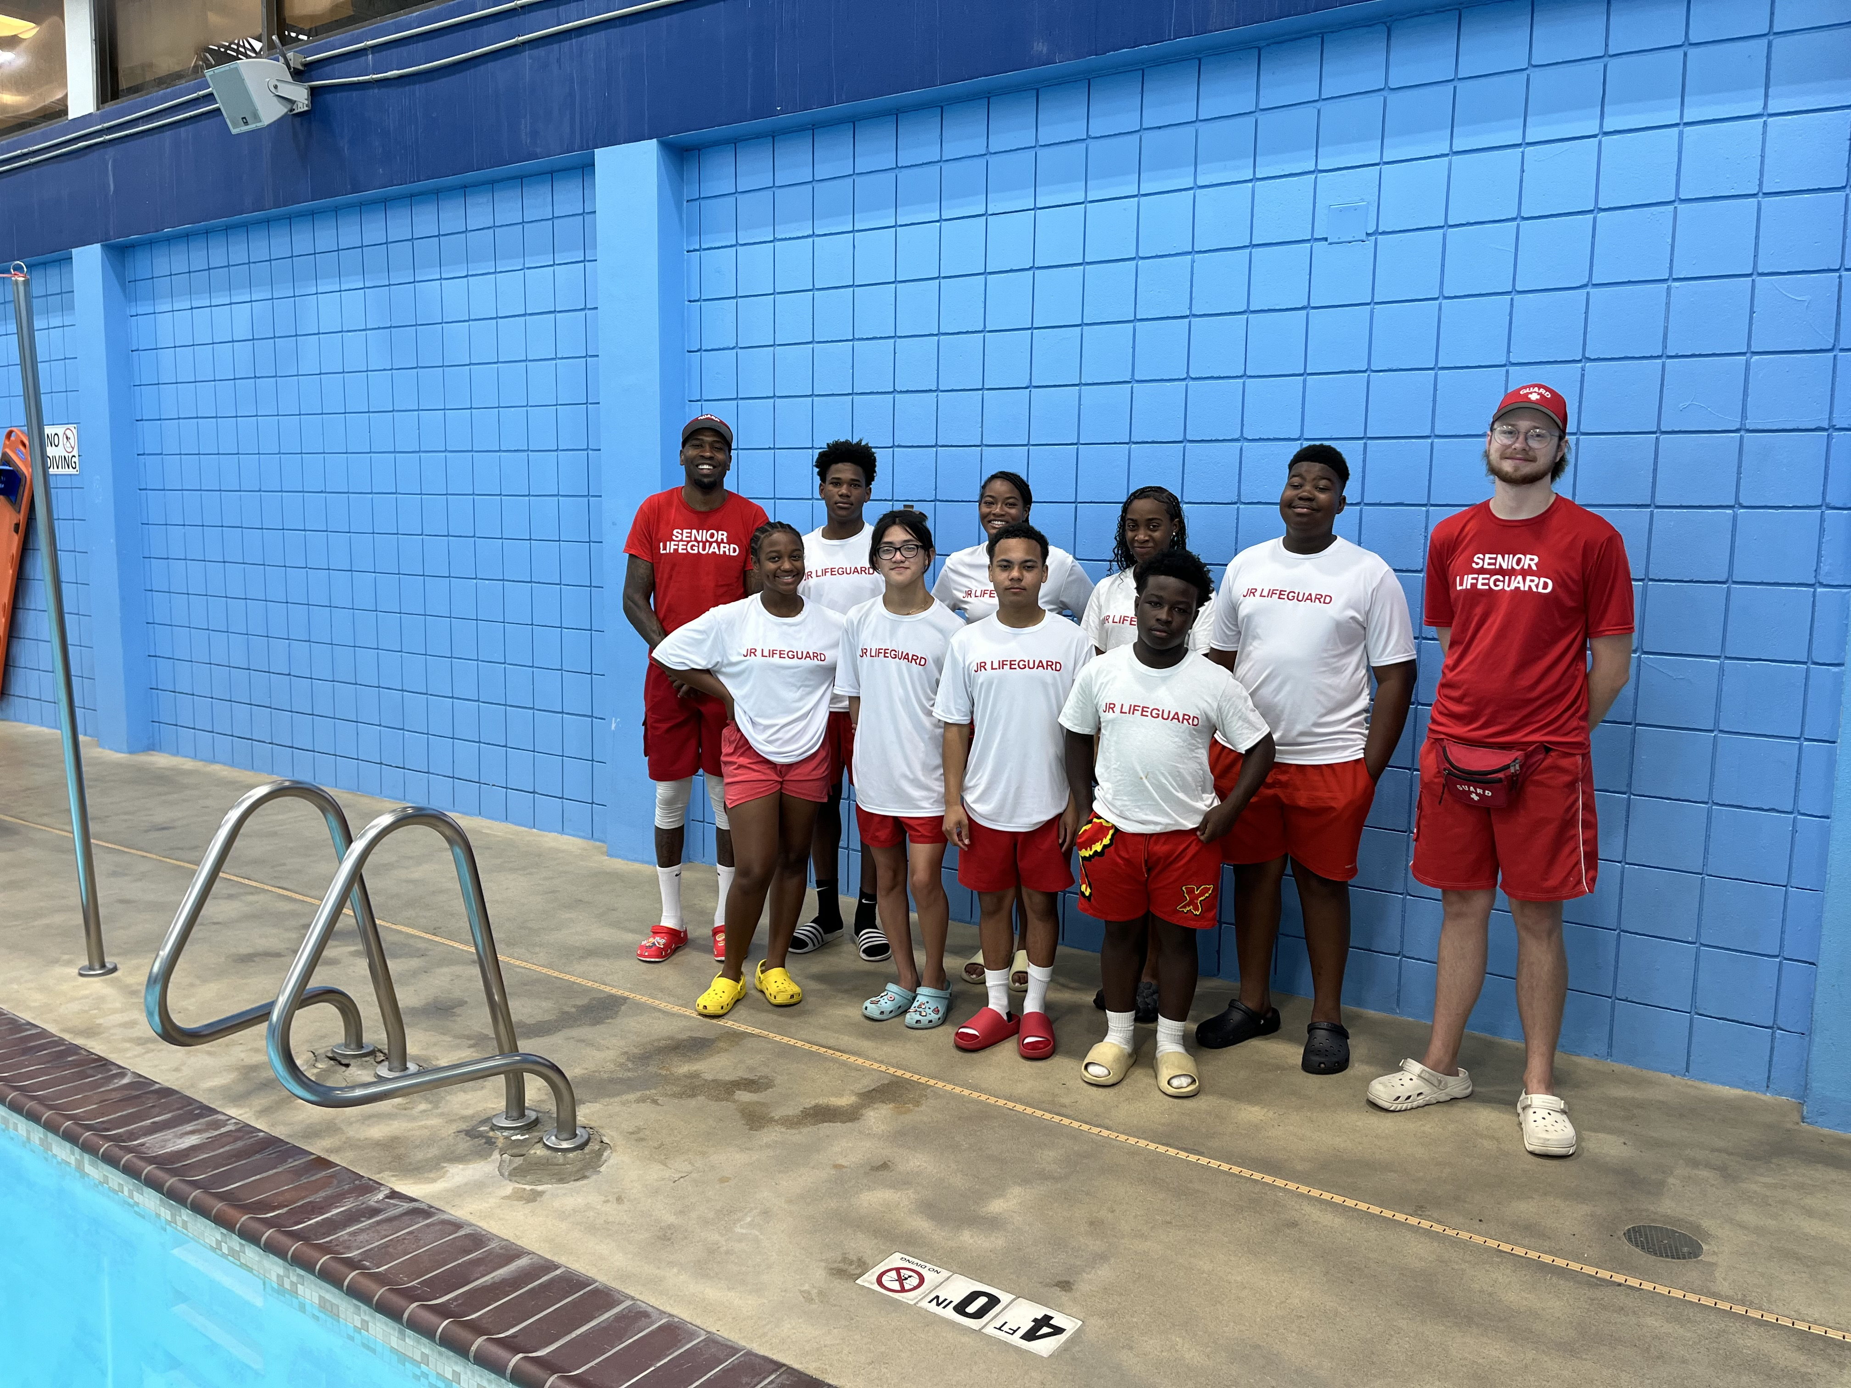
Programming
Aquatics Division
Aquatics March Highlights
Free Summer lifeguard training and recruitment are ongoing Year-round
Summer pool preparation
Currently registering for 2nd session of Spring Swim lessons beginning March 31st through April 4th. Online registration only
Currently recruiting for the NORD Jets
Swim Team practices are held Tuesdays and Thursdays from 4pm to 5:30pm
Swim Team recruits must know how to swim prior to joining
Participation Numbers
Water Aerobics- 630
Lap Swimming- 680
Family Swim- 383
Swim Lessons-338
Swim Team Visits-29

Slide 10
Programming
Multi Programs
Multi Programs cont’d…
Movies in the Park Season began March 7th and will run every Friday through May 16, 2025, provided there is no required scheduled changes.
Summer Camp Expo – Saturday, March 8, 2025
Daddy Daughter Spring Fling – March 14, 2025, at Milne – 79 in attendance
Outdoor Programs – Open canoeing, fishing, and archery – ongoing
Nature Photo Contest – March 7, 2025 – April 25, 2025.
Family Camp Out – March 28, 2025 @ Joe Brown Complex
Youth Camp Registration – over 1,000 applicants
Teen Camp Registration – over 250 applicants
Teen Council Meetings – 2nd Saturday of each month
Outdoors ​ | Cultural ​
Archery 72 Canoeing 46 Volunteers 2 Open Fishing 14 | Senior Choir 55 Youth Piano 76 Adult Piano 31 Senior Piano 46 Youth Guitar 17 Adult Guitar 20 Senior Dance 485 Senior Guitar 21 Youth Painting/ Drawing 5 Youth Dance 309 Adult Art 12 Senior Art 7 ​ Youth Ceramics 6 Adult Ceramics 26 Senior Ceramics 16
Upcoming Events
Summer Camp Registration Dates: March 8th through May 9th happening every Mondays through Thursdays- 10a – 7:30p at Milne Movies in the Park – each Friday, starting at Dusk Family Game Night – Friday, April 11, 2025 @ Treme Rec. Center games will begin at 5pm – 5:00 pm
March Program Participation Numbers
Youth
Kid Café Meal Program - 422 Boys & Girls Club After School Program - 209 Concepts of Education After School Program - 254 Girl Scouts - 4 GLAM U Mentoring Program - 38

Slide 11
Facility/​ Playground​ | Project​ | Completion​ Status (%)​ | Comments​
Joe W. Brown​ | Damaged Sail Shades at Playset​ | 25%​ | Job is routing through Procurement Process.​
Gert Town Natatorium​ | Repairs to Dehumidification Equipment​ | 25%​ | Job is routing through Procurement Process
Cuccia-Burns Park | Fencing Repairs | 100% | Job Complete!
Burke Park | Electrical Connection | 100% | Job Complete!
Turf Alliance – Superbowl Turf NORDC Fields​ | Field improvements to Perry Roehm, Joe Brown Baseball Infield, and Lemann Greenway​ | 65%​ | Job is in Progress.​
Rosenwald Rec Center​ | Roof Repair​ | 25%​ | Job to be Re-Bid.​
Norman Playground | Underground Water Leak in Field | 100% | Job Complete!
Morris FX Stadium | Remove Fallen Oak Tree | 100% | Job Complete!
A. L. Davis Playground​ | Resurface Tennis/Pickleball Courts​ | 10%​ | Job routing through Procurement/Contract process. ​
Facilities and
Maintenance Projects Updates

Slide 12
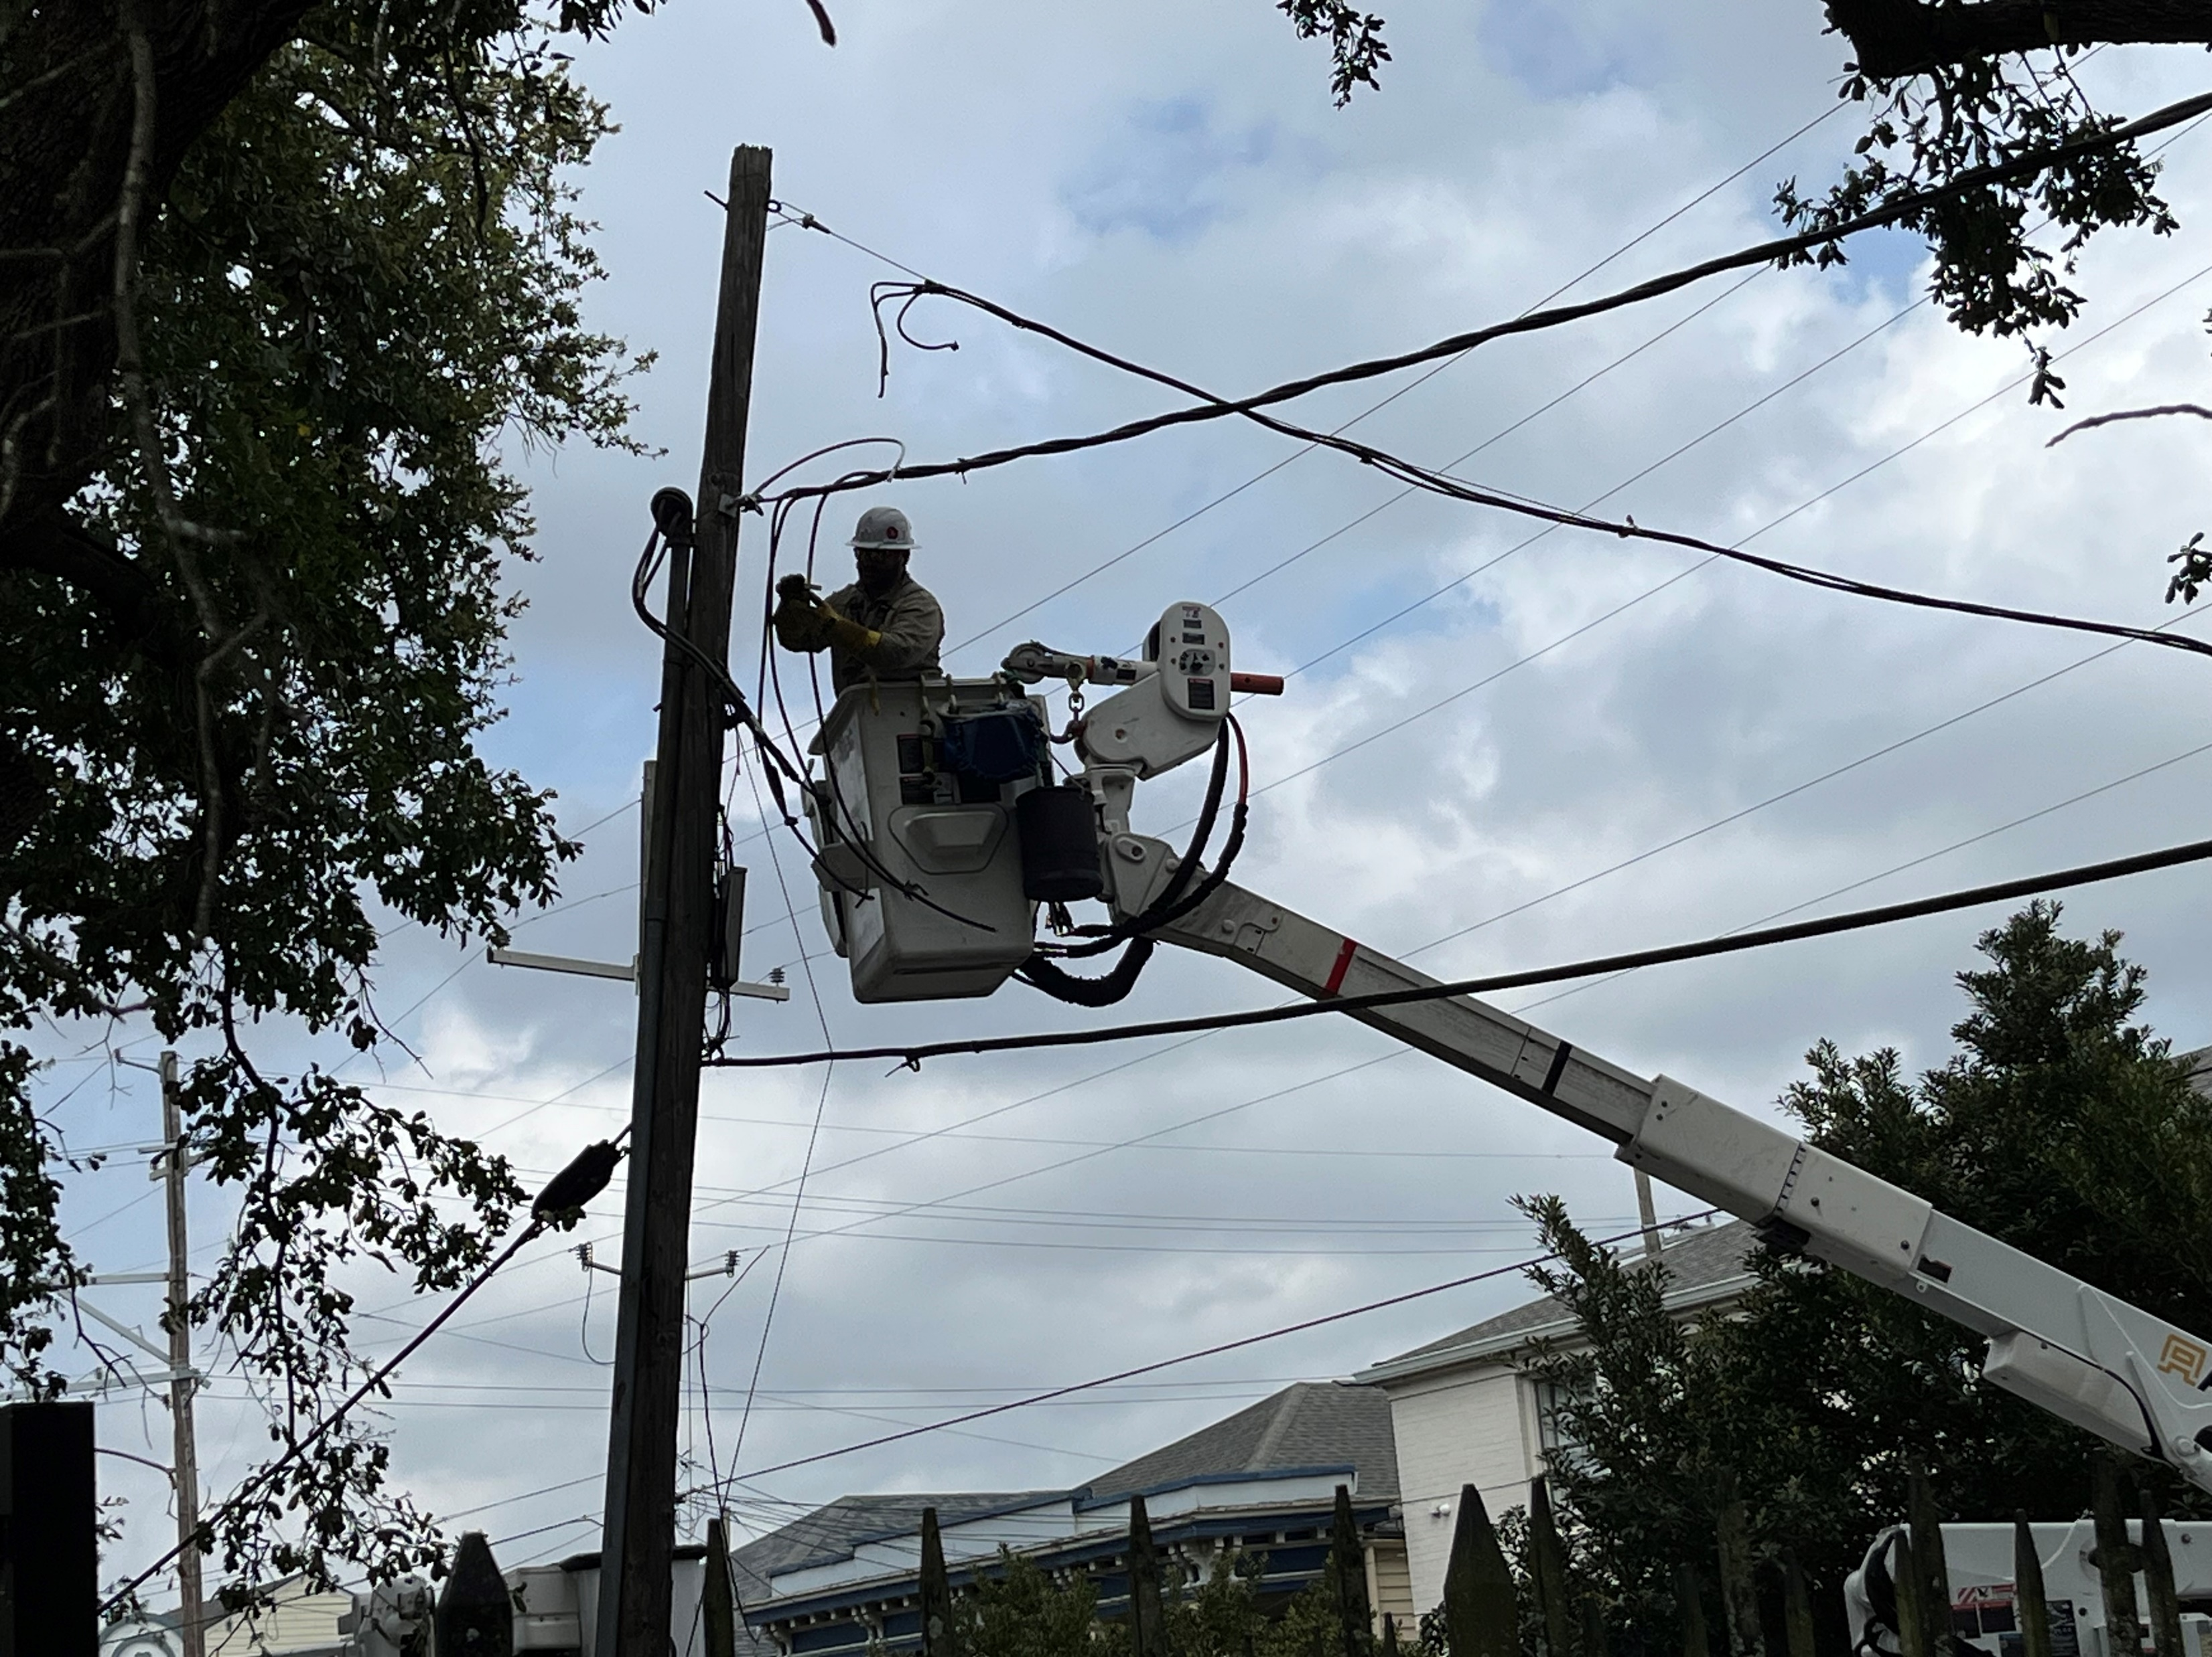
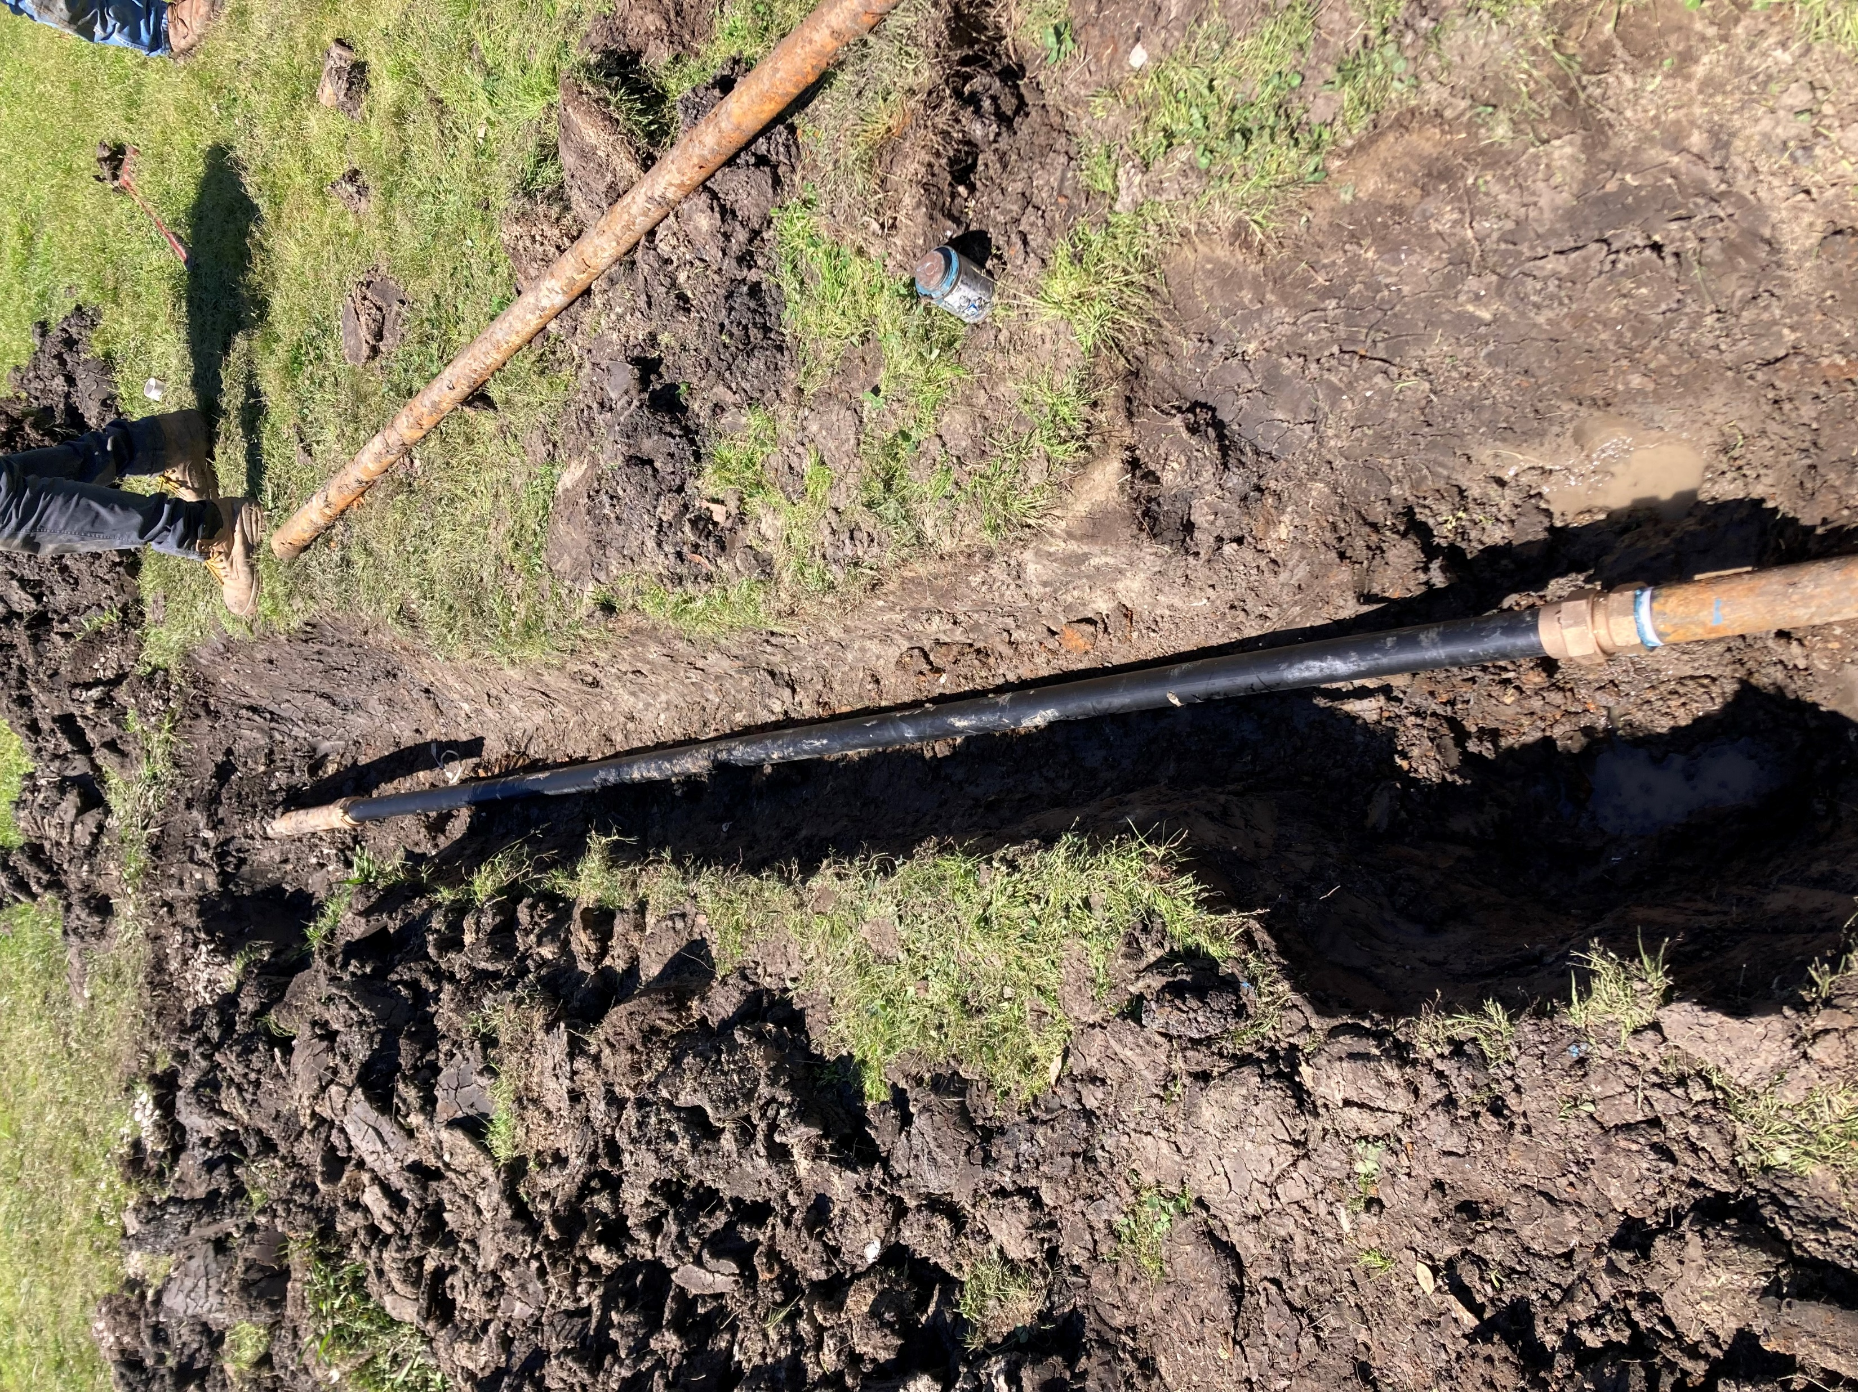
Facility/​ Playground​ | Project​ | Completion​ Status (%)​ | Comments​
Sanchez Rec Center​ | Roof Top HVAC Unit Repair​ | 10%​ | Job is routing through Procurement Process.
Joe Brown Park | Tree Pruning and Removal near Tennis Courts | 100% | Job Complete!
Joe Brown Park | Entry Gate Fence Repair | 50% | Materials on Order.
Facilities and
Maintenance Projects Updates
Norman Underground Water Line and Burke Park Electrical Completion

Slide 13
Budget Summary November 2024

Slide 14
February Financial Facts at a Glance
Administration
Athletic Programing
$1,574,777 – P e r s o n n e l
$214,18 5- Pe r s on ne l
$ 1,8 47,817 - O p e r a t I n g
$3 20, 0 81- O p e r a t i n g
Personnel: Filled vs Vacancies
$ 1,7 9 0,10 3 - P e r s o n ne l
$ 2 9 4,18 0- P er s o n ne l
$ 3 2 5, 8 8 7 - O p e r a t in g
$6 2 ,3 0 4 - O p e r a t in g
Filled: 188.04
Vacancies: 13.39
Multi- Programming
$876,745 – Personnel
$107,491- Personnel
$85,800- Operating
$2,190 - Operating
$ 1,136,787 – CDBG
$26,289
$450,000 – Teen Camp Stipend
$ 0
Balance Allocation
$19,382,748/$3,115,988
Revolving Fund/Self Generating
2025 Through 3/17/2025
$86,215
Maintenance
$3,208,898 – Personnel
$386,175 - Personnel
$1,729,707 - Operating
$744,426 - Operating
Aquatics
$3,596,910 – Personnel
$257,018- Personnel
$95,000 - Operating
$47,699 Operating
Recreation Centers
$3,871,104 - Personnel
$584,368- Personnel
$380,000 - Operating
$69,582
Notes:
Financial Facts at a glace provides another picture of the line item budget slide, it breaks down the agency’s entire appropriation and balances by division along with, CDBG Funding Revolving Revenue Fund, and Teen Camp Stipend allocation.

Slide 15
Funding Allocation
Year End 2023 Self Generating Revenue
Year End 2024 Self Generating Revenue
Revenue Sources: Facility Rentals Tennis Center Revenue Admission & Concession Revenue Summer Camp Athletics Registration Act No. 892 Session 2008 Mardi Gras Parking Misc. Vendor Refunds NORD Merchandise Sales Jazz Fest Parking | $289,955 $35,284 $96,613 $18,337 $4,325 $25,000 $3,560 $2,336 $80 $3,381
Total Revenue Generated * - Unaudited | $478,871*
Revenue Sources Year to Date: Facility Rentals Tennis Center Revenue Admission & Concession Revenue Summer Camp Athletics Registration Act No. 892 Session 2008 Mardi Gras Parking Misc. Vendor Refunds NORD Merchandise Sales Jazz Fest Parking | $46,797 $7,077 $4,471 $0 $500 $25,000 $2,370 $0 $0 $0
Total Revenue Generated * - Unaudited | $86,215*
Notes:
The Agency’s Fund allocation deck provides a comparison of collected revenue from the previous fiscal year versus the current. YTD the agency has collected in revenue (117% of 2023 revenue collected) through facility rentals, tennis court utilization and we also introduced into our revenue stream admission, concession and registration for sports participation.

Slide 16
Questions?

