Slide 1
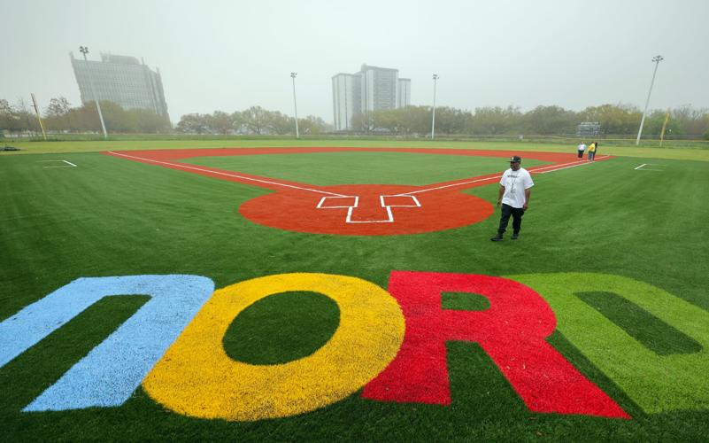

Presented by:
Larry Barabino Jr., NORD CEO
July 1, 2025

Slide 2
CEO Updates
Recent news coverage has highlighted concerns regarding unpaid wages for lifeguards employed by the New Orleans Recreation Development (NORD) Commission. NORD has been working closely with the CAO’s office to assist in working to resolve the issue. Multiple efforts are underway to ensure that all impacted and future NORD employees are paid as quickly as possible. As of Friday, June 27th , 95% of the summer employees that were impacted was paid. The CAO’s HR Team and Finance are working diligently to have the remaining 8 summer employees paid this week. Currently, 50 new lifeguards are being processed by the CAO’s HR Team with 18 cleared to start this week.
Extended Pool Hours Starting June 28
To better serve the community during the summer heat, NORD will extend hours at six of our busiest pools starting Saturday, June 28. Saturday hours will be extended from a 2PM closing to 5 PM, and pools will now also be open on Sundays from 1 PM to 5 PM.
The following pools will have extended hours:
Stallings Gentilly
Lyons Recreation Center Pool
Federal City
George V. Rainey
Sampson
Joe W. Brown Pool
Summer Camps & End-of-Season Events
Teens Campers will receive their first stipend check of $225.00 max on Tuesday & Wednesday, July 1st & 2nd
Our 2025 Summer Youth and Teen Camps will wrap up with special events at City Park’s Carousel Gardens:
Youth and Teen Camps: Final events on Wednesday, July 9 and Thursday, July 10
Teen Camp: Last day is Friday, July 11
Youth Camp: Last day is Friday, July 25
Joe W. Brown Park Bridge Closure
Please be advised that the back entrance bridge at Joe W. Brown Park has been closed by the Department of Transportation and Development (DOTD) due to structural concerns. While there is currently no timeline for repairs, the bridge remains open to pedestrian traffic only.

Slide 3
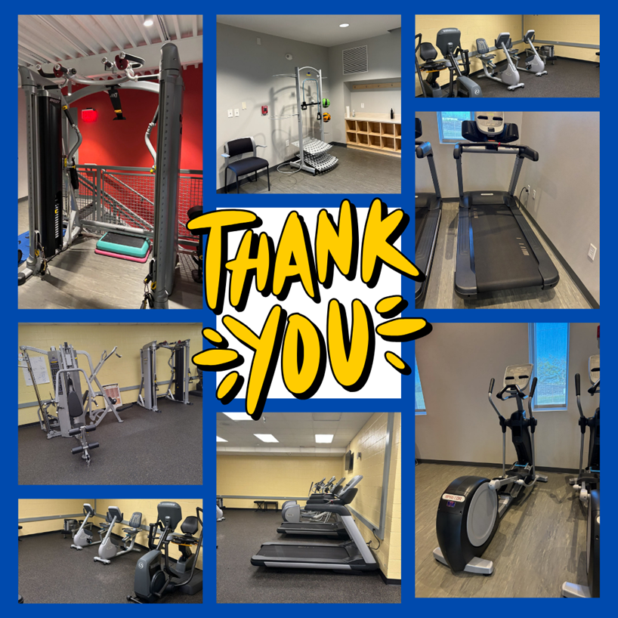
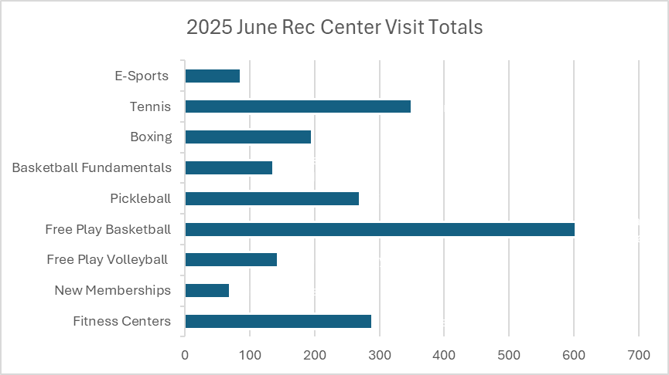

2025 Program Information
Centers Division
Centers Division
We would like to formally thank J.M. Smucker Company, specifically Folgers Coffee here in New Orleans for the donation of fitness equipment. The equipment was delivered to the St. Bernard Center and Rosenwald Rec Center over the last 2 weeks so please stop by!
NORD is working in conjunction with the Mayor's Office of Human Rights & Equity on the Crescent City ID Program which is a part of Mayor LaToya Cantrell's priorities. The Crescent City ID Program is a municipal identification card program to expand access, belonging, and inclusion for all residents, especially those who may lack traditional forms of identification. In addition to serving as a form of identification, the Crescent City ID will also function as a New Orleans Library card and a NORD Rec Trac Card.

Slide 4
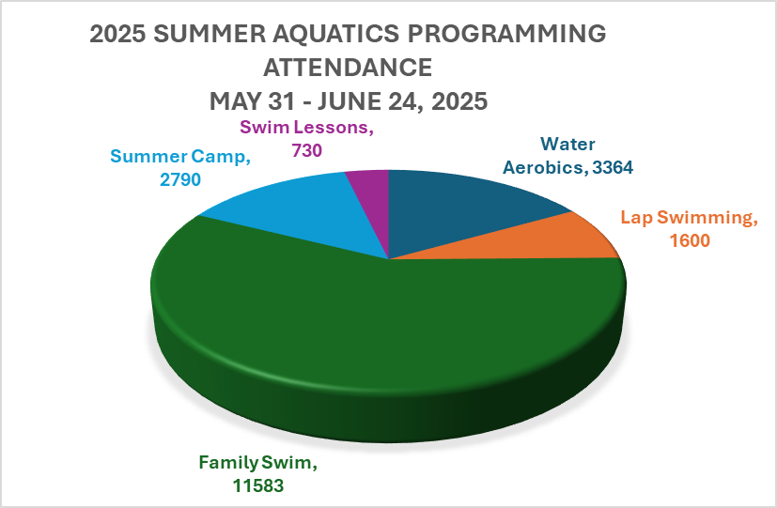

2025 Program Information
Aquatics Division
Aquatics Division
We heard the community, we heard the commissioners, and we are pleased to announce that extended summer pool hours at select locations began Saturday, June 28th and Sunday, June 29th. Our goal is to provide families and residents with greater access to safe, fun, and free opportunities to stay cool and active for the rest of the summer.
So far, since pools opened May 31st, we have had a total of 20,067 patrons to visit the 14 open pools!
Saturday Pool Hours 9:00 AM – 2:00 PM | Saturday Pools with extended Hours 9:00 AM – 5:00 PM | Sunday Pools with extended Hours 1:00 PM – 5:00 PM
Gert Town Natatorium Rosenwald Recreation Center Pool Pradat Pool St. Bernard Recreation Center Pool Sanchez Multi-Purpose Center Pool Stallings St. Claude Recreation Center Pool Treme Recreation Community Center Pool Whitney Young Pool | Stallings Gentilly Lyons Recreation Center Pool Federal City George V. Rainey Sampson Joe W. Brown Pool | Stallings Gentilly Lyons Recreation Center Pool Federal City George V. Rainey Sampson Joe W. Brown Pool

Slide 5
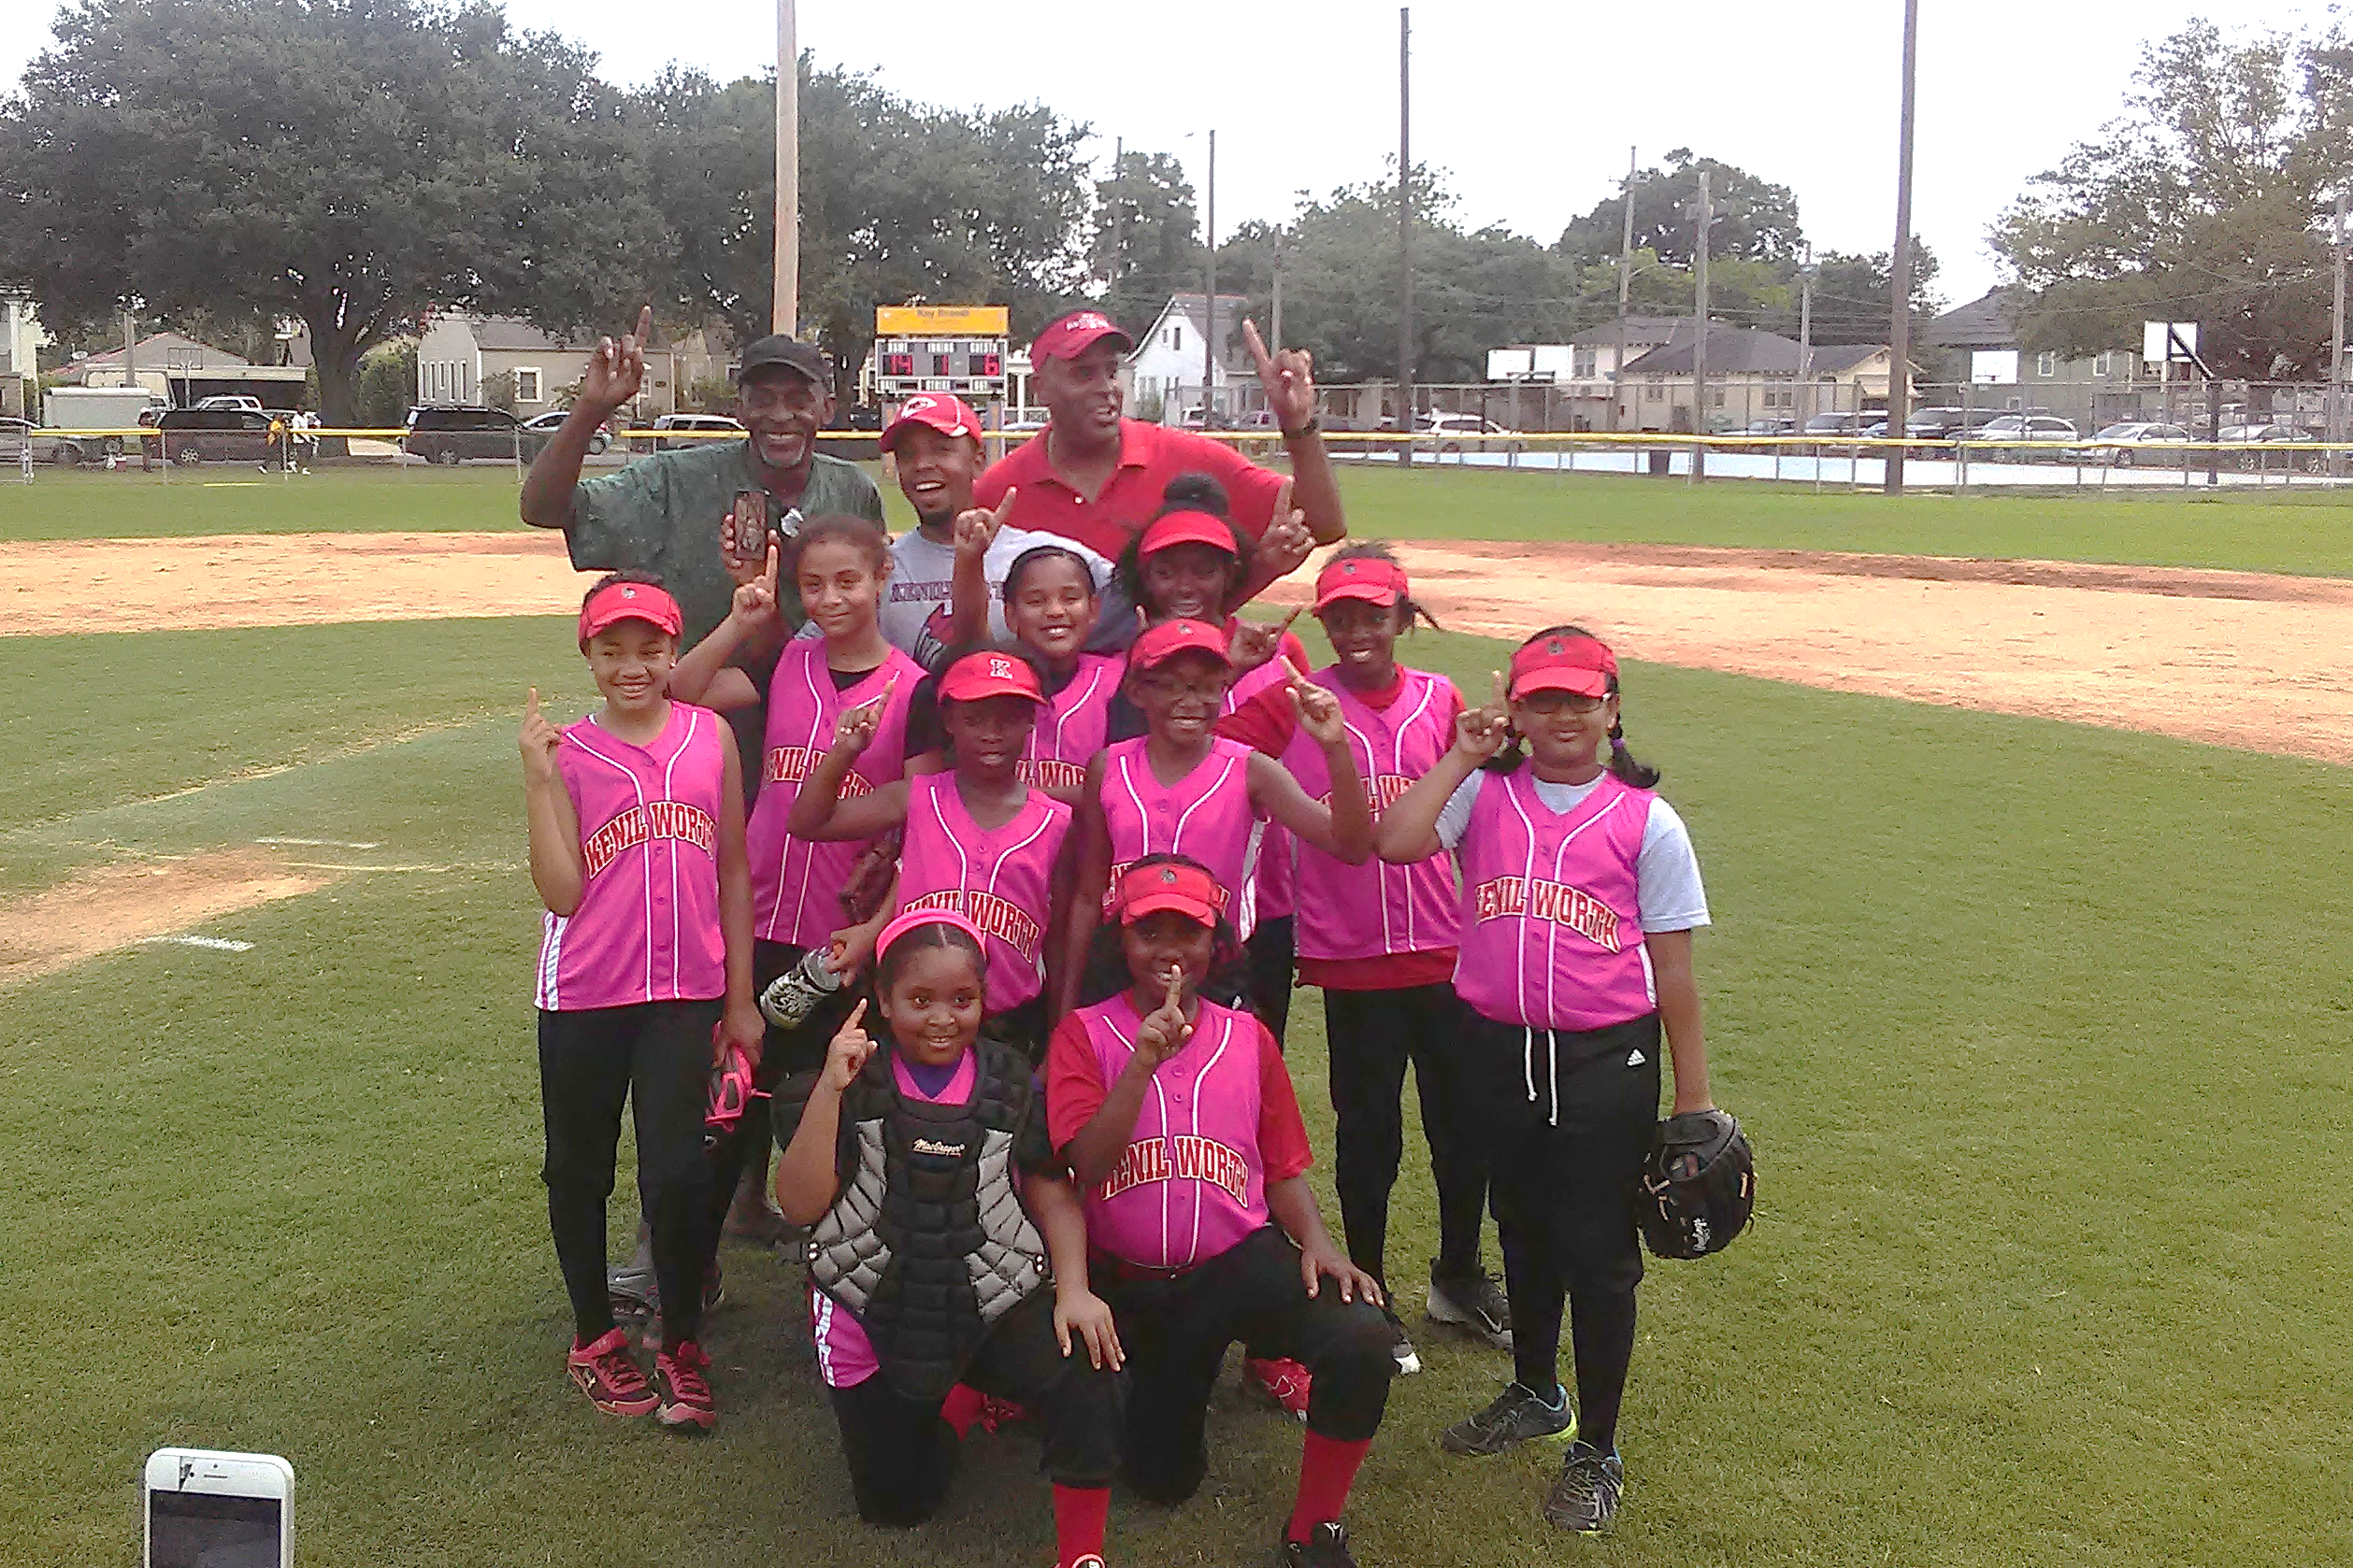
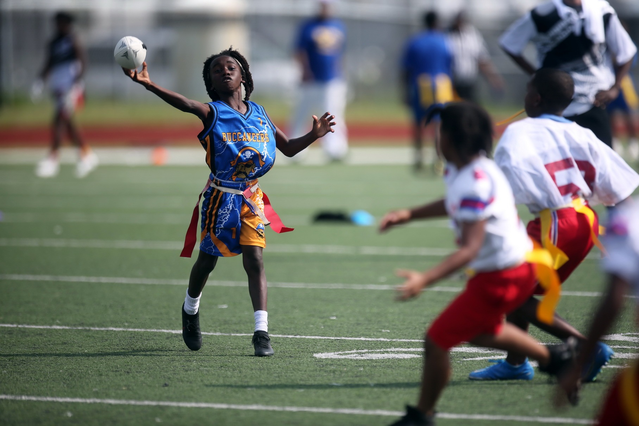
2025 Program Information
Athletics Division
Athletics Division
This summer, NORD registered 723 youth ages 5 – 14 for baseball and softball. The championship games will be played on July 12th at Joe W. Brown Baseball Field and Skelly Rupp. Regional tournament play for NORD Little League teams begins on July 11th.
Registration continues for NORD’s flag football league, which currently has just over 340 registrants. Tournament play will run July 19 through August 23rd and games will be played on the Lafitte Greenway and Joe W. Brown Victory Stadium.
Efforts are underway to bring booster clubs back into compliance before the 2025 football season. We met with representatives from Harrell, Morris F. X. Jeff, Evans, Lemann, Goretti, and Village de’ lest last week and will reach out to host another community meeting in July. Booster clubs in compliance will be able to sell concessions at their parks and fundraise in other ways to help support the programming – not just football teams – at parks and playgrounds throughout the city.

Slide 6
2025 Program Information
Multi Programs Division
Multi Programs Division
NORD is having a successful summer thus far!
Over 1600 youth registered for youth camps ages 5-12, that started on June 2nd and will end on July 25th.
There were over 540 teens ages 13 – 15 to register for teen career camp, which runs 6 weeks and is scheduled to end on Friday, July 11th. The teens earn a stipend of $450 for attending the 6-week camp and will be paid in 2 installments - June 30th and the end of July.
Additionally, there are 300 teen participants in the summer sports challenge ages 13 – 17. This program gives teens something productive to do in the evenings during the summer and still earn money. Teens were able to select from 7 on 7 flag football, basketball, volleyball, E-sports, Podcast and Jr. Lifeguarding. The teens will earn a $450 stipend paid in one full check 3-4 weeks after the program’s conclusion on July 11th.
This summer, we will be taking 30 active teen council members from our program on a college tour from July 14th to 18th. We plan to visit Tuskegee University, Georgia State University, Spelman and Morehouse Universities, Morris Brown College, and Talladega University. This trip is funded by the Wisner Foundation and aims to expose the teens to cultural diversity, inspiring them to put in greater effort now to gain admission to these college campuses.
Our Multi-Programs team accomplishes so much by working with community partners. Summer camps, afterschool programs and cultural programs are run by partnering organizations operating in NORD facilities. Right now, we have two application processes open to the public for partnership opportunities:
The application for the after-school programmatic partnership is currently open for organizations that operate after-school or Saturday programs within the New Orleans community. Interested parties can submit their applications online, with a deadline set for July 15th. This timeline will facilitate registration in August, enabling programming to commence shortly after Labor Day.
The Movie in the Park application process for community partners that would like to host a Friday night movie at a park or playground in their neighborhood this fall. The deadline for the Movie in the Park application is Friday, July 25th.

Slide 7
Facility/​ Playground​ | Project​ | Completion​ Status (%)​ | Comments​
Joe W. Brown​ | Replace damaged Sail Shades at Playset​ | 50%​ | Job is in Progress!
St Bernard Rec Center | Roof Repair | 25% | PO Received!
Hardin Playground | HML Repair | 50% | Job is in Progress
Atkinson-Stern Tennis Center | Elevator Repair | 75% | Job is in Progress
St Bernard Rec Center | Replace Chiller Coil | 100% | Job Complete!
Morris FX Stadium | Fence Repair | 50% | Job is in Progress!
Morris FX Jeff Sr. Stadium | New Concrete Walkway | 100% | Job Complete!
Skelly-Rupp Stadium | Parking Entry Gates | 30% | In Progress!
A. L. Davis Playground​ | Resurface Tennis/Pickleball Courts​ | 50%​ | Contract Received!
Pontchartrain Clubhouse | Replace Stepdown Transformer | 10% | Purchase Order received 6/27/25; Installation expected Tuesday, July 1, 2025
Facilities and
Maintenance Project Completion Status by Facility

Slide 8
Facility /​ Playground​ | Project​ | Completion​ Status (%)​ | Comments​
A.L. Davis Pool | ​Repair A.L. Davis Pool | ​10% | Being processed as ITB through Purchasing Bid opening date 7/11/2025. NORD Maintenance staff continue working through options to open pool.
Harrell Pool | Plumbing Repairs. | 60% | Contractor is in the process of repairing backflow preventer to complete water supply portion of repair. Ordering new Plumbing Fixtures and Pump. NORD's plumber will install.
Lemann Pool | Plumbing Repairs. | 80% | Water has been restored. NORD staff is working on replacing damaged and stolen fixtures as well as new pool pump.
​St Bernard Rec Center | Replace Gym Lights | 25% | PO Received!
Lafitte Greenway Field | Adding New Bleachers | 100% | PO Received!
Morris FX Stadium | Repair Underground Water Main | 25% | PO Received!
Facilities and
Maintenance Project Completion Status by Facility

Slide 9
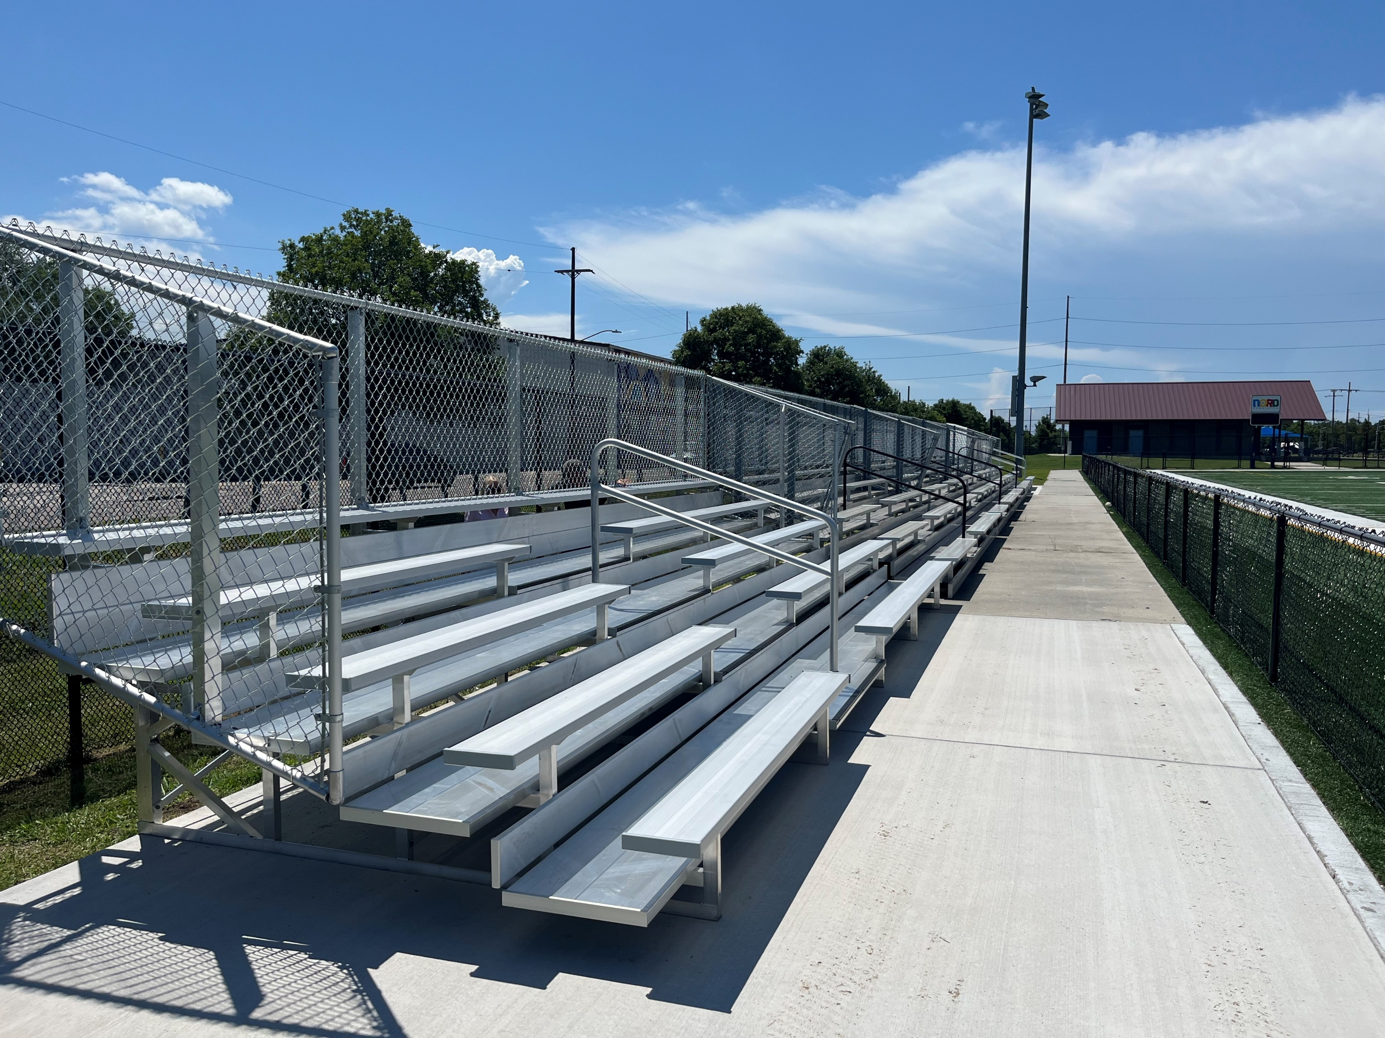
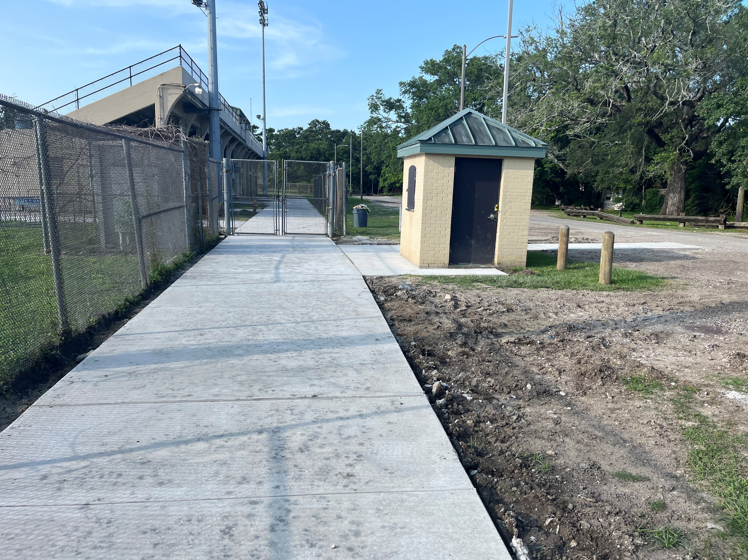
Facilities and
Maintenance Project Completion Status by Facility
Lafitte Greenway Stadium Bleachers Addition
Morris FX Jeff, Sr Stadium Concrete Walkways

Slide 10
NORD Budget Summary May 2025

Slide 11







May Financial Facts at a Glance
Administration
Athletic Programing
$1,574,777 – P e r s o n n e l
$ 6 4 7,510 - Pe r s on ne l
$ 1,8 47,817 - O p e r a t I n g
$ 1,12 6,113 - O p e r a t i n g
Personnel: Filled vs Vacancies
$ 1,7 9 0,10 3 - P e r s o n ne l
$ 8 7 4,101- P er s o n ne l
$ 3 2 5, 8 8 7 - O p e r a t in g
$ 2 2 5-, 3 5 6 - O p e r a t in g
Filled: 208.53
Vacancies: 29.33
Multi- Programming
$876,745 – Personnel
$285,570 - Personnel
$85,800- Operating
$16,997- Operating
$ 1,136,787 – CDBG
$436,686
$450,000 – Teen Camp Stipend
$ 23,365
Balance Allocation
$19,382,748/$9,020,685
Revolving Fund/Self Generating
2025 Through 6/23/2025
$176,994
Maintenance
$3,208,898 – Personnel
$1,087,406- Personnel
$1,729,707 - Operating
$1,553,624 - Operating
Aquatics
$3,596,910 – Personnel
$798,080- Personnel
$95,000 - Operating
$79,346 Operating
Recreation Centers
$3,871,104 - Personnel
$1,630,801- Personnel
$380,000 - Operating
$235,729
Notes:
Financial Facts at a glace provides another picture of the line item budget slide, it breaks down the agency’s entire appropriation and balances by division along with, CDBG Funding Revolving Revenue Fund, and Teen Camp Stipend allocation.

Slide 12
Funding Allocation
2024 Self Generating Revenue
2025 Self Generating Revenue
Revenue Sources: Facility Rentals Tennis Center Revenue Admission & Concession Revenue Summer Camp Athletics Registration Act No. 892 Session 2008 Mardi Gras Parking Misc. Vendor Refunds NORD Merchandise Sales Jazz Fest Parking | $289,955 $35,284 $96,613 $18,337 $4,325 $25,000 $3,560 $2,336 $80 $3,381
Total Revenue Generated * - Unaudited | $478,871*
Revenue Sources Year to Date: Facility Rentals Tennis Center Revenue Admission & Concession Revenue Summer Camp Athletics Registration Act No. 892 Session 2008 Mardi Gras Parking Misc. Vendor Refunds NORD Merchandise Sales Jazz Fest Loading – Stallings Gentilly | $104,731 $14,695 $9,832 $16,320 $635 $25,000 $2,370 $0 $30 $3,381
Total Revenue Generated * - Unaudited | $176,994*
Notes:
The Agency’s Fund allocation deck provides a comparison of collected revenue from the previous fiscal year versus the current. YTD the agency has collected in revenue (37% of 2024 revenue collected) through facility rentals, tennis court utilization and we also introduced into our revenue stream admission, concession and registration for sports participation.

Slide 13

Questions?

