Slide 1

Who We Are and What We Do: Programs, Impacts and Progress
Presented by: Larry Barabino, Jr.
Tuesday, February 3, 2026

Slide 2
Mission
To advance the physical, mental, and social well-being of New Orleanians by providing safe and welcoming environments for recreational, athletic, and cultural experiences.
Vision
A sustainable and innovative organization that transforms lives

Slide 3
CEO Updates
Scope, Scale, & Reach: NORD operates and maintains up to 160 parks, playgrounds, athletic fields, pools, recreation centers and facilities citywide.
Programs for All Ages: NORD offers free and low-cost programs for all ages, including youth sports, aquatics, wellness, cultural programming, teen enrichment, and senior activities that support physical health, social connection, and community well-being.
Emergency Role: Recreation centers serve critical roles during emergencies, extreme heat, and severe weather.
2026 Budget Environment: Recent budget reductions are impacting program operations, staffing capacity, and service levels, requiring thoughtful prioritization to maintain core offerings.
Facilities & Infrastructure: Aging infrastructure and deferred maintenance at some facilities, fields, and pools continue to require focused attention to support safe and reliable operations.
Workforce Capacity: NORD’s workforce of 230+ full- and part-time employees supports programs, facilities, and operations citywide. Staffing gaps in key roles have increased workload demands and required departments to adjust service levels, scheduling, and operational coverage in some areas.
Ongoing Commitment: NORD remains committed to providing safe, accessible, and inclusive recreational opportunities for New Orleanians of all ages while planning strategically for long-term sustainability.

Slide 4
Programming Division
Centers
Aquatics
Multi Programs
  Youth
  Teens
  Cultural
  Outdoors
Athletics

Slide 5
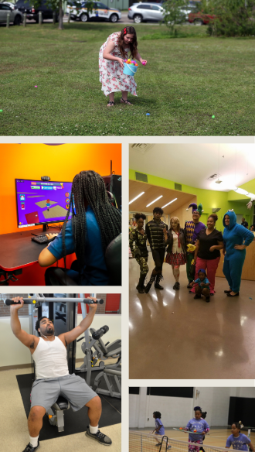
Recreation Centers
NORD Recreation Centers serve as the City’s most accessible and equitable community infrastructure and provide safe spaces, meals, cultural connection, physical activity, and civic engagement.
In addition to daily recreation and youth development services, City recreation centers serve as frontline resilience hubs that protect lives during hurricanes, freezes, and extreme heat by providing shelter and safe refuge for vulnerable populations including seniors, families, and residents without stable housing.

Slide 6
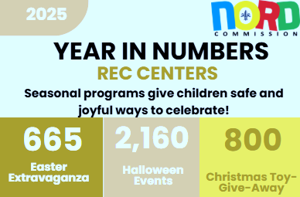
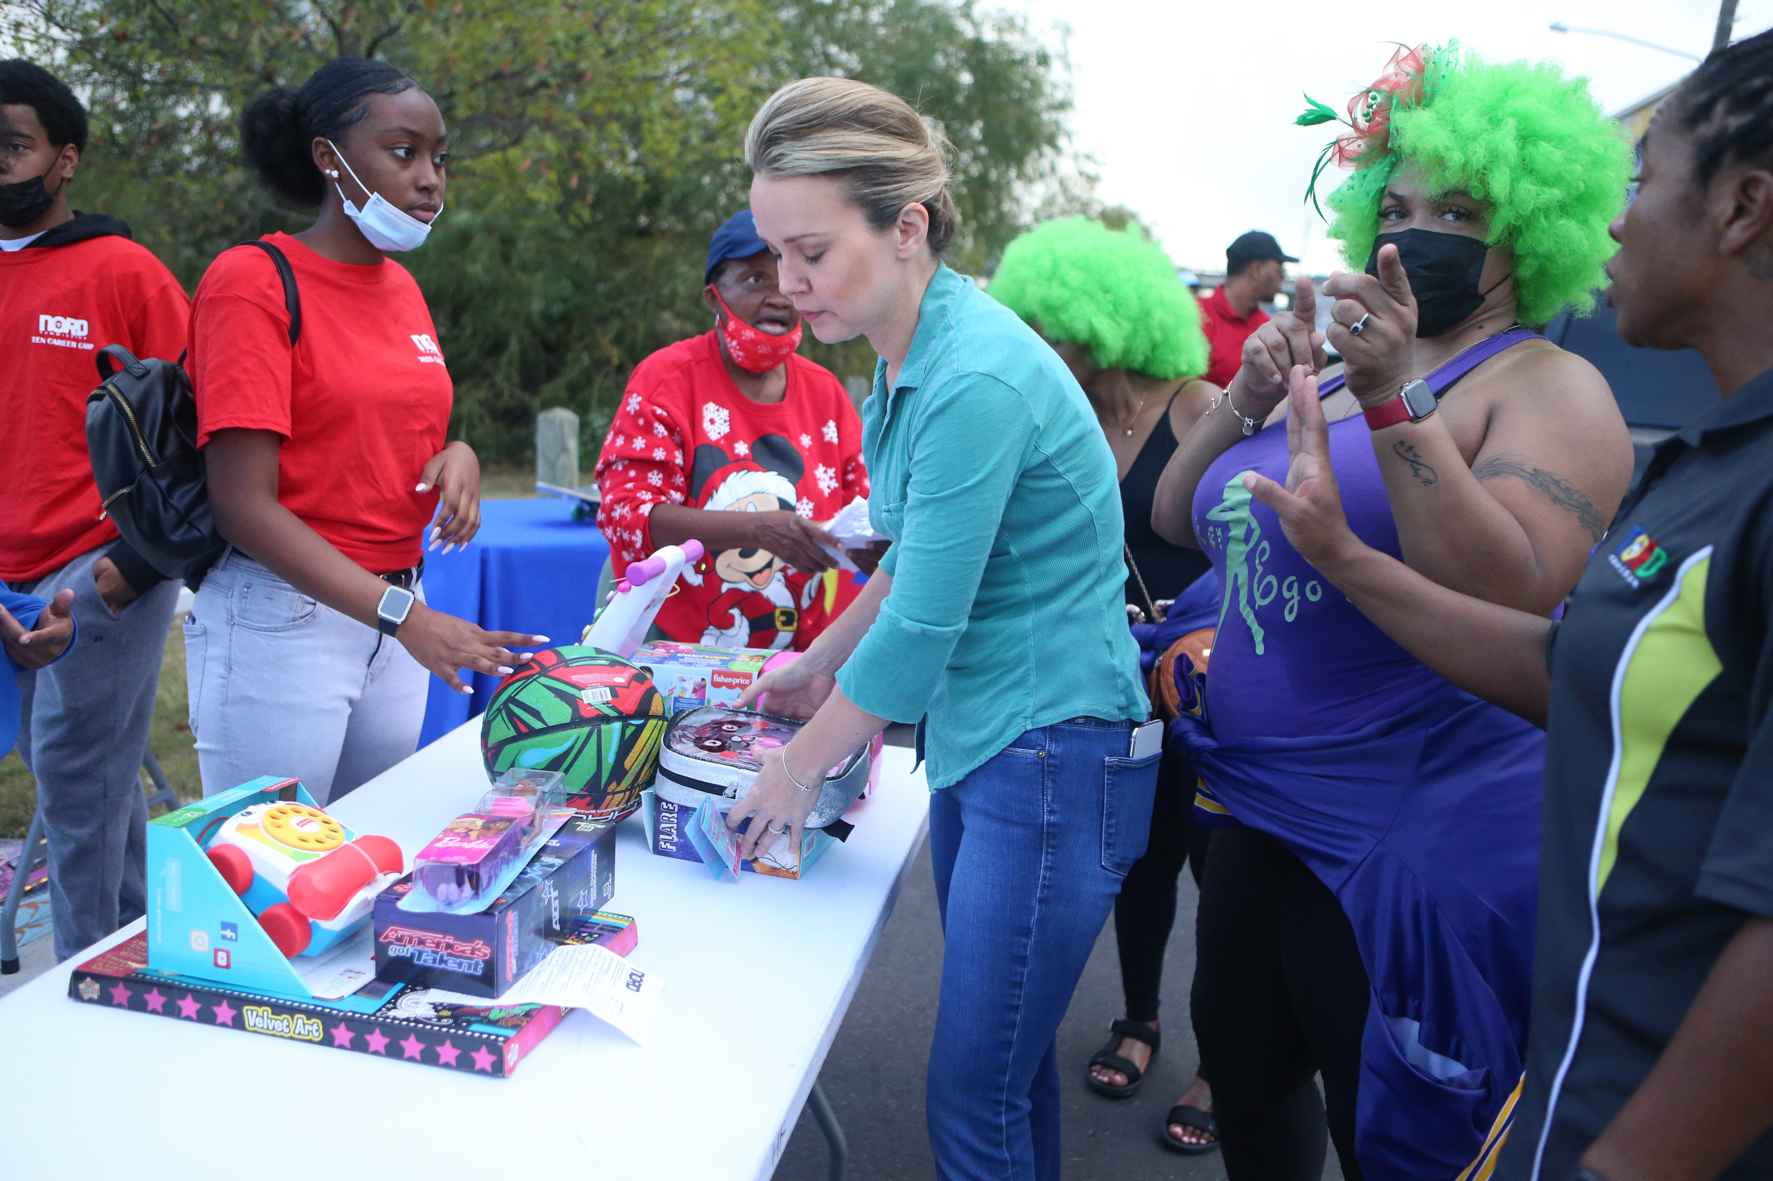
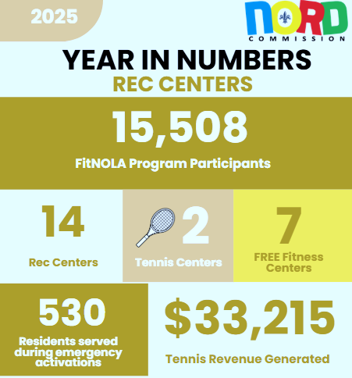
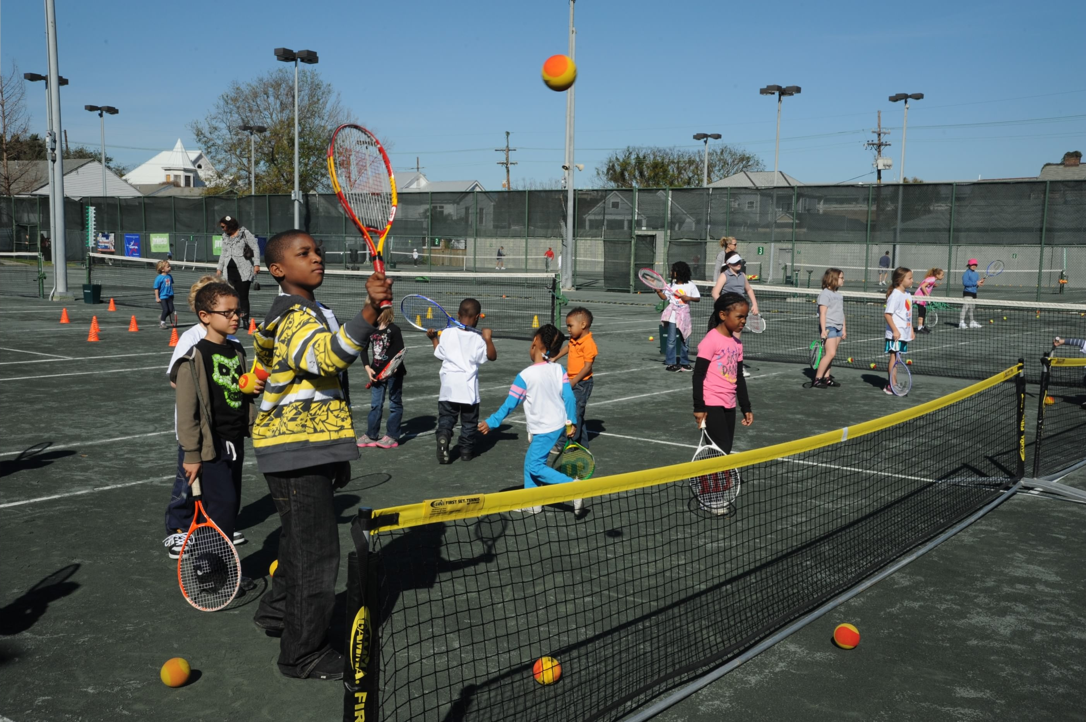
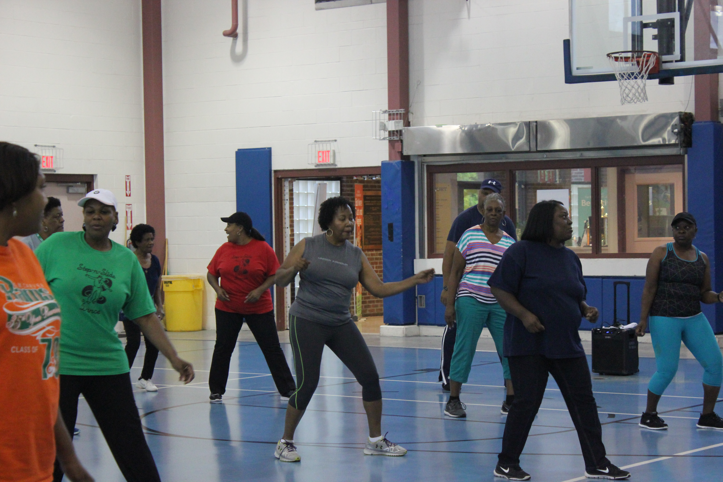


Recreation Centers
Serving 15,508 participants annually demonstrates that the FitNOLA program is a high-demand, high-impact public health investment, reaching thousands of residents with free, accessible opportunities to improve their physical health, prevent chronic disease, and build lifelong wellness habits.

Slide 7
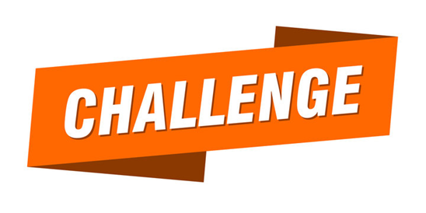
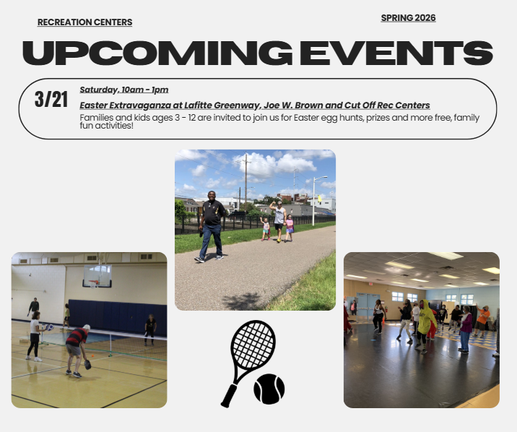

Recreation Centers
The FitNOLA program will have to revamp in 2026 due to elimination of the general funds budget allocation for instructors and events.
The recreation centers are in need of significant infrastructure improvements including HVAC, indoor & outdoor lighting, and elevator repairs.
Recreation centers have experienced staff attrition brought on by the hiring freeze implemented in 2025 and subsequent budget cut for 2026.

Slide 8
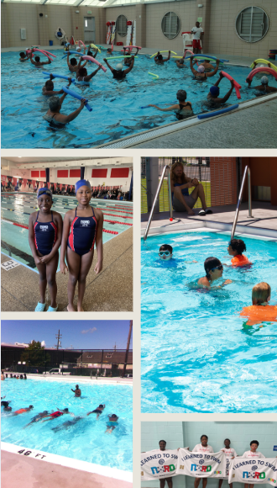
Aquatics
NORD Aquatics Division provides staff and programs at 5 year-round natatoriums, 13 seasonal outdoor pools and soon to be 2 splash pads, which deliver critical drowning-prevention education, year-round wellness opportunities, and safe community spaces that support public health, and climate resilience.
By offering swim lessons, water fitness classes, lifeguard certification, lap swimming, and more at no cost, NORD Aquatics is uniquely positioned to close the gap in swim equity, expand access to water sports and competitive swimming, create pathways to lifeguarding employment, promote full-body fitness, and encourage greater use of neighborhood aquatic facilities by New Orleanians.

Slide 9
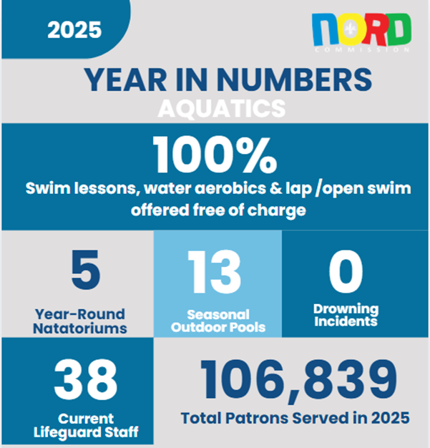
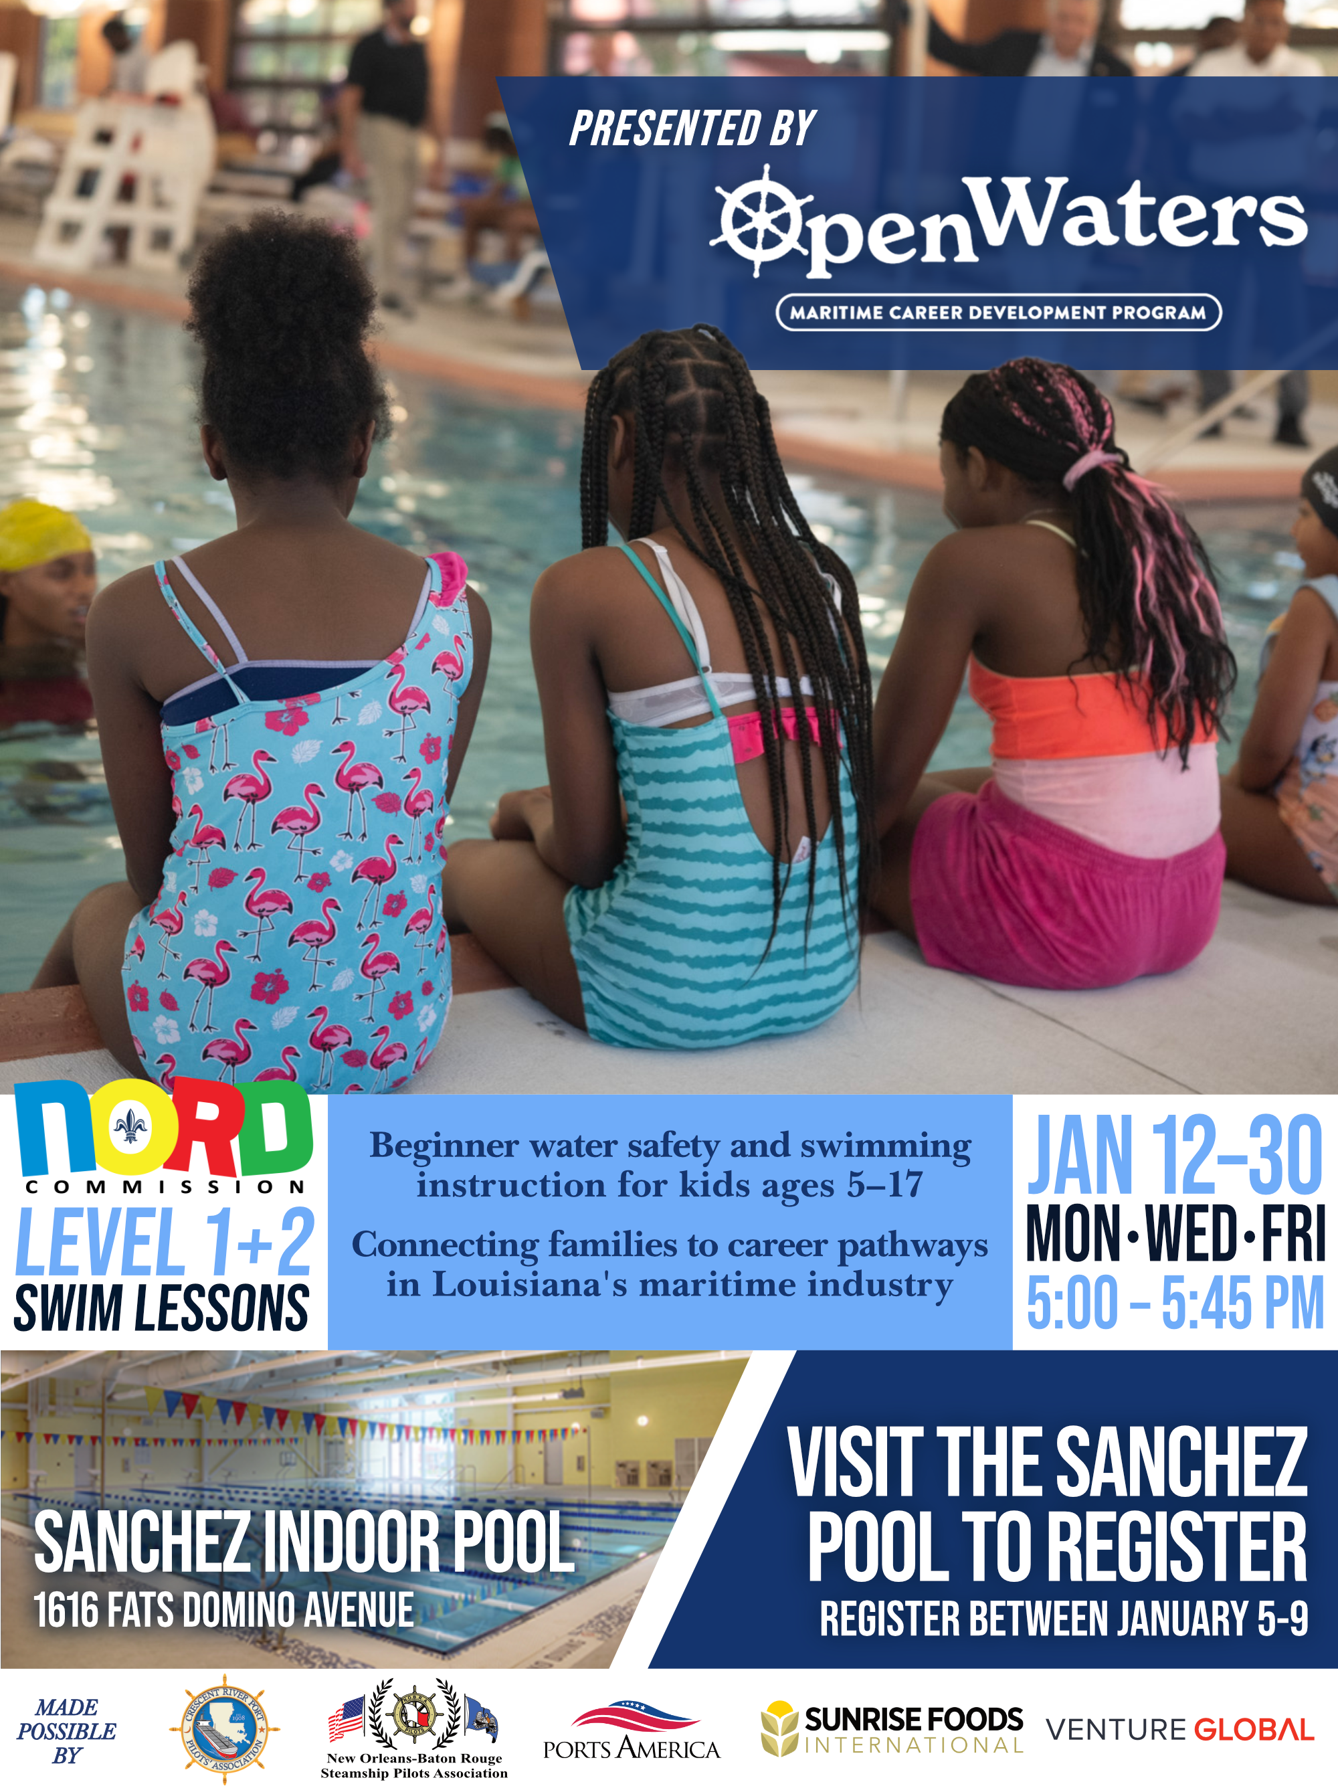


2025 Program Information
Aquatics Division
Out of a total Orleans parish population of 362,701, NORD Aquatics served 106,839 residents in one year — reaching nearly 30% of the entire city.
NORD partners with Open Waters, to offer beginner water safety and swimming instruction for kids ages 5–17 and connect families to career pathways in Louisiana's maritime industry.
Join the NORD Jets!
NORD’s swim team for 6 – 18 year- olds practices every Tuesday and Thursday from 4:00pm – 5:45pm at the following locations:
Gert Town Natatorium
George V. Rainey Natatorium
6,381 residents—from infants to adults—received American Red Cross–certified swim instruction through NORD Aquatics in 2025, building critical water safety skills.

Slide 10

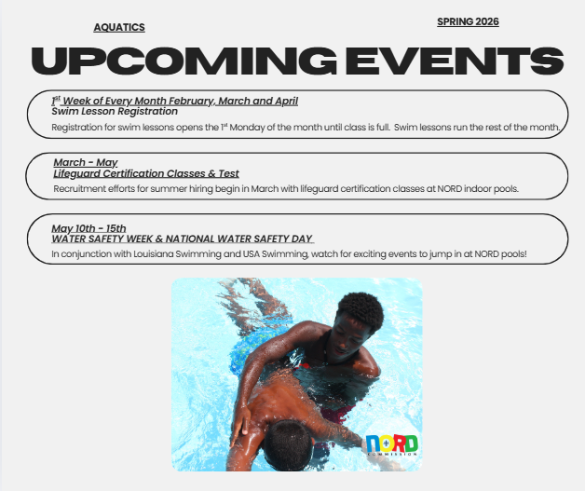
Aquatics Division
Outdoor seasonal pools have significant challenges in terms of repairs and equipment needed for operations.
Summer lifeguard recruitment and onboarding presents operational challenges due to the volume and timing of required certifications and hiring processes.

Slide 11
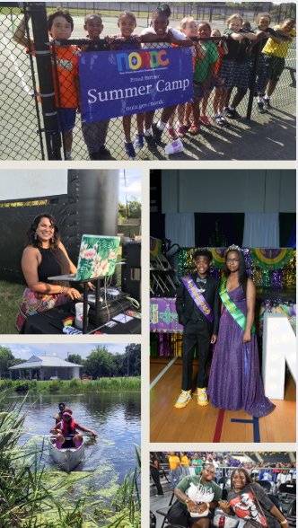
Multi-Programs
Through inclusive, varied, yet relevant programming, NORD Multi-Programs Division engages nearly 30,000 residents of all ages and walks of life. Cultural, youth, teen and outdoor programs at NORD facilities provide hundreds of hours of safe, structured learning and engagement opportunities, seek to reduce youth involvement in violent behavior and supports working New Orleanian families with out-of-school options and year-round FREE-family friendly events and programs.

Slide 12
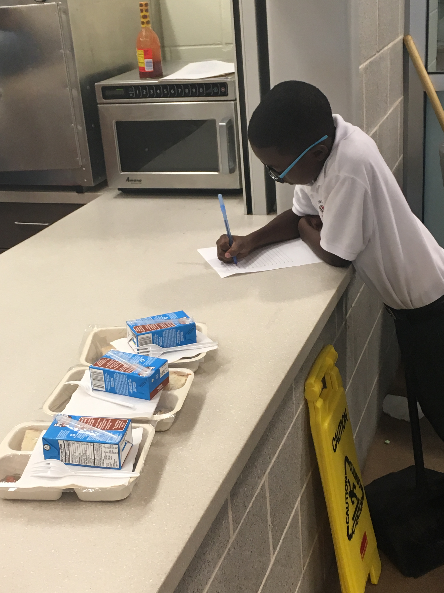
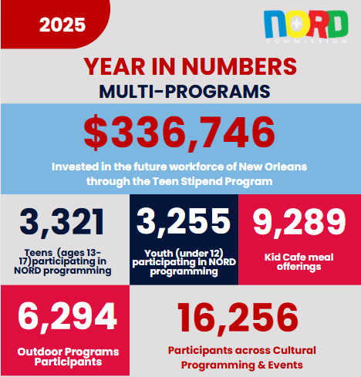
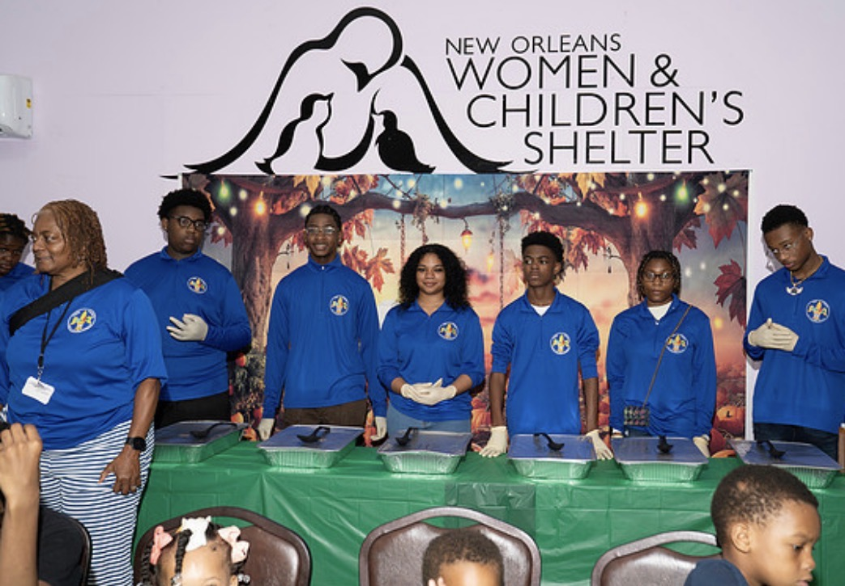
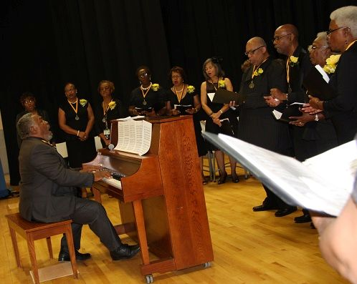
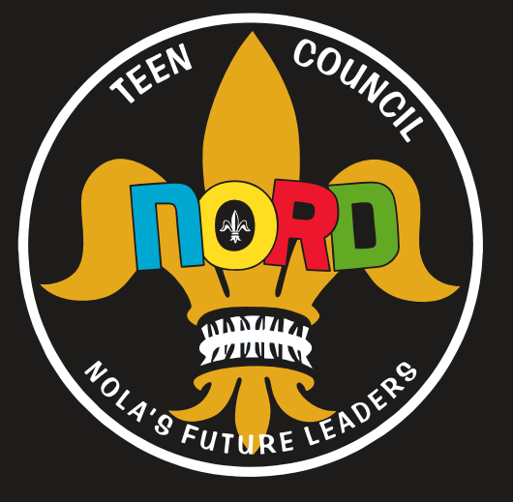
Multi-Programs
Through the Kid Café program, in 2025, there were 9289 critical instances where a child left our centers fed, supported, and able to focus on homework, safety, and enrichment rather than hunger.
In 2025, NORD distributed $336,746 in stipends, putting meaningful income into the hands of local teens while empowering them to grow as leaders, collaborators, and future professionals.
The Department’s cultural programming and community events served a total of 16,256 participants in 2025. Through partnerships with community and cultural organizations, these programs and events were offered free of charge, removing financial barriers and expanding equitable access to arts, culture, and enrichment opportunities.

Slide 13
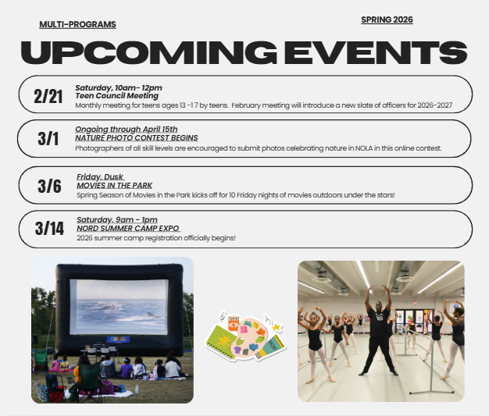
Multi-Programs
Elimination of funding for the Teen Stipend program in the City of New Orleans 2026 general fund budget will leave hundreds of teens without structured activities during the summer out-of-school hours.
The 2026 reduction in Multi-Program funding presents a substantial challenge to NORD’s ability to both maintain service levels and respond to growing community needs.

Slide 14

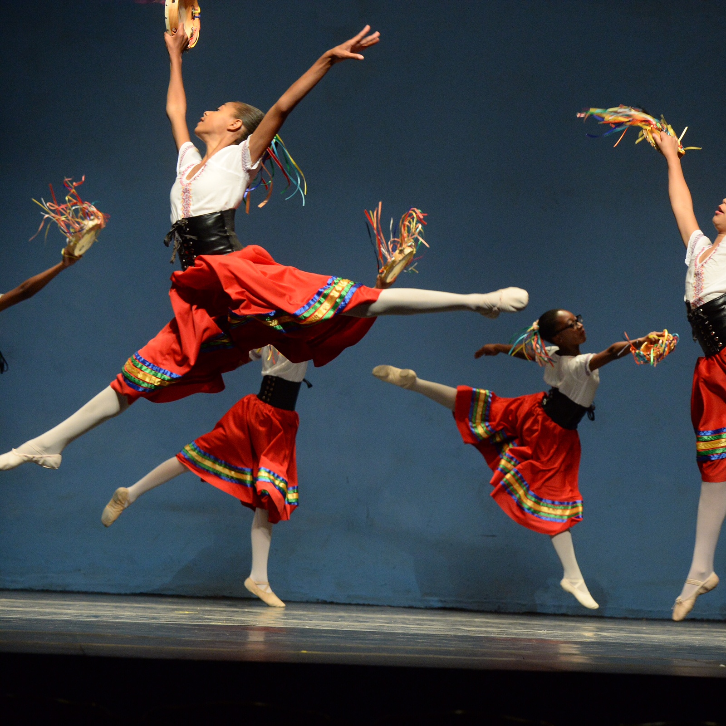
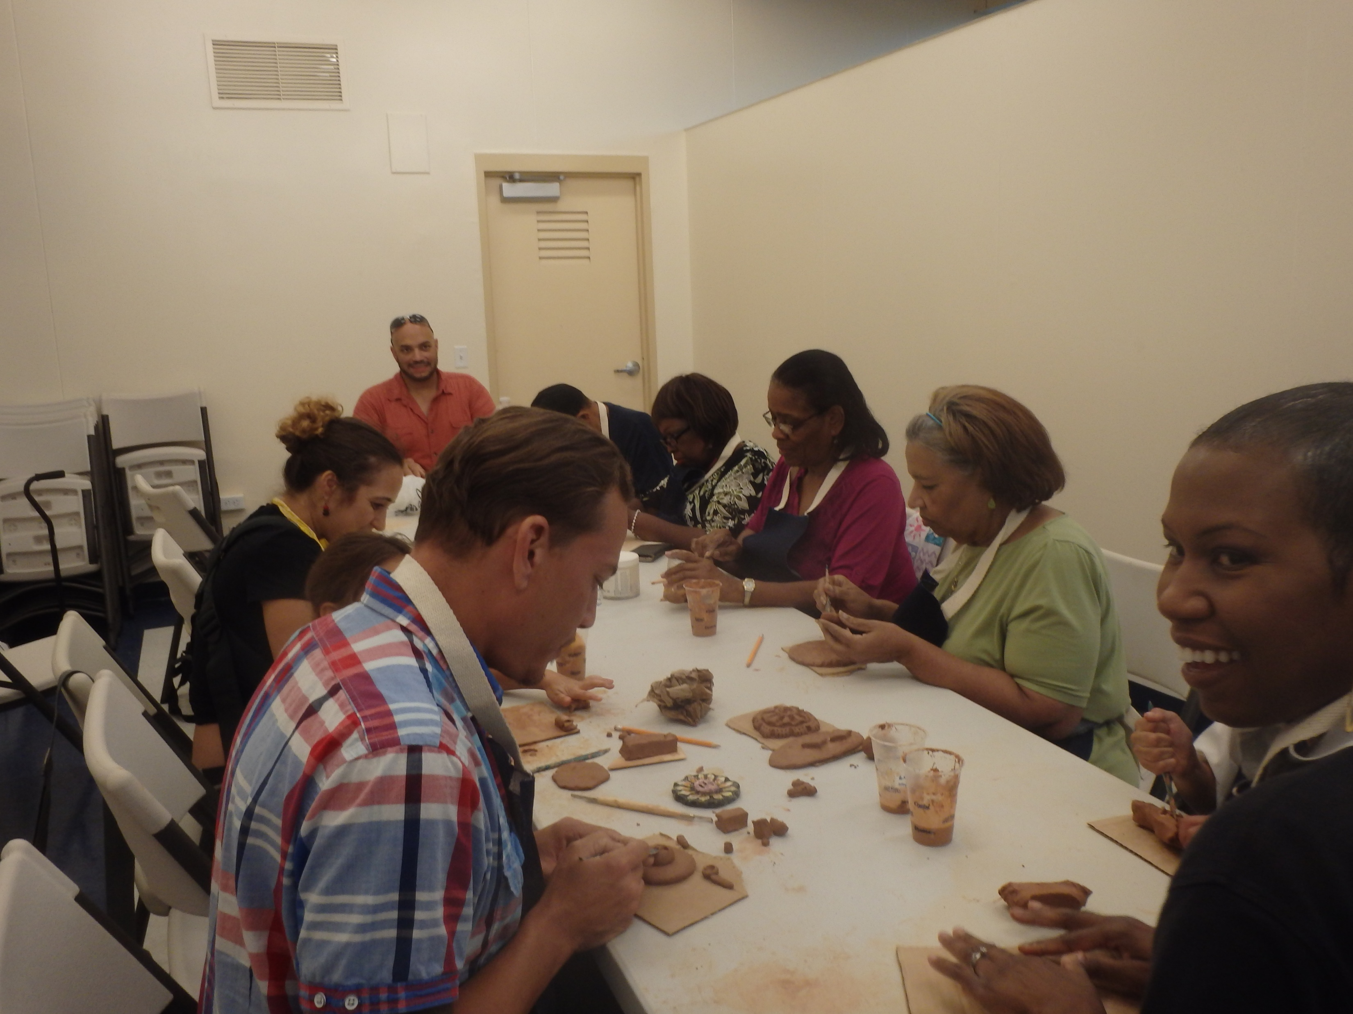
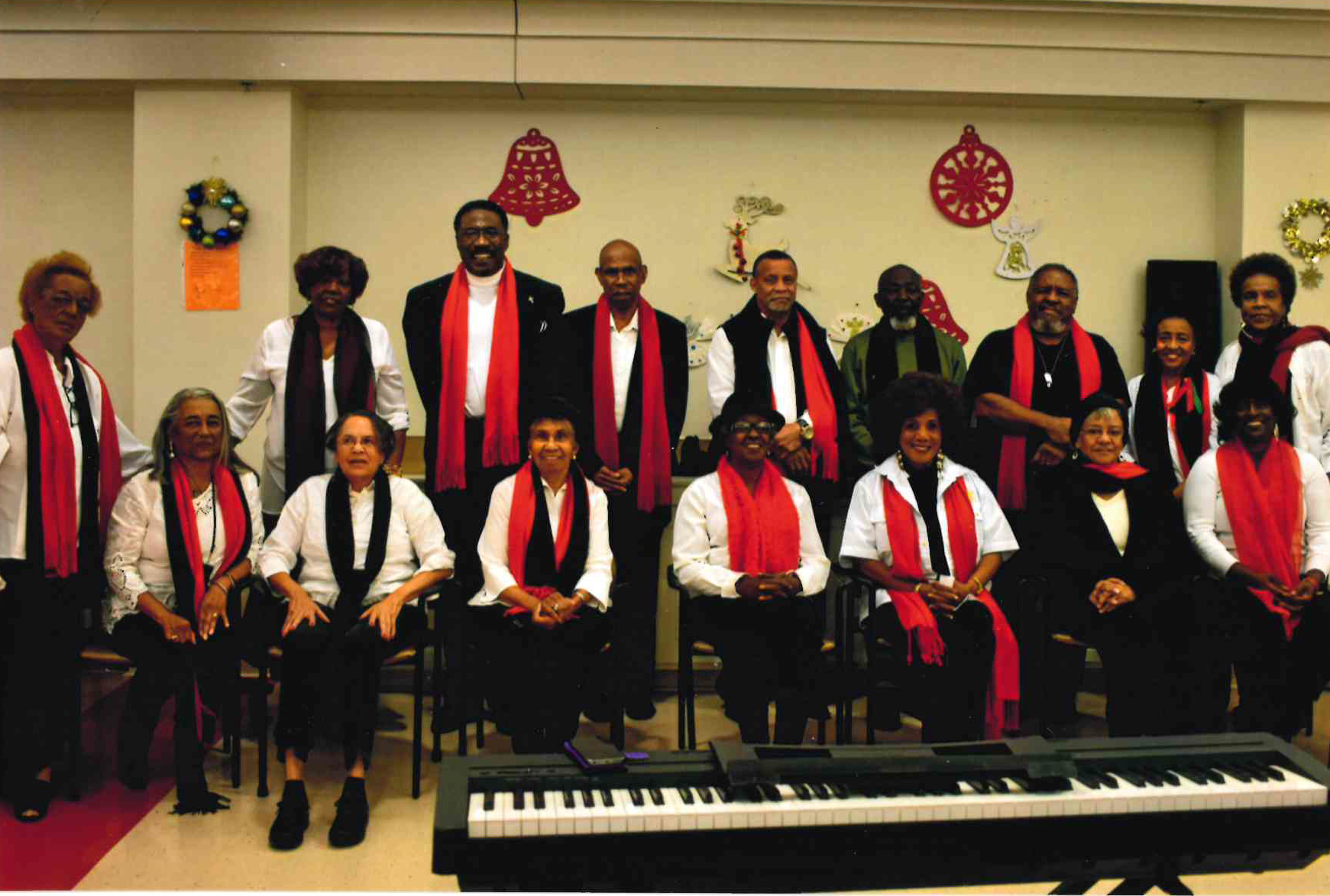
Registration for a Cultural Arts classes are on-going. Check your nearest rec center for a schedule!
Ceramics
Visual Arts (Painting / Drawing)
Piano
Guitar
Sewing
Senior Choir
Family Game Night
Senior Dance Fitness
Senior Choir
Youth Dance Classes (Ballet, Hip Hop and Tap through NOBA)
Open Canoeing & Fishing
Open Archery
Family Camping

Slide 15
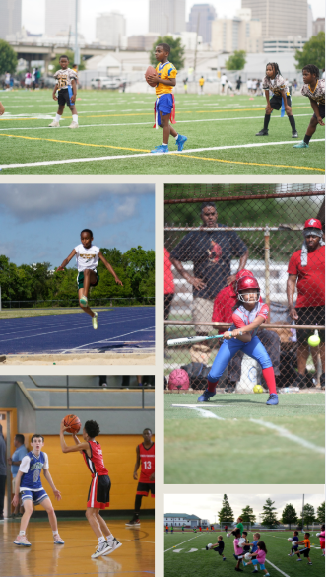
Athletics
NORD Athletics Division provide safe, equitable, and high-quality access to competitive sports programming for over 5,400 youth annually that enhances physical and mental health, promotes social-emotional development, seeks to strengthen neighborhood and community connection, and supports working New Orleanian families with structured after-school and weekend programming.

Slide 16
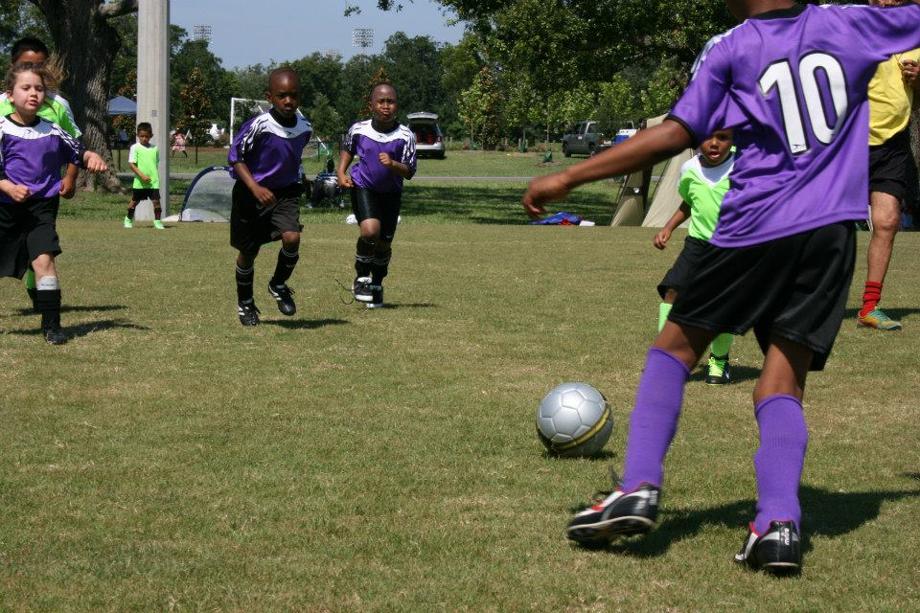
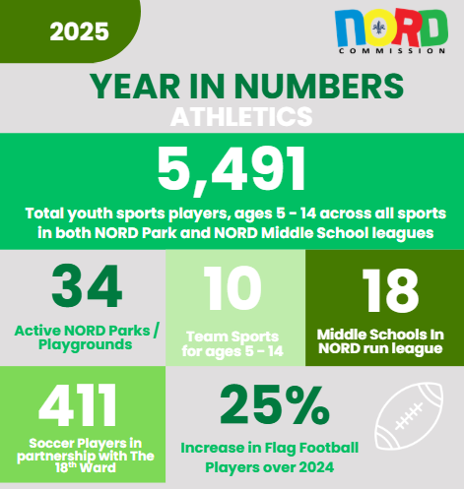
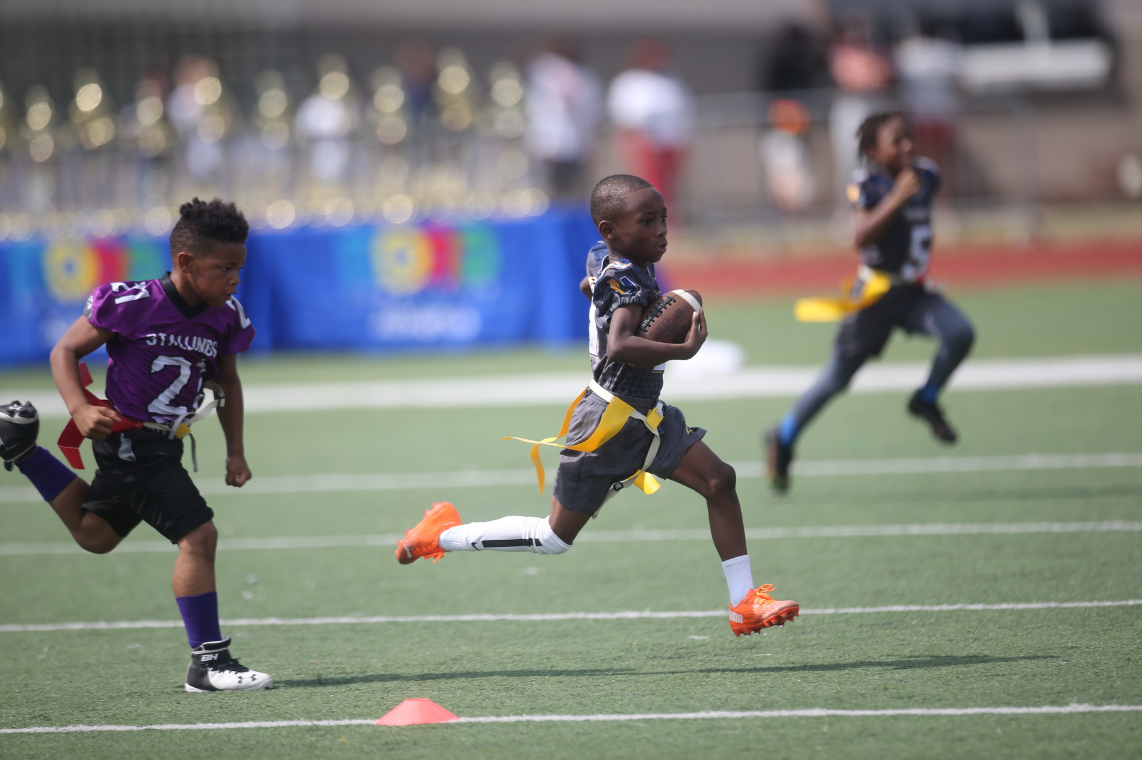
Athletics
NORD Athletics served 5,491 youth in 2025—up from 5,063 in 2024 (8% growth)—reaching nearly 1 in 13 New Orleans children through safe, structured sports at parks and middle schools.
In 2025, 631 youth participated in soccer programming through NORD partnerships with The 18th Ward at Norman, Hardin and Digby Playgrounds, and the New Orleans Jesters at Annunciation Playground.
In 2024, 328 youth played flag football with NORD, compared to 410 players in 2025. That’s a 25% increase, mirroring a national trend of flag football as one of the fastest growing sports.

Slide 17
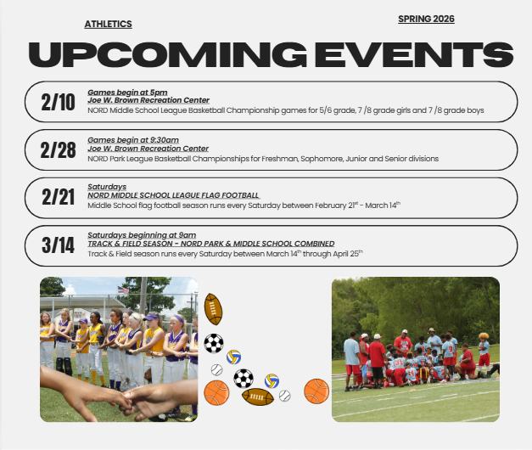
Athletics Division
Turf field conditions at Morris FX Jeff Stadium and Harrell Stadium, along with the track conditions at Harrell Stadium pose an unsafe playing surface.
Growth in girls’ sports programs has become over the last 3 years.
NORD has 42 active parks and playgrounds, but only 34 are staffed with part-time site facilitators, who are tasked with building sports teams and programs in the neighborhood.
The proposed 2026 reduction in Athletic operating funds will limit NORD’s ability to provide effective crowd control and quality game management.

Slide 18
Facilities and Maintenance

Slide 19
Facilities & Maintenance Division
NORD Facilities and Maintenance Division supports the safe, reliable operation of New Orleans Recreation Development Commission assets across the city. The Division focused on maintaining parks, recreation centers, pools, athletic fields and stadiums while maximizing available resources, responding to service needs, and protecting public infrastructure investments.
Scope of Facilities Maintained
Parks and Playgrounds (111): neighborhood, regional parks and play spots, dog run, skate park
Recreation Centers (16): Indoor facilities serving youth, families, and seniors.
Pools (18): 13 Seasonal and 5 year-round aquatic facilities.
35 Athletic Fields, 5 Baseball Stadiums and 2 Football Stadiums: Grass and turf fields supporting High School, College leagues, programs, and community use.

Slide 20
Facilities and Maintenance Project Status
🏁 Completed Projects - 2025
Facility | Project | Completion Status (%) | Comments
Annunciation Rec Center | Roof Repair | ✅ 100% | Job Complete!
Atkinson-Stern Tennis Center | Elevator Repair | ✅ 100% | Job Complete!
Burke Park | HML Repairs | ✅ 100% | Job Complete!
Cuccia Byrnes Stadium | HML Repairs | ✅ 100% | Job Complete!
Evans Playground | HML Repairs | ✅ 100% | Job Complete!
Hardin Playground | HML Repairs | ✅ 100% | Job Complete!
Harrell Stadium | HML Repairs | ✅ 100% | Job Complete!
Joe Brown Park | Pedestrian Bridge Repairs | ✅ 100% | Job Complete!
Lakeview Playground | HML Repairs | ✅ 100% | Job Complete!
Larry Gilbert Stadium | HML Repairs | ✅ 100% | Job Complete!
Milne Playground | Kaboom Playground Build | ✅ 100% | Job Complete!
Milne Playground | Clubhouse Repairs | ✅ 100% | Job Complete!
Milne Playground | HML Repairs | ✅ 100% | Job Complete!
Morris FX, Jr Stadium | Home Side - Concrete Area Repair | ✅ 100% | Job Complete!
Norwood Thompson | HML Repairs | ✅ 100% | Job Complete!
Pontchartrain Park | HML Repairs | ✅ 100% | Job Complete!
Rosenwald Rec Center | Roof Repair | ✅ 100% | Job Complete!
Rosenwald Rec Center | Gym Light Repairs | ✅ 100% | Job Complete!
Sanchez Rec Center | Roof Repair | ✅ 100% | Job Complete!
Skelly Rupp | New Entry Gates | ✅ 100% | Job Complete!
St Bernard Rec Center | Gym Light Repairs | ✅ 100% | Job Complete!
St. Bernard Roof Repair | Roof Repair | ✅ 100% | Job Complete!
Turf Fields (In Partnership with Capital Projects) | Lemann Football Field, Joe Brown Baseball Field, Perry Rome baseball Field, Larry Gilbert Baseball Field, Joe Brown Football Field | ✅ 100% | Job Complete!
Werner Playground | New Playground Sign Installed | ✅ 100% | Job Complete!
Wesley Barrow Batting Cage | Install HVAC to Building | ✅ 100% | Job Complete!

Slide 21
🏁 Proposed Projects - 2026
Facility | Project | Comments
Comiskey Park | Clubhouse Repairs | Project needs to be rebid
Conrad Playground | Clubhouse Renovation | Project needs to be rebid
Conrad Playground | HML Repairs | Pricing being requested
Delcazel Play spot | Playground equipment upgrades | Algiers Development District
Desmare Playground | Playset equipment Repairs | Pricing needs to be updated
Easton Playground | Electrical Repair ( HML ) | Replace Meter Pan due to electrical surge. Contractor has been notified
Eastshore Playground | Railing/Gutters needs to be installed | Project needs to be bid
Goretti Playground | Clubhouse Roof Repair | Roof Repairs need to be bid
Goretti Playground | HML Repairs | Pricing being requested
Harold Gene Devore | HML Repairs | Pricing being requested
Harold Gene Devore | Basketball Court Lighting Repairs | Material being gathered in house repairs
Harris Playground | Basketball Court Striping | Hoopla Project Quotes submitted
Hunter’s Field | Storm Drain and Paver Repair | Project needs to be rebid
Joe Brown Park | Shelter Door Repairs (Throughout the Park) | Project needs to be bid
Larry Gilbert Stadium | Roll-Down Concession Door Replacement | Requisition Created
Larry Gilbert Stadium | HML Repair | Pricing Requested
Lyons Rec Center | Cooling Tower Replacement | Capital Project Request
Morris FX Stadium | Artificial Turf Replacement | Project needs to be funded
Morris FX, Jr Stadium | Press Box and Visitor Concrete Area Repairs | Algiers Development District
Norwood Thompson | Install Safety Hand Rails | Project needs to be bid
Pontchartrain Playground | HML Repairs | Project needs to be bid
Pontchartrain Playground | Clubhouse Roof Repair | Roof repairs need to be bid
St Bernard Rec Center | Elevator Repair | Extensive repairs needed due to water damage. Quote received
St Bernard Rec Center | Window Repair | Project needs to be rebid
St. Bernard Rec Center | HVAC Chiller Coil Replacements | Pricing needs to be redone
Facilities and Maintenance Project Status

Slide 22
Facility | Project​ | Completion​ Status (%)​ | Comments​
🏁 Proposed Projects – Playground Safety Soft Surfaces 2026
Bunny Friend Playground | Install new Pour in Place Safety Surface | 0% | Need to obtain quotes
Cut-Off Playground | Install new Pour in Place Safety Surface | 0% | Need to obtain quotes
Daneel Playground | Install new Pour in Place Safety Surface | 0% | Need to obtain quotes
Desmare Playground | Install new Pour in Place Safety Surface | 0% | Need to obtain quotes
Delcazel Playground | Install new Pour in Place Safety Surface | 0% | Need to obtain quotes
Cutoff Playground | Install new Pour in Place Safety Surface | 0% | Need to obtain quotes
Burke Park | Install new Pour in Place Safety Surface | 0% | Need to obtain quotes
Eastshore Playground | Install new Pour in Place Safety Surface | 0% | Need to obtain quotes
Conrad Playground | Install new Pour in Place Safety Surface | 0% | Need to obtain quotes
Norwood Thompson Playground | Install new Pour in Place Safety Surface | 0% | Need to obtain quotes
FP Jackson Playground | Install new Pour in Place Safety Surface | 0% | Need to obtain quotes
Hardin Playground | Install new Pour in Place Safety Surface | 0% | Need to obtain quotes
Kingswood Playground | Install new Pour in Place Safety Surface | 0% | Need to obtain quotes
Lakeview Playground | Install new Pour in Place Safety Surface | 0% | Need to obtain quotes
Lyons Playground | Install new Pour in Place Safety Surface | 0% | Need to obtain quotes
River Playground | Install new Pour in Place Safety Surface | 0% | Need to obtain quotes
Facilities and Maintenance Project Status

Slide 23
2026 Seasonal Pool Updates
No. | Pools | Comments
1 | Lyons | Working on quotes for tub repair 2026 Structural Damage. Side wall separated from pool inhibiting full circulation. Pool Filters need sand media replaced
2 | Whitney Young | Pump room needs to be rewired. Structural damage. Pool leaks when topped off. Pool Filters sand media need to be replaced
3 | AL Davis | Contract being routed for repairs. Pool has structural damage as well as filtration system issues. Pool filter sand media needs to be replaced. Project in progress for repairs
4 | Federal City | Water in pool. Pool closed. Pool filter sand media needs to be replaced. Pool has a small leak with no visible signs of flooding
5 | Harrell | Copper theft possible, structural damage to pool tub. Vandalism repairs completed. Deck issues as well as bottom of pool. Pool Filters sand media need to be replaced
6 | Lemann | Pool was filled pump was ran no leaks present draining for closure. Pool Filters sand media need to be replaced. Pool pit does leak when pit is filled but not when pump is running
7 | Pradat | Vandalism/Trespassing a consistent problem. Pool Filters sand media need to be replaced. Pool deck needs to be addressed (Possible in house). Pool has a small leak in an unknown area no visible signs of flooding but level drops regularly
8 | Rosenwald Center | Pool Filters sand media needs to be replaced
9 | Sampson | Pool slated for Capital Projects renovations. Pool Filters sand media need to be replaced. Current piping leaks in pit
10 | St Bernard Center | Structural issues pool deck buckling. Pool Drain has issues with Pool Filter sand media needs to be replaced
11 | Stallings Gentilly | Pool pump at location waiting on parts. Structural damage. Pool leaks more than last year. Filters/sand need to be replaced. Working on quotes for tub repair 2026 possible Capital Project in future
12 | Stallings St Claude | Pool filters sand media require replacement
13 | Taylor | Mechanical issues filtration system needs total replacement(Vandalism). Water source needs to be replaced(Theft Vandalism).Pool filters sand media needs to be replaced. Vandalism a constant factor. Pool is also closed due to stormwater mitigation project.

Slide 24
2026 Year-Round Pool Updates
No. | Pools | Comments
1 | Joe W. Brown Natatorium | Pool Pump, Heater and leak being addressed ASAP Cajun Innovative January 2026. Pool Filters sand media will require replacing 2027/2028
2 | Gert Town Natatorium | Submitted quote for Pool Pak dehumidification system repair. HVAC work currently in progress. Assessing exterior lighting issues. Problem appears to be broken underground. Repaired 1 pool heater water 85 degrees pricing parts for 2nd boiler Awaiting Purchase Order. Quotes being gathered for Pool Tub. Pool Filters sand media needs to be replaced repair
3 | George V. Rainey Natatorium | Pool opened Pool Filters sand media will need replacing 2030/2031. Contractor addressing warranty issues.
4 | Andrew P. Sanchez & Copelin-Byrd Natatorium | Pool open
5 | Treme Natatorium | Pool Filters sand media will need replacing 2028/2029

Slide 25
2025 Key Activity Metrics
Total Work Orders: [852]
Total Work Orders Completed: [771]
Total Open Work Orders: [81]
Average Monthly Work Orders: [64]
2024 Key Activity Metrics
Total Work Orders Completed [923]
Average Monthly Work Orders [76]
Impact
Completion of these work orders ensured facilities remained operational, safe, and accessible for year-round programming and public.

Slide 26

Personnel Challenges
Staffing shortages and vacancies within skilled trades and maintenance positions limited capacity to respond as quickly as desired to all service requests.
NORD currently have one Electrician, Plumber and HVAC Specialist on staff.
There are currently two service contracts (Electrical and Plumbing) for routing, but due to 2026 budget restraints, these contracts may not be available.
Impact:
Reduced staffing levels placed pressure on existing teams and required prioritization of critical and safety-related work orders.
Facility-Related Challenges
Aging infrastructure across parks, recreation centers, pools, and athletic fields resulted in increased corrective maintenance and unexpected repairs.
Deferred maintenance needs continued to impact on the workload, particularly on the older facilities.
Vandalism and theft across NORD’s inventory required additional unbudgeted funding to address these issues.
Weather-related impacts, including extreme heat, heavy rainfall, hurricanes accelerated wear on outdoor facilities and fields and increased maintenance demands.
Impact:
Facility conditions require greater focus on reactive maintenance, limiting opportunities to expand preventive maintenance efforts.
2026 Budget Constraints
Limited growth in the 2026 maintenance budget, combined with rising material and labor costs, constrained the Division’s ability to address all identified needs.
Competing priorities required careful allocation of resources to ensure life-safety, code compliance, and program continuity remained the top focus areas.
Capital vs. operating funding gaps limited the pace at which larger facility improvements could be implemented.
Impact:
Budget constraints necessitate continued prioritization, phased repairs, and strategic planning to sustain service levels in 2026
Facilities & Maintenance Plan — 2026
NORD is part of the City of New Orleans’ 2026–2030 Capital Improvement Plan, which includes targeted investments in recreation infrastructure:
Playground & Park Enhancements: Projects like Norman Playground upgrades, Morris F.X. Jeff Complex improvements, and multi-purpose facility enhancements are slated for design and funding phases.
Continued splash pad installations and other playground enhancements are planned across various sites.
Maintenance and upgrades on ball fields, natatorium systems, and accessibility improvements remain a core focus in bid/award and construction pipelines.
These facility projects are part of ongoing efforts to ensure parks, playgrounds, pools, and rec centers remain safe, accessible, and welcoming across New Orleans.

Slide 27
Critical Position Summary
Summary Maintenance Unfilled
Trades | 2.00
Public Works Sup IV | 1.00
Labor | 23.50 | 9 unfilled
Maintenance worker | 3.00 | 2 unfilled
Sr Maintenance worker | 0.00
Equipment OP III | 1.00
Public Works Sup III | 2.00
Public Works Sup I | 6.00 | 1 unfilled
Public Works Sup II | 1.00
Main. Project Manger | 1.00
Public Work Main. Spec | 0.00 | unfilled
Office Worker | 1.00
Building Maint manager | 1.00
Current Filled | 42.50
Vacant/Lost Positions |  | 13
Summary Programming Unfilled
7002- Multi Programs | 2.00
7004-Atletics | 7.0
District Manager | 2.0
4 Site Facilitator | 4.0
Recreation Program Manager Girls Sports | 1.00
7005 - Recreation Centers | 9.0
RCA-I | 6.0
RCA-III (District Manager) | 1.00 | Revenue Generating Position @ Tennis Center
7006-Aquatics | 10.0
Lifeguards | 10
Each pool requires a minimum of 4 lifeguards per shift totaling 8 per day plus a manager to operate safely.

Slide 28
Strategic Analysis

Slide 29
Strengths
Strong neighborhood presence providing safe, inclusive spaces for youth, families, and residents
High community participation in seasonal events, athletics, and wellness programming
Proven reach and impact across the city through diverse recreational and enrichment offerings
Ability to respond to community needs with innovative and non-traditional programming
Recreation centers serve as critical assets during emergencies as shelters and resource hubs
Weaknesses
Limited funding for programming, staffing, and ongoing facility maintenance
Aging infrastructure requiring increased capital investment and repair
Staffing shortages that affect program delivery, facility operations, and service consistency
Limited resources for staff training and professional development
Extended timelines for facility repairs, impacting pool operations and center availability
Opportunities
Expansion of sustainable, revenue-generating program models to support operations
Strategic capital improvements to modernize facilities and enhance user experience
Increased investment in staff training, retention, and workforce development
Program growth aligned with evolving community interests and wellness priorities
Strengthened partnerships to leverage external funding and shared resources
Threats
Ongoing fiscal constraints and potential budget reductions
Equity challenges associated with increased reliance on fee-based programming
Continued workforce shortages and staff burnout
Operational and safety risks related to deferred maintenance and aging facilities

