Slide 1

Presented by:
Larry Barabino, Jr.
April 7, 2026

Slide 2
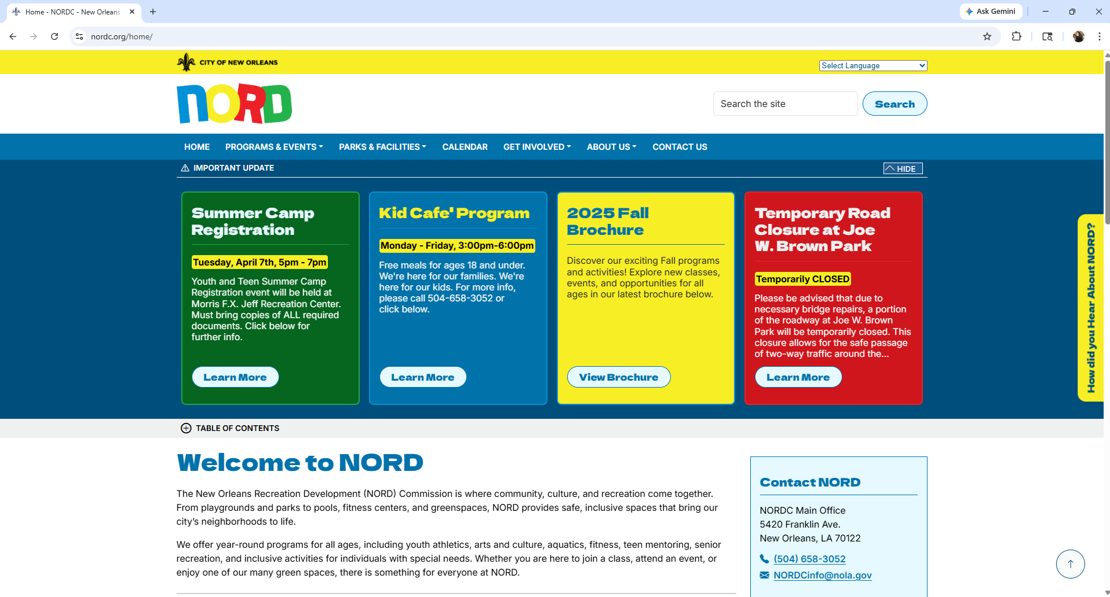

Slide 3
Programming Division
Centers
Aquatics
Multi Programs
Youth
Teens
Cultural
Outdoors
Athletics

Slide 4
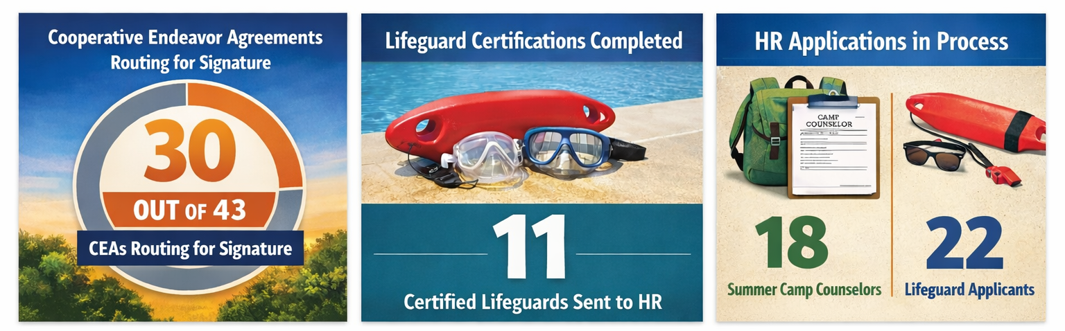
2026 Programming Information
Seasonal Hiring Dashboard
Summer CEA Progress
NORD Contracts is on-schedule to have CEAs released to partners & NORD Commission for signature by mid-April. Once signed, the CEAs are then executed by the Mayor. CEAs must be fully executed to process camp partners 1st payment, tentatively set for release by May 22nd .
Aquatic Certifications Met
Applicants 15 years or older must possess a nationally recognized Lifeguard Training Certification from a professional provider, to be hired as a NORD Lifeguard for the summer, earning $17.58 an hour. NORD’s Aquatics division hosts lifeguard training certification course for FREE every weekend in April. As of March 30th, 11 people have been certified through NORD Aquatics for hiring at a NORD pool this summer.
Application Process in Motion
The application process, managed by the CAO’s HR division, includes collecting applications, successful completion of drug and background checks, and for minors under 18, obtaining worker’s permits. The HR team is onsite in NORD’s Administrative Office Monday – Friday, between 9am and 5pm to collect and review applications.

Slide 5
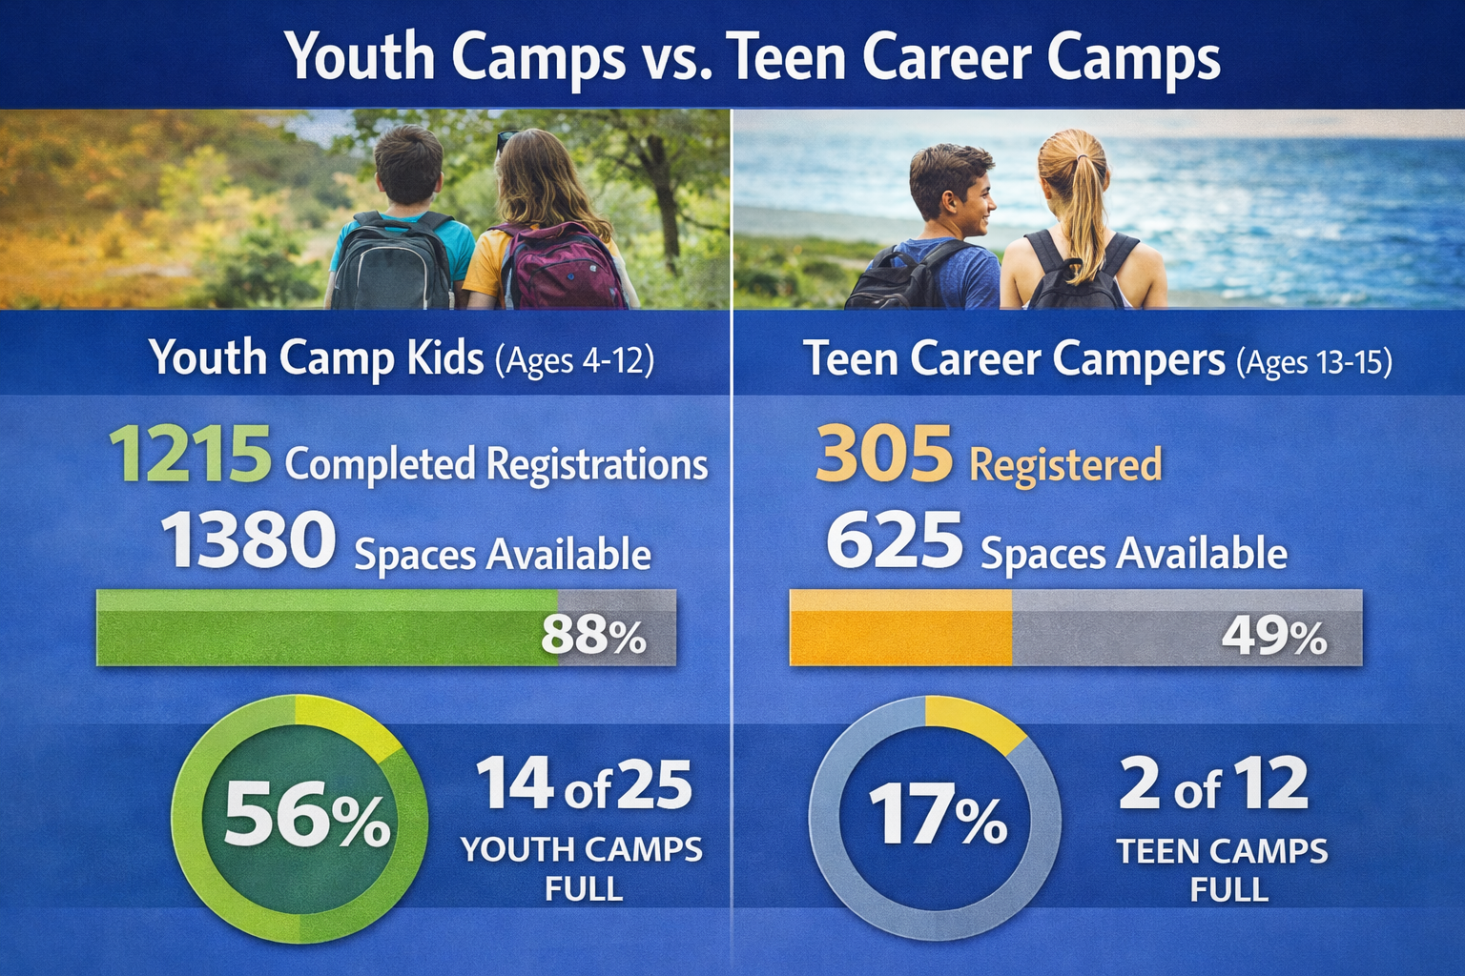
2026 Programming Information
Seasonal Hiring Dashboard
Summer Camp Availability
Registration continues through May 7th for NORD Youth & Teen Camps. Parents must call the NORD office to schedule an appointment to submit completed registration packets, Monday through Thursday 9am to 5:30pm. We are planning to host 2 more additional open registration days in April.

Slide 6
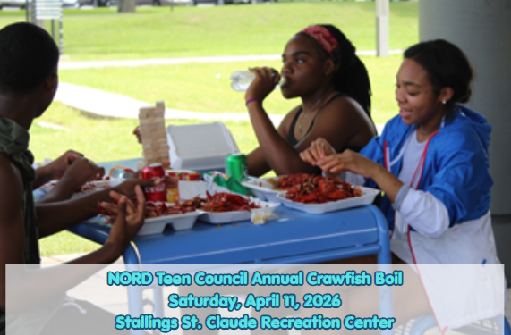
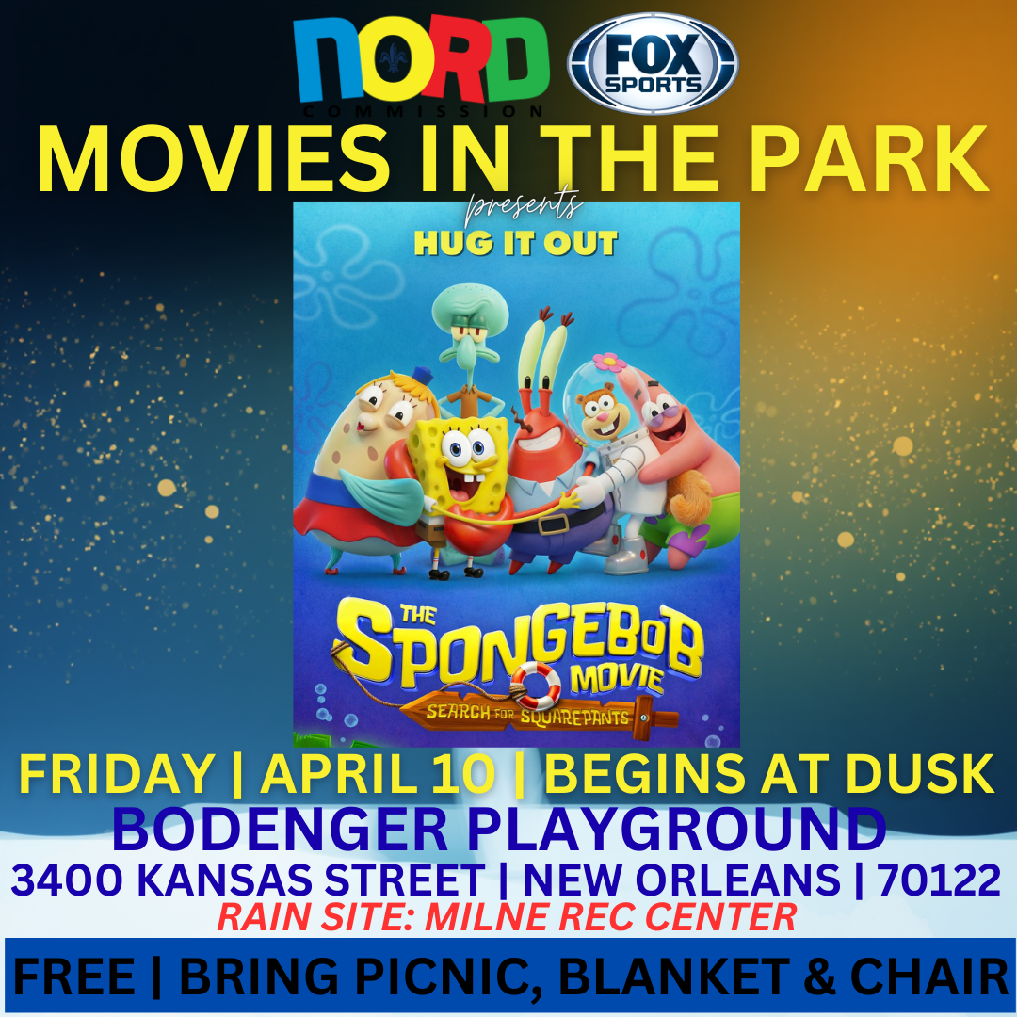
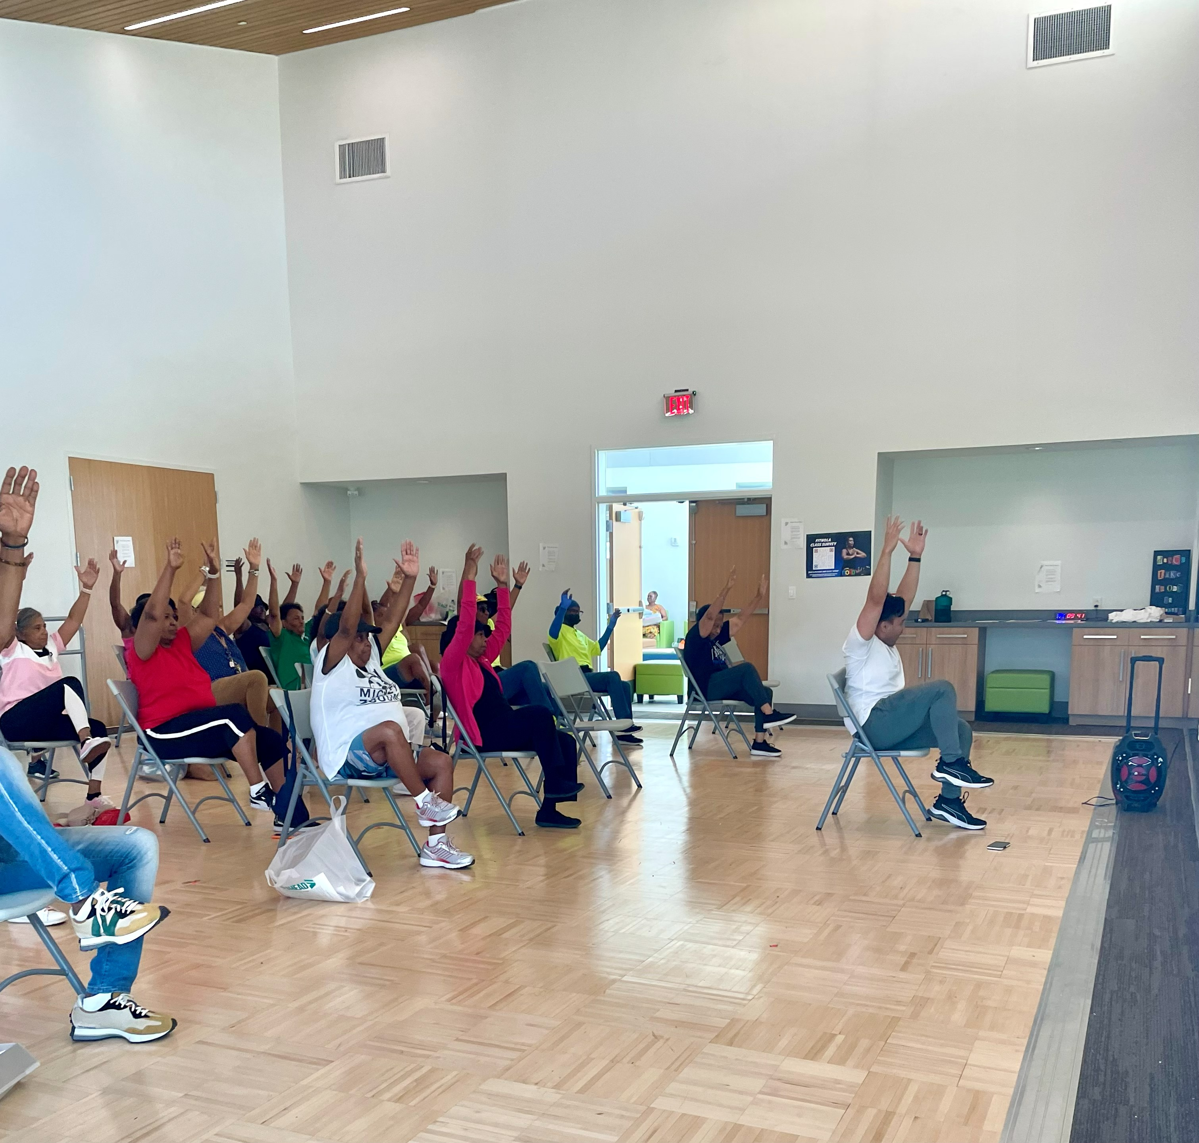
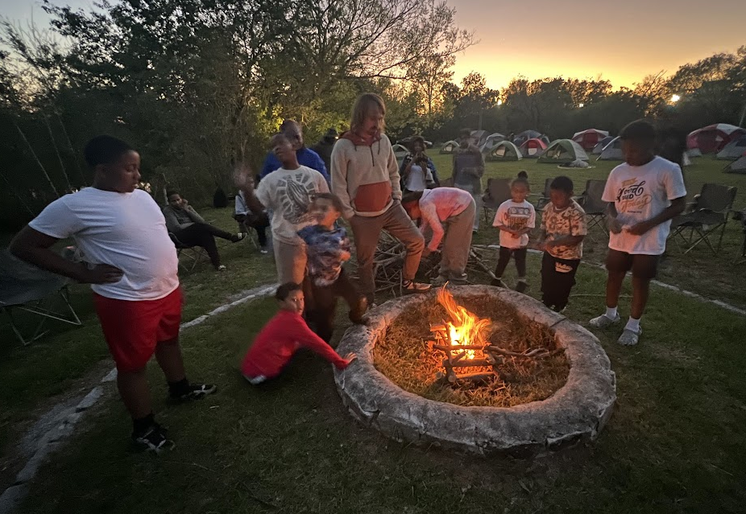
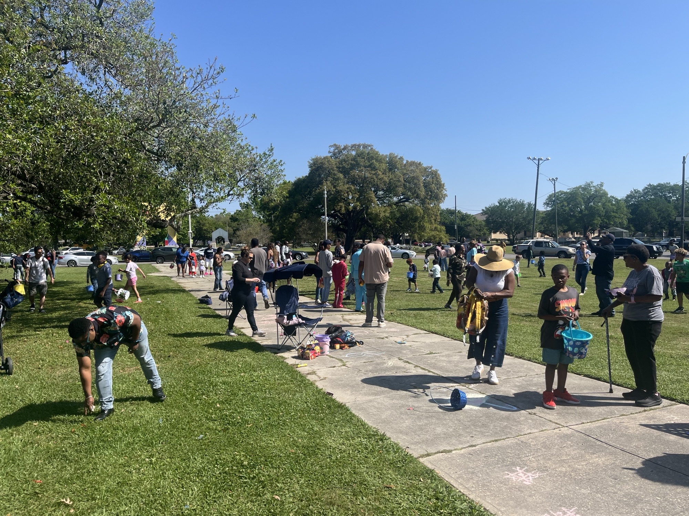

2026 Program Information
Recreation Centers Division
Multi Programs Division
“My health has benefited greatly from attending [Fit NOLA] classes. I support the continuation of...classes at our NORD facility.” Victor A., Chair Yoga Participant
Through collaboration with businesses, non-profits and sponsors, Easter events at NORD provide safe, inclusive spaces for families to gather and celebrate, supporting our mission of providing welcoming environments for cultural experiences. Events were held on the Lafitte Greenway, Morris FX Jeff Park, Eastshore Playground, McCue Playground and the Desire Florida Community Center.
The Spring Movies in the Park season continues every Friday through May 15th at different NORD parks. This Friday, join us at Bodenger Playground, with partner The Wellness Collective, at dusk for The SpongeBob Movie. For a full list of remaining movies & locations, visit our website.
Explore the impact of FitNOLA programming to see firsthand how our collective efforts are strengthening health and wellness across our community. Review the 2025 FitNOLA Impact Report today.
The NORD Outdoors Family Campout, held March 20–21, provided 60 New Orleanians with an accessible and welcoming introduction to overnight camping. Designed to remove common barriers to participation, attendees were only required to bring basic personal items, while NORD supplied all essential equipment, including tents, sleeping pads, meals, and structured activities, such as a marshmallow roast with s’mores, a guided night hike, and fireside storytelling.

Slide 7
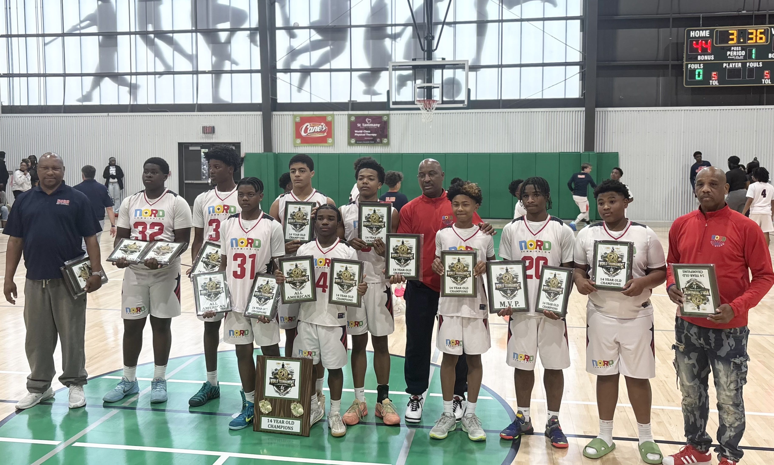
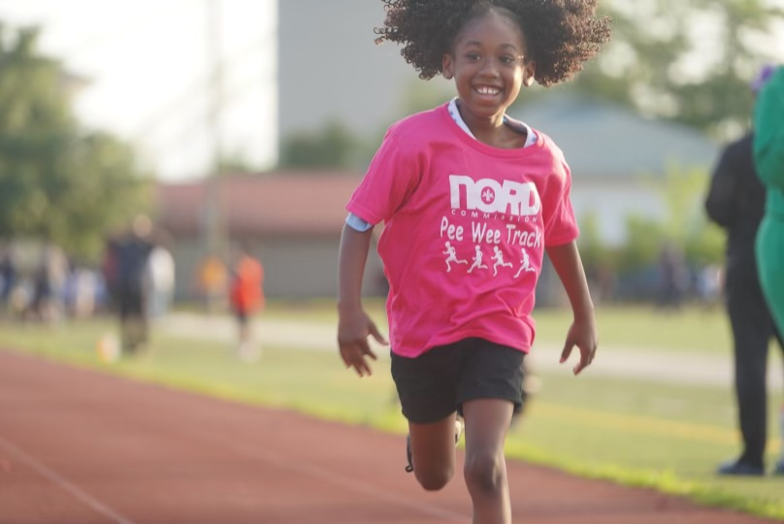

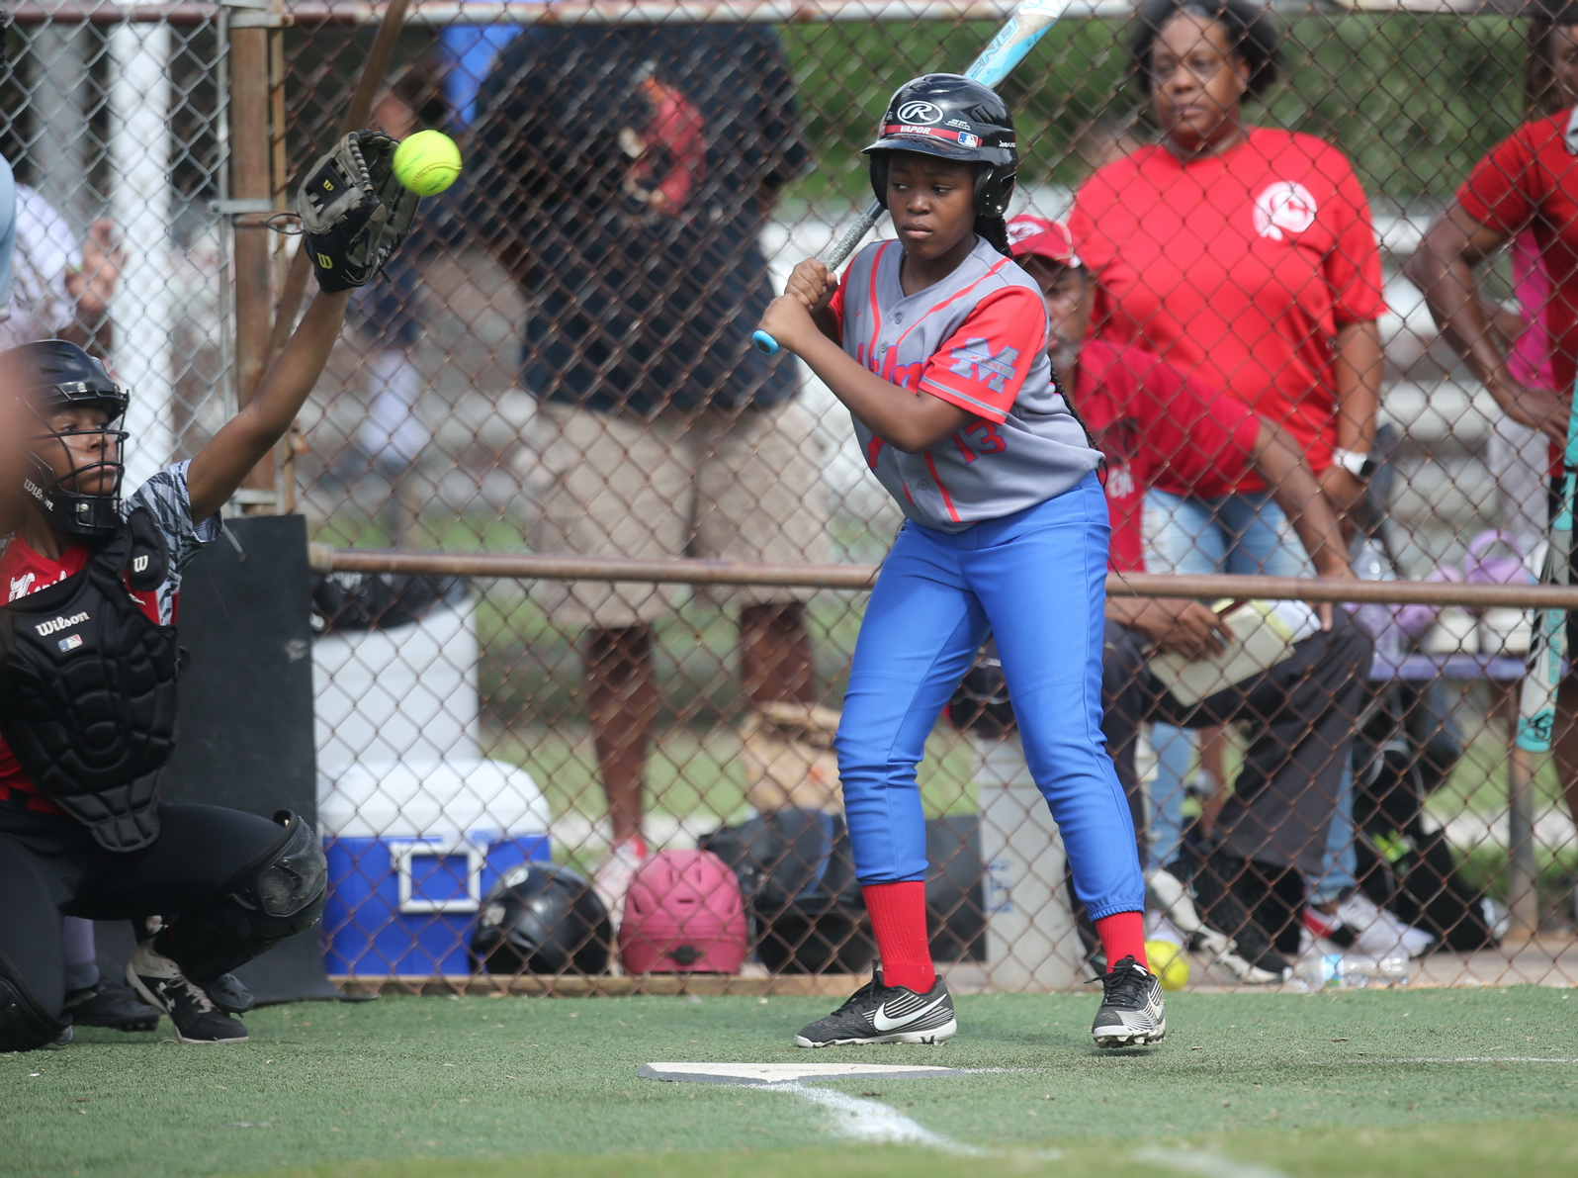

2026 Program Information
Aquatics Division
Athletics Division
Biddy Basketball Season Wrap-Up
NORD entered 48 players across 4 teams for the 2026 Biddy National tournaments. NORD’s 14u team defended it’s National Title by defeating the Raceland Jaguars 45-44 in Madisonville, LA March 21-22nd.
Track & Field Kick-Off
The 2026 track and field season kicked off March 19th with over 700 registered runners s participating in track and field this season. The season ends on April 25th with the Steven J. George Citywide Track and Field Championships at Joe W. Brown Victory Track.
Water Safety Day Partnership International Water Safety Day is designed to educate the public in becoming safer in and around water. NORD will partner with the New Orleans Health Department for a water safety campaign in April leading up to Water Safety Day promotions at NORD pools May 10th – 15th.
NORD Baseball / Softball Tees Up
GNO Little League
The 8-week Little League season started in March with 10u and 12u divisions and 120 players.
NORD Rec League
The NORD Rec League is currently registering participant through April 18th. The sseason's Kickoff Jamboree will be Saturday, May 2nd at Cuccia Byrnes Playground beginning at 9:30am. Season runs through July 9th.

Slide 8
Facilities and Maintenance

Slide 9
🏁 Proposed Projects - 2026
Facility | District | Project | Comments
Conrad Playground | A | Clubhouse Renovation | Project needs to be rebid
Conrad Playground | A | HML Repairs | Pricing being requested
Desmare Playground | A | Playset equipment Repairs | Pricing needs to be updated
Comiskey Park | B | Clubhouse Repairs | Project needs to be rebid
Lyons Rec Center | B | Cooling Tower Replacement | Capital Project Request
Norwood Thompson Playground | B | Install Safety Handrails | Project needs to be bid
Harold Gene Devore | C | Basketball Court Lighting Repairs | Material being gathered in house repairs
Norman Playground | C | HML Repairs | Pricing Being Requested
Digby Playground | D | Clubhouse Rebuild | Project needs to be bid
Harris Playground | D | Basketball Court Striping | Hoopla Project Quotes submitted
McCue Playground | D | Repair Fence | Project Needs to be Bid
St Bernard Rec Center | D | Window Repair | Project needs to be bid
Eastshore Playground | E | Railing/Gutters needs to be installed | Project needs to be bid
Joe Brown Park | E | Shelter Door Repairs (Throughout the Park) | Project needs to be bid
Goretti Playground | E | Basketball Fence Repair | Project needs to be bid
Village d 'Lest Playground | E | HML Repairs | Pricing Being Requested
Facilities and Maintenance Project Status

Slide 10
🏁 Proposed/Completed Projects – 1st Quarter 2026
Facility | District | Project | Comments | Estimated Cost
Easton Playground | A | Electrical Repair ( HML ) | In Progress | $13,015.00
Larry Gilbert Stadium | A | Underground Plumbing Repairs | Exploratory work in progress | $6,380.00
Larry Gilbert Stadium* | A | HML Repair | Completed | $6,400.00
Lyons Rec Center* | B | Underground Plumbing Repairs | Completed | $11,160.00
Delcazel Playspot | C | Playground Repairs | Algiers Development District in Progress | $22,822.30
Harold Gene Devore | C | HML Repairs | PO received awaiting scheduling | $23,150.00
Morris FX Jeff, Sr Rec Center | C | HVAC Heater Two new Coils | Work in Progress | $10,600.00
Morris FX Jeff, Sr Stadium | C | Concrete Flat Work Visitors Side | Algiers Development District in Progress | $26,560.00
Morris FX Jeff Sr. Stadium | C | Press Box Renovations | Algiers Development District in Progress | $23,701.57
Morris FX Jeff Sr. Stadium | c | Install 4ft fencing | Algiers Development District in Progress | $8,129.94
Morris FX jeff Sr. Stadium | C | Install Concrete Dumpster Pad | Algiers Development District in Progress | $9,800.00
Skelly Rupp Stadium | C | Scoreboard Repair | Completed | n/a
Hunter’s Field | D | Storm Drain and Paver Repair | Contract Routing | $8,989.43
Pontchartrain Playground | D | HML Repairs | PO received awaiting scheduling | $5,840.00
Pontchartrain Playground* | D | Clubhouse Roof Repair | PO received awaiting scheduling | $2,621.45
St Bernard Rec Center | D | Pool Coping Repair | Completed | $4,850.00
St Bernard Rec Center | D | Elevator Repair | PO Issued Material ordered | $39,767.95
St. Bernard Rec Center* | D | HVAC Chiller Coil Replacements | Completed | $40,873.00
Goretti Playground | E | HML Repairs | Pricing submitted awaiting PO | $15,850.00
Goretti Playground* | E | Clubhouse Roof Repair | In progress | $7,041.29
Facilities and Maintenance Project Status

Slide 11
🏁 Proposed/Completed In-House Projects – 1st Quarter 2026
Facility | District | Project | Comments | Estimated Cost
City Wide Locations | A,B,C,D,E | Plumbing Repairs | In process Work Orders | $7,781.37
City Wide Locations | A,B,C,D,E | A/C Filters | Proposals Submitted | $5,454.12
City Wide Locations | A,B,C,D,E | Lighting/Security | In Process Work Orders | $10,039.93
City Wide Locations | A,B,C,D,E | Fire Alarm Inspections | Proposals Submitted | $24,640.00
City Wide Locations | A,B,C,D,E | Swing Parts | Proposals Submitted | $5,967.04
Annunciation Playground | B | Play Structure Repairs | Foundation Funding in Progress | $3,480.07
Atkinson Stern Tennis Center | B | Three Compartment Sink Repair | Kitchen Upgrade to meet DHH Standards Proposals submitted | $4,500.00
Norwood Thompson Playground | B | Repair / Replace vandalized restroom parts | Completed | $1,385.14
Rosenwald Rec Center | B | HVAC Parts | Proposals submitted | $2,497.06
Facilities and Maintenance Project Status

Slide 12
🏁 Proposed Projects – Playground Safety Soft Surfaces 2026
Facility | District | Project​ | Completion​ Status (%)​ | Comments​
Conrad Playground | A | Install new Pour in Place Safety Surface | 0% | Need to obtain quotes
Daneel Playground | A | Install new Pour in Place Safety Surface | 0% | Need to obtain quotes
Desmare Playground | A | Install new Pour in Place Safety Surface | 0% | Need to obtain quotes
Lakeview Playground | A | Install new Pour in Place Safety Surface | 0% | Need to obtain quotes
Burke Park | B | Install new Pour in Place Safety Surface | 0% | Need to obtain quotes
Lyons Playground | B | Install new Pour in Place Safety Surface | 0% | Need to obtain quotes
Norwood Thompson Playground | B | Install new Pour in Place Safety Surface | 0% | Need to obtain quotes
Cutoff Playground | C | Install new Pour in Place Safety Surface | 0% | Need to obtain quotes
Cut-Off Playground | C | Install new Pour in Place Safety Surface | 0% | Need to obtain quotes
Delcazel Playground | C | Install new Pour in Place Safety Surface | 0% | Need to obtain quotes
River Playground | C | Install new Pour in Place Safety Surface | 0% | Need to obtain quotes
Bunny Friend Playground | D | Install new Pour in Place Safety Surface | 0% | Need to obtain quotes
FP Jackson Playground | D | Install new Pour in Place Safety Surface | 0% | Need to obtain quotes
Hardin Playground | D | Install new Pour in Place Safety Surface | 0% | Need to obtain quotes
Eastshore Playground | E | Install new Pour in Place Safety Surface | 0% | Need to obtain quotes
Kingswood Playground | E | Install new Pour in Place Safety Surface | 0% | Need to obtain quotes
Facilities and Maintenance Project Status

Slide 13
2026 Seasonal Pool Updates
No. | Pools | District | Comments
1 | Lyons | B | Pool Prep has begun.Working on quotes for tub repair 2026 Structural Damage. Side wall separated from pool inhibiting full circulation. Pool Filters need sand media replaced.
2 | Whitney Young | A | PoolPrep has begun. Pump room needs to be rewired. Structural damage. Pool leaks when topped off. Pool Filters sand media need to be replaced
3 | AL Davis | B | Contract being routed for repairs. Pool has structural damage as well as filtration system issues. Pool filter sand media needs to be replaced. Project in progress for repairs
4 | Federal City | C | Water in pool. Pool closed. Pool filter sand media needs to be replaced. Pool has a small leak with no visible signs of flooding
5 | Harrell | A | Structural damage to pool tub.Pool does not hold water. Quoting repairs Vandalism repairs completed. Deck issues as well as bottom of pool. Pool Filters sand media need to be replaced.
6 | Lemann | C | Pool prepped and painted.. Pool Filters sand media need to be replaced. Pool pit does leak when pit is filled but not when pump is running
7 | Pradat | E | Pool prepped and painted. Vandalism/Trespassing a consistent problem. Pool Filters sand media need to be replaced. Pool deck needs to be addressed (Possible in house). Pool has a small leak in an unknown area no visible signs of flooding but level drops regularly
8 | Rosenwald Center | B | Pool prep has begun. Pool Filters sand media needs to be replaced
9 | Sampson | D | Pool Prepped and Painted. Pool slated for Capital Projects renovations. Pool Filters sand media need to be replaced. Current piping leaks in pit
10 | St Bernard Center | D | Pool prepped and Painted. Pool deck repairs completed. Pool Drain has issues with Pool Filter sand media needs to be replaced
11 | Stallings Gentilly | D | Pool prepped and painted. Pool pump at location waiting on parts. Structural damage. Pool leaks more than last year. Filters/sand need to be replaced. Working on quotes for tub repair 2026 possible Capital Project in future
12 | Stallings St Claude | C | Pool filters sand media require replacement
13 | Taylor | B | Mechanical issues filtration system needs total replacement(Vandalism). Water source needs to be replaced(Theft Vandalism).Pool filters sand media needs to be replaced. Vandalism a constant factor. Pool is also closed due to stormwater mitigation project.

Slide 14
2026 Year-Round Pool Updates
No. | Pools | District | Comments
1 | Joe W. Brown Natatorium* | E | Pool Pump, Heater and leak repairs in progess.Early April ETA. Pool Filters sand media will require replacing 2027/2028
2 | Gert Town Natatorium * | B | Pool Open. Quotes being gathered for Pool Tub repair. Pool Filters sand media requires replacement in 2026/27. Repair / Replace two ventilation support wires.
3 | George V. Rainey Natatorium | C | Pool open
4 | Andrew P. Sanchez & Copelin-Byrd Natatorium | E | Pool open
5 | Treme Natatorium* | C | Pool open. New Pool Boiler ordered. Installation scheduled April 2026 Pool Filters sand media will need replacing 2028/2029

Slide 15
Financials

Slide 16

Budget to Actual

Slide 17
Quarter 1 Available Budget Allocation

Slide 18
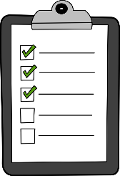








February Financial Facts at a Glance
Administration
Athletic Programing
$1,,6 9 9,874 – P e r s o n n e l
$ 2 54,131- Pe r s on ne l
$ 1,14 5,00 8 - O p e r a t I n g
$ 73,49 6 - O p e r a t i n g
Vacancy FTEs
$ 1,3 3 4 ,91 6 - P e r s o n ne l
$ 3 0 8,12 6 - P er s o n ne l
$ 2 2 8,12 0 - O p e r a t in g
$ 5 1,6 8 2- O p e r a t in g
Teen Stipends
$450,000 - Personnel
Vacancies: 29.33
Revolving Fund
$1,105,269 – Operating
$193,237 - Operating
Multi- Programming
$959,807 – Personnel
$111,388- Personnel
$60,060- Operating
$0 -Operating
$ 1,105,269 – CDBG
$43,228
NORDC Trust
$51,929
Balance Allocation
$22,153,106/$2,414,504
Revolving Fund/Self Generating
2026 Through 3/2/2026
$50,759
Maintenance
$2,767,387 – Personnel
$402,200- Personnel
$1,210,796 - Operating
$236,512- Operating
Aquatics
$5,536,538 – Personnel
$294,945- Personnel
$66,500 - Operating
$15,291- Operating
Recreation Centers
$3,682,473 - Personnel
$572,145 Personnel
$266,000- Operating
$51,360
Notes:
Financial Facts at a glace provides another picture of the line item budget slide, it breaks down the agency’s entire appropriation and balances by division along with, CDBG Funding Revolving Revenue Fund, and Teen Camp Stipend allocation.

Slide 19
2026 NORD BUDGET To ACTUAL FTEs Vacancies As of March

Slide 20
Funding Allocation
2025 Self Generating Revenue
2026 Self Generating Revenue
Revenue Sources: Facility Rentals Tennis Center Revenue Admission & Concession Revenue Summer Camp Athletics Registration Act No. 892 Session 2008 Mardi Gras Parking Misc. Vendor Refunds NORD Merchandise Sales Jazz Fest Parking | $225,803 $33,213 $112,070 $16,320 $3,770 $50,000 $2,370 $0 $30 $3,381
Total Revenue Generated * - Unaudited | $446,957*
Revenue Sources Year to Date: Facility Rentals Tennis Center Revenue Admission & Concession Revenue Summer Camp Athletics Registration Act No. 892 Session 2008 Mardi Gras Parking Misc. Vendor Refunds NORD Merchandise Sales Jazz Fest Loading – Stallings Gentilly | $36,716 $3,811 $3,607 $0 $1,080 $0 $5,505 $0 $40 $0
Total Revenue Generated * - Unaudited | $50,759*
Notes:
The Agency’s Fund allocation deck provides a comparison of collected revenue from the previous fiscal year versus the current. YTD the agency has collected in revenue (11% of 2025 revenue collected) through facility rentals, tennis court utilization and we also introduced into our revenue stream admission, concession and registration for sports participation.

