Slide 1
NORD Commission Meeting
Presented by:
Larry Barabino Jr., NORD CEO
April 5, 2022
| nordc.org

Slide 2
Celebrating 75 Years
NORD continues to rebuild/regain its momentum from a pandemic state. Although we saw steady increases in participation in some areas in 2021, we continue to adapt to the ever-changing COVID-19 restrictions and strands.
As you will see in this report, we are currently finalizing summer programming and planning for NORD’s 75th anniversary celebrations and fund-raising activities. In addition to traditional summer programming, we are currently working with all partners, to provide additional thoughtful activities to engage a larger teen population this summer. To further those efforts of engagement with a larger teen population, our campaign to recruit summer lifeguards (16yrs old & older) and Jr. lifeguards (13-15yrs old) will begin this month with our Human Resources department attending a job fair hosted by JOB1.
Lastly, our largest efforts beginning 2022 will be to put emphasis on reaching more teens as well as focusing on our 75th Anniversary. We are very excited to have an opportunity to showcase the offerings of NORD, revisit its impact and history and we would like to openly invite all to celebrate and contribute to our future successes.

Slide 3
NORD 75th Anniversary
This year NORD will celebrate 75 years of service to this community and the City of New Orleans. We are currently planning multiple events to increase our visibility and fundraising efforts that directly benefit the programs and the services we provide. We would like to take this opportunity to invite each Commissioner to participate on our various committees and join in the planning of this wonderful celebration of service to the community.
Meet and Greet with the Mayor
March 16, 2022
Golf Tournament
May 21, 2022
Alumni Picnic
July 23, 2022
Race of Champions
September 17, 2022
Anniversary Wrap Soiree
December 2022

Slide 4
2022 NORD Spring/Summer
Events and Programs
Annual Easter Eggstravaganza – April 9th Morris FX Jeff, Lafitte Greenway and Joe W. Brown Parks
Daddy Daughter Spring Fling (Outdoor Event) April 23rd at The Station (Lafitte Greenway)
75TH Anniversary Golf Tournament May 21, 2022, Joseph Bartholomew Golf Course
Steven J. George Citywide Track Championship April 30th Joe W. Brown Victory Stadium
NORD Baseball Registration is now open. The season begins May 2nd – July 7th
NORD Youth Camps begin June 6th – July 19th
NORD Teen Camps Session 1 begin June 6th – June 24th and Session 2 begin June 27th – July 15th

Slide 5
GRANTS
Organization | Amount | Status
Pro Bono Publico | $4,500 | Received 2/19
USTA | $319 | Received 2/1
Harrah’s -Councilman Giarrusso- District A | $1,250 | Received 2/7
Harrah’s -Former Councilwoman Nguyen- District E | $2,000 | Received 2/7
Harrah’s -Former Councilwoman At-Large Glapion | $1,000 | Received 2/7
Harrah’s -Banks Former Councilman District B | $3,000 | Received 2/7
VA Adapted Sports Grant | $25,000 | In Progress
First Horizon/Iberia Bank | $10,000 | Received 3/29
AARP – Senior Programming | $10,000 | Submitted
No Kid Hungry | $25,000 | Submitted
NRPA Grant for Senior Fitness | Awaiting Amount | Awarded
State of Louisiana / Gentilly Development District | $75,000 | Received 3/31
Total amount awarded to date for 2022 | $97,069
Total amount awarded in Grants for 2021 | $439,000

Slide 6
NORD Programs and Events Overview
2019
2020
2021
2022
Aquatics- 59,931
Basketball- 1002
Track & Field- 762
Baseball/Softball-866
Flag Football- 612
Football- 1875
Volleyball- 515
*Reinstituted Little League
*Middle School Sports League
Easter Eggstravaganza (3 sites)
Back to School Drive (3 sites)
Halloween (3 sites)
Youth Camps- 4,000
Teen Camps- 638
Teen Mardi Gras Ball
Senior Soiree
Daddy Daughter Dance
National Senior Day 4,000 Seniors
College Tour to Chicago- 56
Kid Café Meals- 40,368
Outdoor Programs
FitNOLA
*Reinstituted NORD Jets Swim Team
*ACT Prep-68
* Denotes New Program/Event
Aquatics- 12, 000
*Increased Kid Café to Parks and Playgrounds- 65,000 meals
Basketball- 1143
*Returned to Biddy Basketball
Track Cancelled/Pandemic
Baseball/Softball- 246
Flag Football Cancelled/Pandemic
Football 1197
Volleyball- 57
Biddy Basketball Cancelled/Pandemic
Little League Cancelled/Pandemic
Middle Sch. Sports Cancelled/Pandemic
FitNOLA- 5082
*Drive Thru Easter Eggstravaganza
*Drive Thru Back to School Drive
*Drive Thru Halloween
Youth Camps- 800
Teen Camps- 300
Teen Mardi Gras Ball
*Special Needs Ball
*Virtual College Tour
*Learning Hubs
*Virtual Music and Dance
*Virtual Fitness Programs
*Adaptive Yoga & Dance Fitness
*Holiday Toy Giveaway – 396 families
Aquatics-47,620
Basketball- 703
Track- 546
Baseball/Softball- 468
Flag Football- 312
Football- 1454
Volleyball- 127
Biddy Basketball
Little League Cancelled/Pandemic
Middle Sch. Sports Cancelled/Pandemic
FitNOLA- 5882
*Girls on the Run
*Drive Thru Easter Eggstravaganza
*Drive Thru Back to School Drive
*Drive Thru Halloween
Youth Camps- 800
Teen Camps- 300
Teen Mardi Gras Ball- Can./ Pandemic
*Special Needs Ball Can./ Pandemic
*Virtual College Tours (3)- 231
*Spanish Language Fitness Programs
*Holiday Toy Giveaway – 675 families
Kid Café- 28,555
*Superhero Run- 200
*Virtual Girls Empowerment-110
*Virtual Youth Empowerment- 80
*Opened 8 Cooling Centers/IDA
*Teens Paid Internships
*Family Swim
We will continue all traditional programs and events in 2022., along with the addition of some new programs.
NORD Spring 2022 Data to Date:
Aquatics- 4658
Basketball- 646
Biddy Basketball- 5 teams participated
Kid Café- 3900
Track & Field- 478
FitNOLA- 2029
Girls on the Run - 8
Youth Camps- 396/2000
Teen Camps- 155/1000
Spring Teen Internships- 105 Registered
Black History Month Program- 150
Upcoming Events:
Easter- April 9
Daddy Daughter Spring Fling- April 22
Youth Camps- Start June 6-July 29
Teen Camps- Start June 6-July 15
New Programming:
NORD on the Geaux
3 on 3 Basketball (late Summer/Fall)
7 on 7 Football (Summer)

Slide 7
2022 Programmatic Overview
Athletics Division
FitNOLA
Aquatics Division
Spring regular session participation has served 2029 participants to date. ​
FitNOLA Participation has reached pre-pandemic attendance with nearly 200 per week with combination of virtual and in person classes. ​
Mini Sessions began on March 28- April 23rd.
FitNOLA will introduce Spin Classes in the Summer of 2022.
2022 Upcoming events:
Superhero Run- A race for individuals with Special Needs- June 24th
Race of Champions- Fundraiser for NORD’ 75th Anniversary- September 17th
Summer lifeguard hiring sessions happening every Tuesday and Thursday at Milne through May. ​
Aquatics Programs​
Lap swimming-
2395 participants
Average weekly attendance- 256​
Water Aerobics-
2111 participants
Average weekly attendance –229​
Swim Team
12 members
Average Weekly Attendance- 5​
Family Swim
140 Participants
Average Weekly Attendance- 15​
Total Participants- 4658
Swim Lessons will return this summer. Online registration will open on May 2nd
NORD Basketball 2022​
NORD’s Basketball season started January 15 and ended with the Championships on March 5th. ​
There were a total of 646 participants playing basketball this season. ​
NORD Basketball City Champions​
*7/8 Joe W Brown Spartans ​
*9/10 Digby Eagles​
*11/12 Conrad Cougars ​
*13/14 Rosenwald Cowboys​
NORD BIDDY Basketball 2022​
5 teams to participated in BIDDY Basketball. The 8u boys and 10u boys both finished 4th at the BIDDY National Tournament. Our 12u boys team defeated JPRD West for the 12u Biddy National Tournament title!​
Track and Field 2022​
The track and field season began with Pee Wee Track on March 17 and the Fun Run on March 19, and will conclude with the Steven J. George Citywide Championship Meet April 30th. There are 478 participants for track and field and we're still registering.​

Slide 8
Programmatic Overview
Recreation Centers Division
Multi Programs
Summer 2022 Overview
February 2nd was National Women and Girls in Sports Day held at JWB- 40 girls participated, led by Xavier University Girls Basketball Team. ​
​
On February 16th, we held our Annual Black History Program at Milne, 150 attendees. Some of our performers included students from MLK and Mary Mc Cloud Bethune Charter Schools, Lower 9 Senior Center and the NORD Senior choir. ​
​
We launched NORD Pilot Universal Based Income Mastercard program for 125 randomly selected teens and Seniors​
​
NORD Staff participated in Red Cross Shelter Trainings – Supervisor and Fundamentals​
WE launched Girls on the Run/ Heart and Sole – March 21 – May 21st.
Participation Numbers:
Open Canoeing & Fishing started on March 12 and will continue through Nov. 5th. ​
​
Nature Photo contest Started on March 1 and will continue through April 15. We already have 111 entries!​
​
Joe W. Brown Park Catfish Stocking on March 28. Catfish stockings occur every three or four months​
​
Movies in the Park Spring season began March 4th and continues through May 13th . There have been a total of 225 attendees for the Month of March. ​
​
ACT Prep currently has 26 Teens enrolled for this session. ​
​
Currently accepting applications for Summer Youth and Teen Camps. To date, 128 teens and 426 youth have completed registration.
Summer Panel met and reviewed applications
January 10, 2022
Selected Summer Youth, Teens and Service Provider Partners received notification of their conditional acceptance status
Held January and February partnership planning meetings
Summer Camp Expo- March 12th. 396/2000 youth participants completed registration.
Teen Career Camp Applications released were March 12th . 128/1000 Teens have completed registration. Registration will continue through April 30th or until full.
Summer Pools open June 6th
Summer Camp Begins June 6th
Teen Camps Begins June 6th
Fitness Centers 1245 New Memberships 303 Milne Spartan Boxing 473 Milne- GOLF 35 | Pickle ball 846 Basketball Fundamentals 1408 Volleyball Fundamentals 37 Tennis 1053

Slide 9
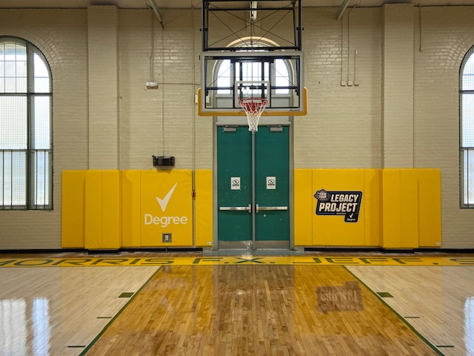
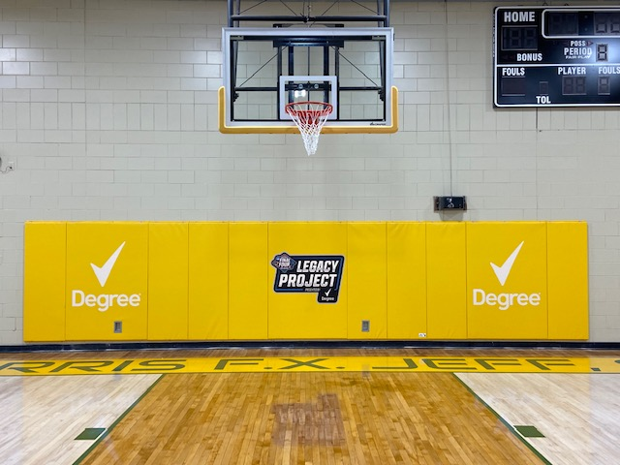
2022 Facilities - Completed
Morris FX Jeff, Sr. – Gym Refurbishment

Slide 10
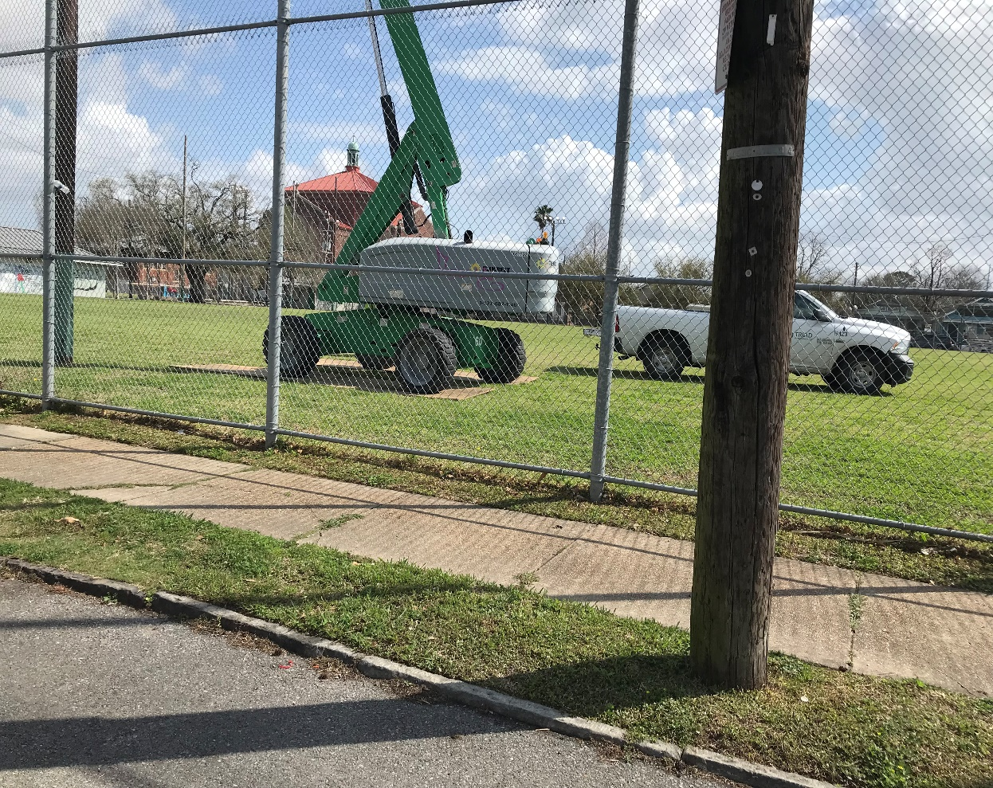
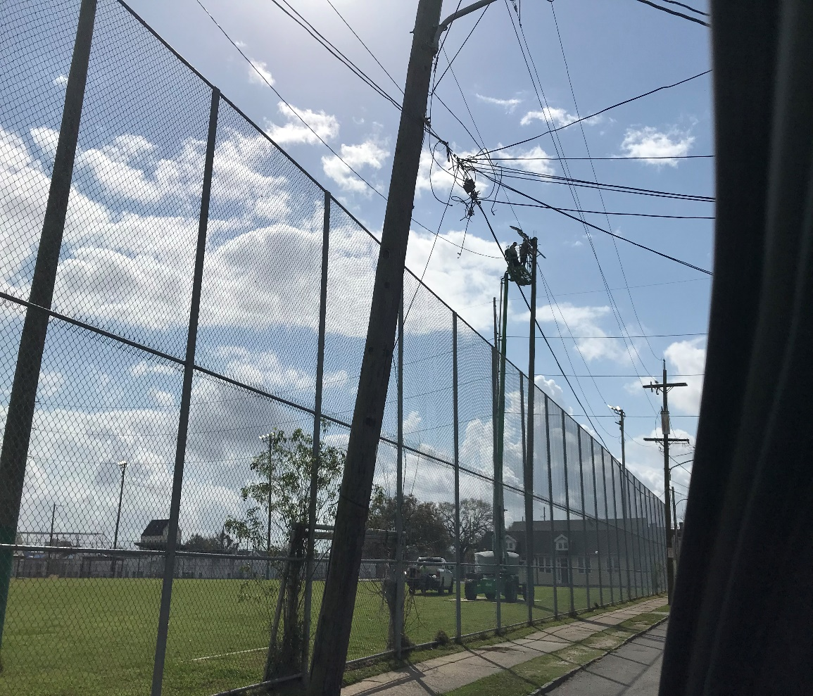
2022 Facilities - Work Progress
St. Roch Playground – HML repairs from Hurricane Ida

Slide 11
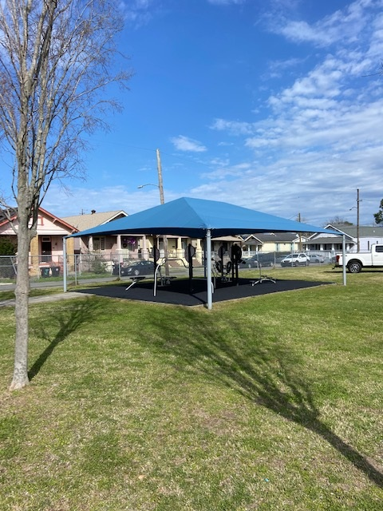
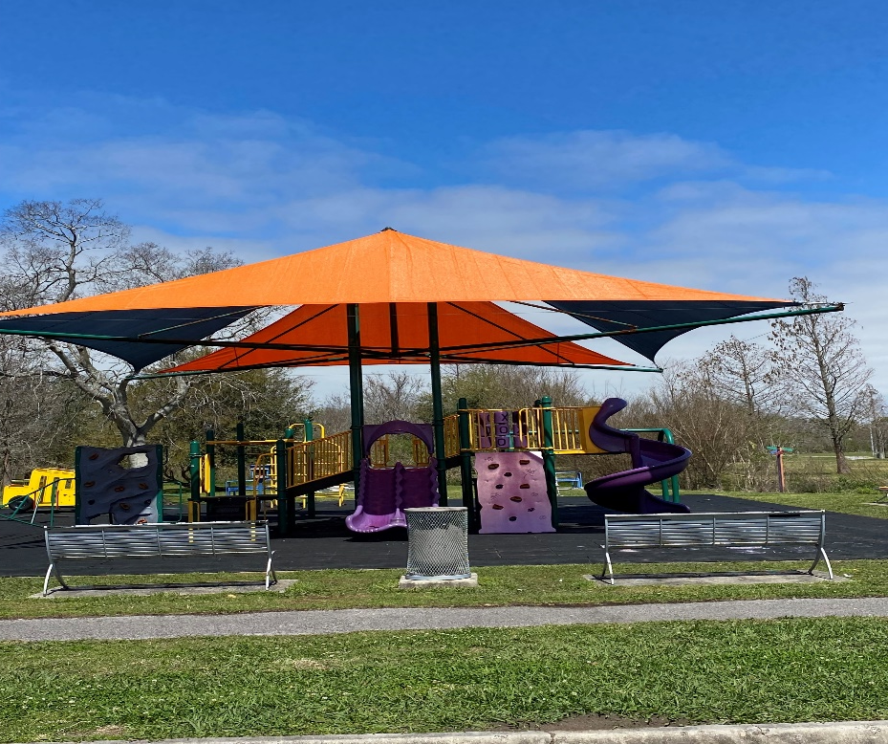
2022 Facilities - Work Progress
St. Roch Playground –Solar Shade Sail Replacement
Joe Brown Park – Solar Shade Sail Replacement

Slide 12
2022 Facilities – Procurement Challenges
Current Challenging Projects:
Joe Brown Pool – Pool Heater
Joe Brown Pool - Deck Heater
Sanchez Pool - Domestic Hot Water Heater
Lyons Rec Center – HVAC Repairs
Treme Rec Center – Pool Filters Replacements

Slide 13
2022 Facilities – Procurement Challenges
Current Challenging Projects:
Joe Brown Pool – Pool Boiler – Requires three (3) bids. Has not been released from purchasing.
Sanchez Pool – Domestic Hot Water Heater – Have only received one (1) bid. Must go b out for bid again.
Lyons Rec Center HVAC Repair – three (3) bidders responded, and the 2nd lowest bidder was chosen with explanation. Vendor awarded and PO processed. Construction started on the job March 28, 2022.
Treme Pool – Replacement of three (3) pool Filters -Emergency procurement – Emergency memo must be signed by CEO, Purchasing Director, CAO, and Law. Must have three (3) bids. Lowest bid must be selected and if it is not, then explanation for why. In this case only two (2) bids were secured because there were no other bidders interested. Purchasing gave approval to move forward with the two (2) bids. Contractor was awarded PO and the filters have been ordered.

Slide 14
2022 Facilities – Additional Procurement Challenges
ITQ Kenilworth Playground Repairs – No responses – 1 bidder submitted bid. Maintenance was fine with the bid. Awaiting directive from purchasing on how to proceed.
ITQ Stalling Gentilly Pool Repairs – Out for Bid three (3 )Times.
ITQ, Sanchez Pool Windows - Went out for Bid, Only one (1 ) bid received. Has been put out for bid again.
ITQ Sanchez Pool Filter – specs need correction has, been resubmitted.
ITQ Sanchez Multi Service Center – HVAC Repairs RTU – Out for bid. First bid closed on 3/30/2022.
Hunter’s Field Building Repair – Resubmitting ITB ( Received 1 bid )
ITQ Rosenwald HVAC RTU – Awaiting three (3) bids from certified contractors

Slide 16
March Financial facts at a glance
Administration
Athletic Programing
$1,5 5 3,444 – P e r s o n n e l
$ 2 8 7,0 2 4 - Personnel
$ 511,6 8 9 - O p e r a t I n g
$ 5 9 , 9 8 8 - Opera t i ng
Personnel: Filled vs Vacancies
$ 1, 6 6 6 , 4 8 7 - P e r s o n ne l
$ 31 2, -8 8 3 P e r s o n n e l
$ 2 2 5, 8 8 7 - O p e r a t in g
$ 8, 3 2 5 - O p e r a t Ii n g
Filled: 183.00
Vacancies: 15.00
FEMA
$220,960
Multi- Programming
$840,003 – Personnel
$139,479 - Personnel
$92,800- Operating
$0- Operating
$ 2,454,127–CDBG
$9,748- CDBG
$450,000 – Teen Camp Stipend
$775- Teen Camp Stipend
Balance Allocation
$18,886,970/$2,155,512
Revolving Fund/Self Generating
2022 YTD Total Unaudited
$67,246 $441,276
Maintenance
$3,155,059 – Personnel
$473,544 - Personnel
$1,576,707- Operating
$25,992-Operating
Aquatics
$2,259,938 – Personnel
$208,742 - Personnel
$95,000- Operating
$0-Operating
Recreation Centers
$3,619,018- Personnel
$629,012 - Personnel
$386,811-Operating
$0-Operating
Notes:
Financial Facts at a glace provides another picture of the line item budget slide, it breaks down the agency’s entire appropriation and balances by division along with the anticipated FEMA reimbursement, CDBG Funding Revolving Revenue Fund and Teen Camp Stipend allocation.

Slide 17
Funding Allocation
2021 Self Generating Revenue
2022 Self Generating Revenue
Revenue Sources: Facility Rentals Tennis Center Revenue Admission & Concession Revenue Athletics Registration | $67,688 $14,027 $16,569 $2,235
Total Revenue Generated | $100,519
Revenue Sources Year to Date: Facility Rentals Tennis Center Revenue Admission & Concession Revenue Athletics Registration | $54,965 $6,720 $3,071 $ 2,490
Total Revenue Generated | $67,246
Notes:
The Agency’s Fund allocation deck provides a comparison of collected revenue from the previous fiscal year versus the current. YTD the agency has collected in revenue (40% of 2020 revenue collected) through facility rentals, tennis court utilization and we also introduced into our revenue stream admission, concession and registration for sports participation.

Slide 18
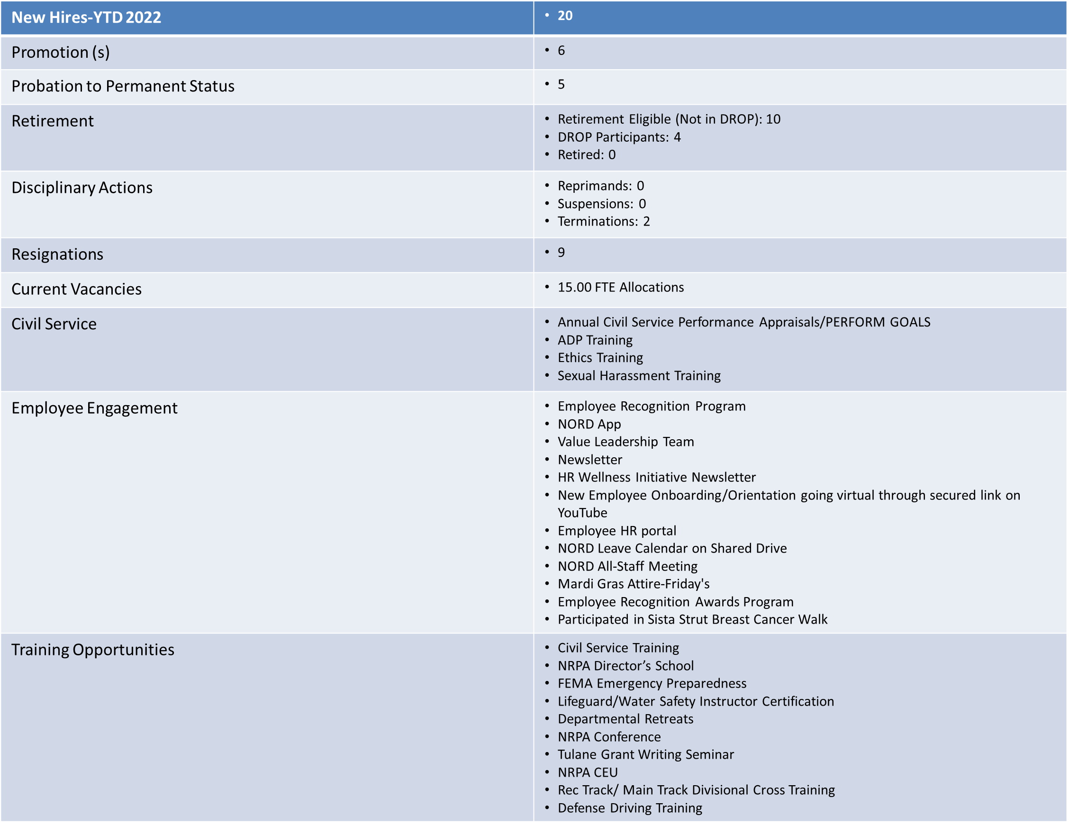
Human Resources

Slide 19
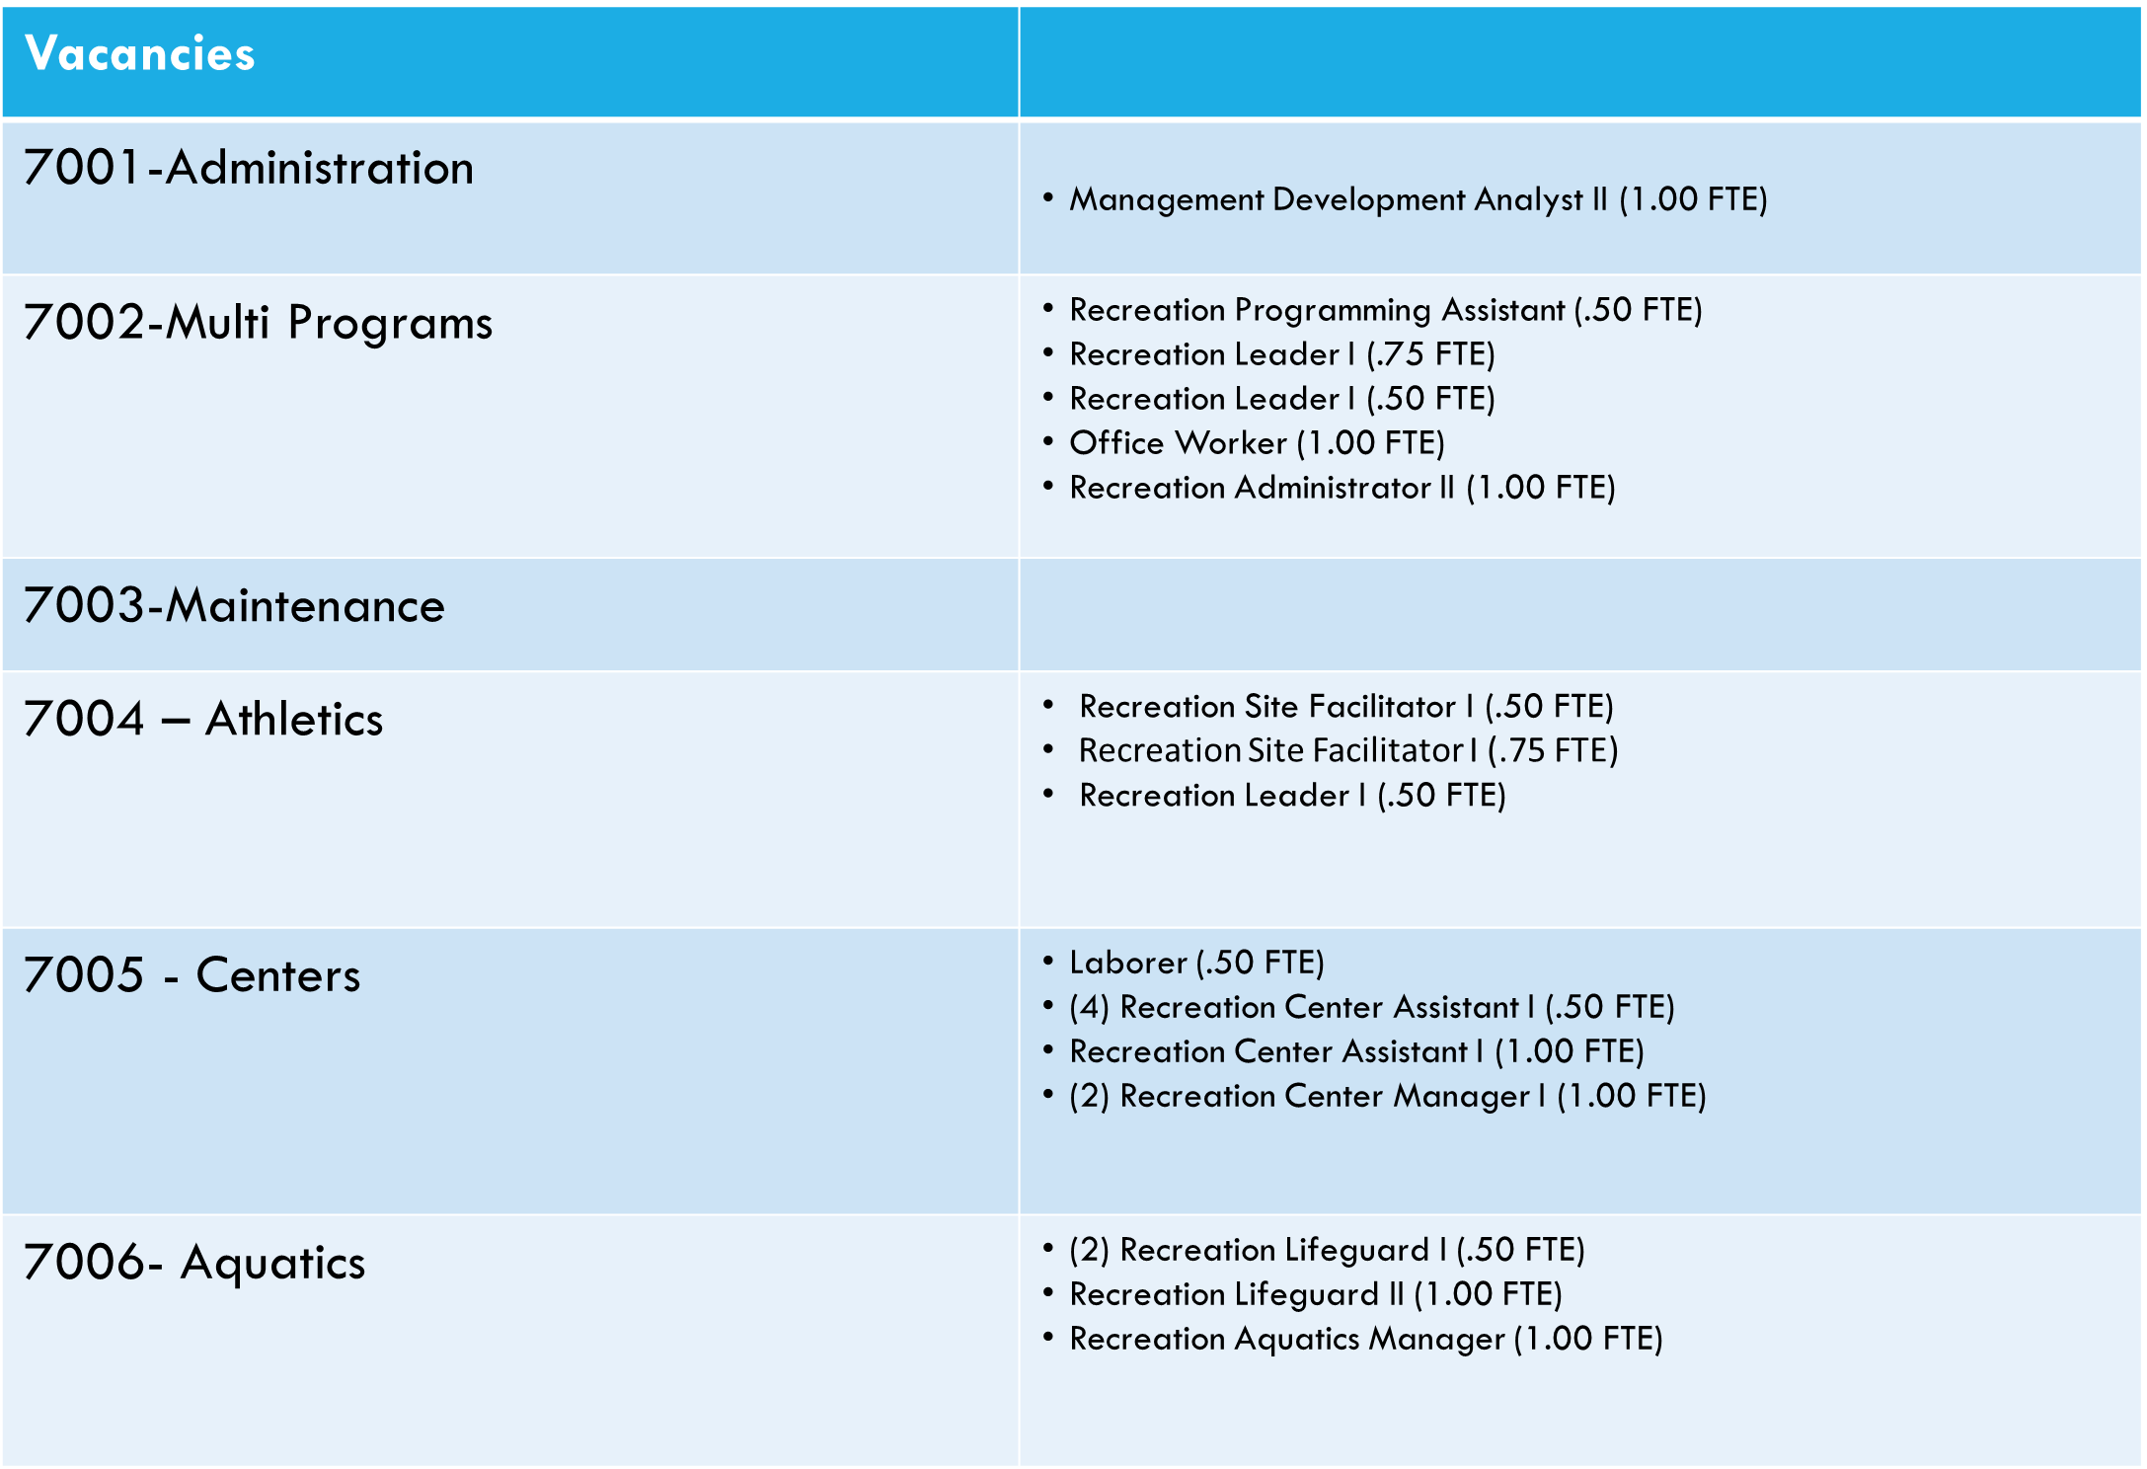
Human Resources

Slide 20
Questions?

